Slide 1
The faculty of Children’s national hospital are thankful for the support for this program provided by Travere therapeutics in the form of aN educational grant
The Story of Telehealth

Slide 2
The faculty of Children’s national hospital are thankful for the support for this program provided by Travere therapeutics in the form of aN educational grant
The Story of Telehealth
The family voice
The provider voice
How to tell our stories

Slide 3
The faculty of Children’s national hospital are thankful for the support for this program provided by Travere therapeutics in the form of aN educational grant
The Story of Telehealth
The family voice
The provider voice
How to tell our stories

Slide 4
The Provider Voice
Eyby Leon (physician)
Erin MacLeod (Dietitian)
Ilana Miller (Genetic Counselor)
Yan Orellano (parent navigator)
Allison Shaw (nurse practitioner)
Natasha Shur (physician)
Marshall Summar (physician)

Slide 5
The faculty of Children’s national hospital are thankful for the support for this program provided by Travere therapeutics in the form of a educational grant
The Story of Telehealth:
Hearing from and advocating for our most vulnerable populations
Debra S. Regier, MD PhD
Medical Director, Rare Disease Institute
Children’s National Hospital

Slide 6
Objectives
Creating a space to hear the stories
Communicating our own & other’s stories
  K
  K
  I
  S
  S

Slide 7
Sometimes reality is too complex. Stories give it form
Jean Luc Goddard

Slide 8
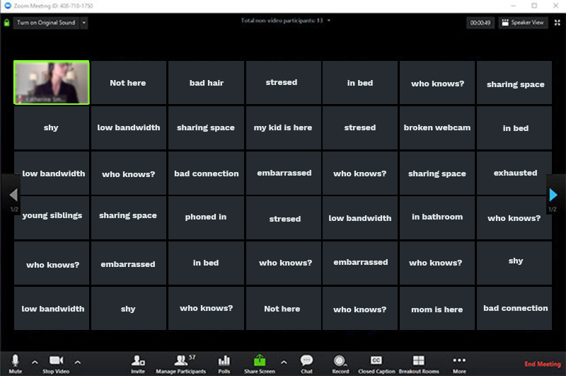
Creating a space to hear a story (to really understand their complexity!)
Meet the person where they are
Notes:
Meet people physically to show you are about their story, which its zoom or “keeping the camera on”

Slide 9



Creating a space to hear a story (to really understand their complexity!)
Meet the person where they are
Meet the emotion that they are feeling

Slide 10
We are all story tellers. We all live in a network of stories. There isn’t a stronger connection between people than storytelling
Jimmy Neil Smith

Slide 11


Creating a space to hear a story (to really understand their complexity!)
Meet the person where they are
Meet the emotion that they are feeling
Meet them in their safe space, culturally (language usage, location, environment, electronic formats)
50 years

Slide 12

Communicating our own stories
Know your audience
Keep it simple and salient
Interesting & Interactive
Short
Stories

Slide 13
Stories create community, enable us to see through eyes of other people, and open us up to the claims of others
Peter Forbes

Slide 14
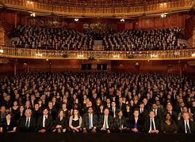
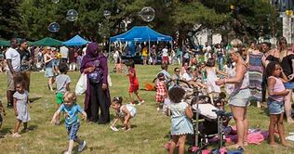
Moving from an Audience to A Community
Notes:
Passive to movement. Listening to singing. Perfection to interactive.

Slide 15
Communicating our own stories
Know your audience
Keep it simple and salient
Interesting & Interactive
Short
Stories

Slide 16
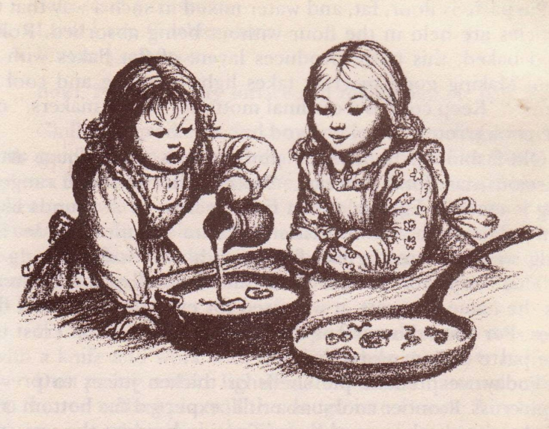
MSUD – specifc presentation
Intense smell (burnt sugar)
Generally not pronounced abnormalities on basic labs
  No dehydration
  No acidosis
  No (or only mild) hyperammonemia
  Normal CBC
Characteristic abnormalities on PAAs
  Massive elevation of BCAAs
  Disturbed BCAA ratio (usually 1:2:3)
  Large ketones on urinalysis
    Diagnostic compounds on UOA

Slide 17


Slide 18
Communicating our own stories
Know your audience
Keep it simple and salient
Interesting & Interactive
Short
Stories

Slide 19

From Short to Life Saving
2 Problems = Call Me!

Slide 20
From Short to Life Saving
2 Problems = Call Me! She called, then texted!

Slide 21
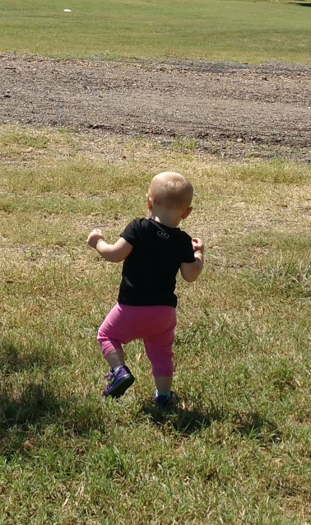
From Short to Life Saving
2 Problems = Call Me!

Slide 22
Storytelling offers the opportunity to talk with your audience, not at them.
Laura Holloway

Slide 23
How do we advance care using stories
We meet people where they are (telehealth or not!)
We listen to patients
We listen to families
We facilitate communities of listening (not talking)
We implement change and then listen more
We acknowledge we will need to “stumble forward” when we try new things

Slide 24
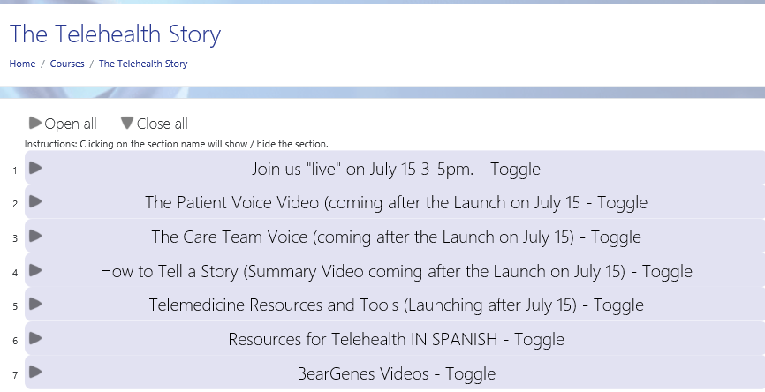
We thank Travere Therapeutics for providing an educational grant to support the creation and endurance of this curriculum.
(Navigate LearnRD.com and to The Story of Telehealth course)
(http://childrensmedicaleducation.org/learnrd/course/view.php?id=52)

