Slide 1
Catalyzing Translational Innovation for Rare Diseases
Look for the Connections
Christopher p. austin, M.D.
DIRECTOR, NCATS
rare diseases clinical Research network Certificate Program
SEPTEMBER 29, 2015

Slide 2
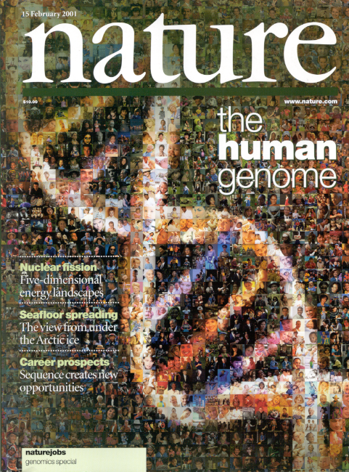
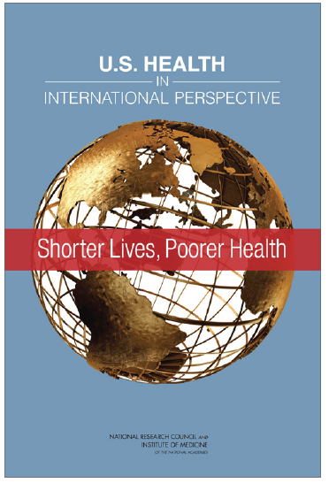
The Best of Times, the Worst of Times
Fundamental science unprecedentedly advanced, but:
Poor transition of basic or clinical observations into interventions that tangibly improve human health
Drug/device/diagnostic development expensive and failure-prone
Clinical trials system inefficient
Poor adoption of demonstrably useful interventions
People unhealthier and funders of biomedical research enterprise (public and private) impatient

Slide 3
Human Conditions with Known Molecular Basis
~500 with therapy
Source: Online Mendelian Inheritance in Man, Morbid Anatomy of the Human Genome
Notes:
OMIM updated stats on 4/13/15
Number of phenotypes for which the molecular basis is known: 5,461
Number of genes with phenotype-causing mutation: 3,381
“In the PDR and similar databases, including the NCATS Pharmaceutical Collection browser, there are about 500 “conditions” or “diseases” listed for which drugs exist. The 250 number is for orphan (aka, rare) diseases only. The ‘genes discovered’ graph I believe covers Mendelian (single gene, rare) diseases, and so the 250 refers to therapies for rare diseases only.”
Source, email from Chris Austin, 12-13-2013

Slide 4
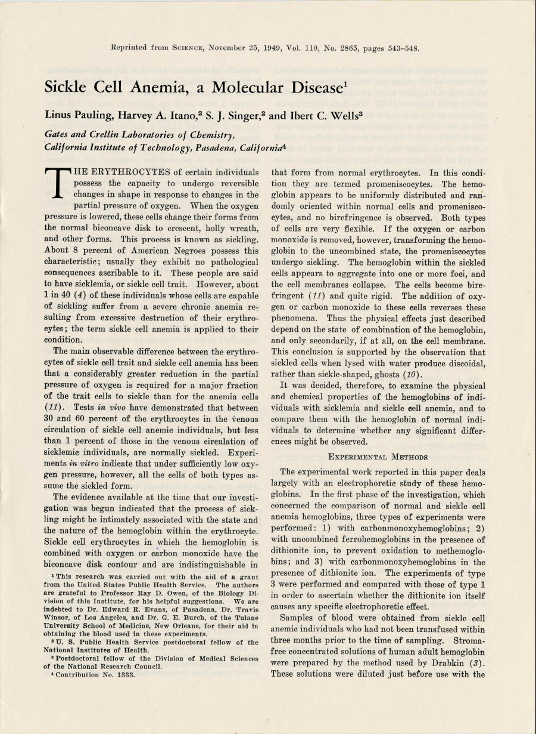
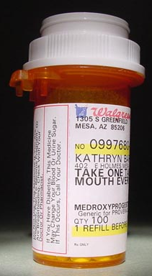
SO….

Slide 5
What is Translation?
Translation is the process of turning observations in the laboratory, clinic, and community into interventions that improve the health of individuals and the public - from diagnostics and therapeutics to medical procedures and behavioral changes.

Slide 6
What is Translational Science?
Translational Science is the field of investigation focused on understanding the scientific and operational principles underlying each step of the translational process.
NCATS studies translation as a scientific and organizational problem.

Slide 7
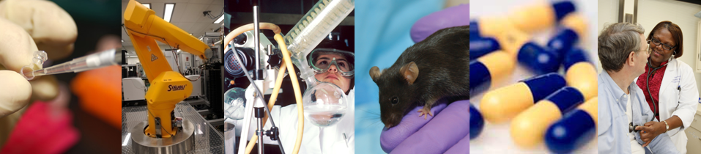
NCATS Mission
To catalyze the generation of innovative methods and technologies that will enhance the development, testing and implementation of diagnostics and therapeutics across a wide range of human diseases and conditions.
Notes:
NCATS is a catalyst for constructing an innovation highway for translation of health research.

Slide 8
Some of the problems on NCATS’ to-do list
Predictive toxicology
Predictive efficacy
Derisking undruggable targets/untreatable diseases
Data interoperability
Biomarker qualification process
Clinical trial networks
Patient recruitment
Electronic Health Records for research
Harmonized IRBs
Clinical diagnostic criteria
Clinical outcome criteria (e.g., PROs)
Adaptive clinical trial designs
Shortening time of intervention adoption
Adherence
Methods to better measure impact on health…

Slide 9
NCATS Scientific Initiatives
Clinical Translational Science
  Clinical and Translational Science Awards
  Rare Disease Clinical Research Network
  New Therapeutic Uses program
Preclinical Translational Science
  NCATS Chemical Genomics Center
  Therapeutics for Rare and Neglected Diseases program
  Bridging Interventional Development Gaps program
Re-engineering Translational Sciences
  Toxicology in the 21st Century
  Microphysiological Systems (Tissue Chip) program
  Office of Rare Diseases Research

Slide 10
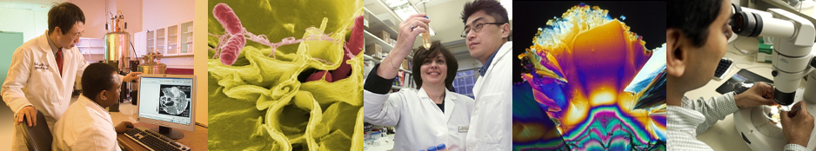
Division of Clinical Innovation
Clinical and Translational Science Awards (CTSA) Program
A national consortium of medical research institutions
Improves the way clinical and translational research is conducted nationwide
Accelerates the research translation process
Provides innovative training for clinical and translational researchers

Slide 11
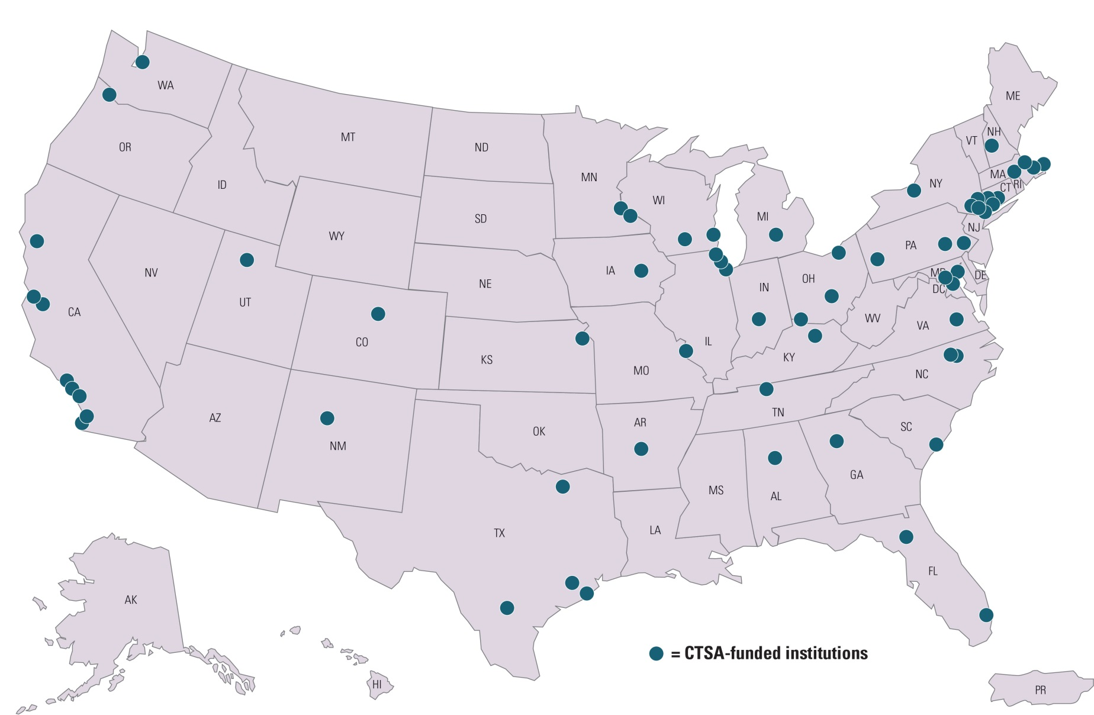
Clinical and Translational Science Awards Program CTSA Hubs

Slide 12

Streamlining Multi-Site Clinical Studies
The problem: current atomized system is inefficient, costly and often ineffective
  Duplicative IRB reviews among sites
  Subcontracting harmonization among institutions delays start-up
  Duplicative investigator/site qualification
Solutions in progress
  Centralized IRB review (reliance agreements, IT solutions)
  Streamlined contracting (pre-negotiated master agreements)
  GCP training across CTSA sites

Slide 13
CTSA Trial Innovation Centers (TICs)
Promote innovation to increase the efficiency and quality of clinical trials
Provide
  Central IRB
  Streamlined budgeting and contracting
  Other trial coordination functions as needed
NCATS will partner with NIH ICs, industry, and other funders to implement trials
RFA-TR-15-002

Slide 14
Improving Participant Recruitment
The problem: slow or failed recruitment leads to delays, increased costs, lost efficiency
Solution in progress
  Building national recruitment capacity across CTSA network using data from Electronic Health Record (EHR) to identify potential trial participants who meet entry criteria
Trial planning phase Trial implementation phase
Data-driven site selection Privacy and IRB compliant recruitment
Feasibility analysis (n) Expert staff helping with implementation
Outside firewall

Slide 15
CTSA Recruitment Innovation Centers (RICs)
RICs will:
  Provide data for trial planning, feasibility analysis, site selection, and recruitment implementation
  Develop innovative solutions to increase recruitment success
RFA-TR-15-004

Slide 16
Training the Translational Research Workforce
Provide innovative, tailored curricula, including
  Non-traditional areas such as regulatory science or entrepreneurship
  Externships in industry, foundations, FDA, etc to enrich the training experience
  Shared online courses/resources across CTSA network
Foster multidisciplinary team science
Create an environment in which translational research is a viable (and attractive!) career path

Slide 17

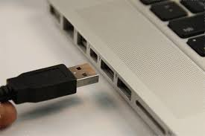
Evolving the CTSA Program to Transform Clinical Translational Science
CTSA Hubs
TIC:
Trial Innovation Centers
Central IRB
Contracting
Budgeting
Other support PRN
RIC:
Recruitment Innovation Centers
Feasibility Assessment
Recruitment Plan and Implementation
Multi-site Study funded by NIH IC or others
No need to re-build trial components each time
Clinical Lead
Stats/Data Management
Notes:
Based on the results of the pilot studies, we are now implementing the new FOAs
We want to set up clinical trials like an experiment with mice in a lab – we want everyone intellectually engaged (NOT LIKE CRO)

Slide 18
Office of Rare Diseases Research
Rare Diseases Clinical Research Network (RDCRN)
  22 consortia at 250 institutions worldwide
  Studying >200 diseases with 83 active protocols, and
  More than 85 patient advocacy groups participating
Genetic and Rare Disease Information Center (GARD)
Scientific Conferences Program
  Identify scientific opportunities and establish research agendas
  Patients + NCATS + NIH ICs + FDA + Biopharma
Global Rare Disease Registry (GRDR)
  15 GRDR patient registries + 19 existing registries
  Ability to conduct cross-disease analysis and recruitment

Slide 19


Slide 20

ORDR/NCATS
(NCI, NHLBI, NIAID, NIAMS, NICHD, NIDCR, NIDDK, NIMH, NINDS, ODS)
PAG
Coalition of Patient
Advocacy Groups
(CPAG)
Porphyria Rare Disease Clinical
Research Consortium
Dystonia
Coalition
PAG
North America Mitochondrial
Diseases Consortium
PAG
Developmental Synaptopathies
Associated with TSC, PTEN
And SHANK3 Mutations
PAG
Primary Immune Deficiency
Treatment Consortium
PAG
PAG
The Frontotemporal Lobar
Degeneration Clinical
Research Consortium
Brittle Bone Disorders
Consortium
PAG
PAG
Inherited Neuropathies
Consortium
Chronic Graft Versus
Host Disease
PAG
PAG
Nephrotic Syndrome
Study Network
The Data Management and Coordinating Center
PAG
Collaborative Clinical Research
Centralized Data Coordination and Technology Development
Public Resources and Education
Training
Rare Lung Diseases
Consortium
Urea Cycle Disorders
Consortium
PAG
PAG
Lysosomal
Disease Network
Brain Vascular
Malformation Consortium
PAG
Rare Kidney
Stone Consortium
PAG
PAG
Genetic Disorders of
Mucociliary Clearance
PAG
Vasculitis Clinical
Research Consortium
PAG
PAG
Consortium of Eosinophilic
Gastrointestinal Disease Researchers
Clinical Research in ALS & Related
Disorders for Therapeutic Development
PAG
PAG
PAG
PAG
Rett, MECP2 Duplications
and Rett-Related
Disorders Consortium
Autonomic Disorders
Consortium
Sterol and Isoprenoid
Diseases Consortium
Notes:
Stars indicate the 6 new consortia

Slide 21
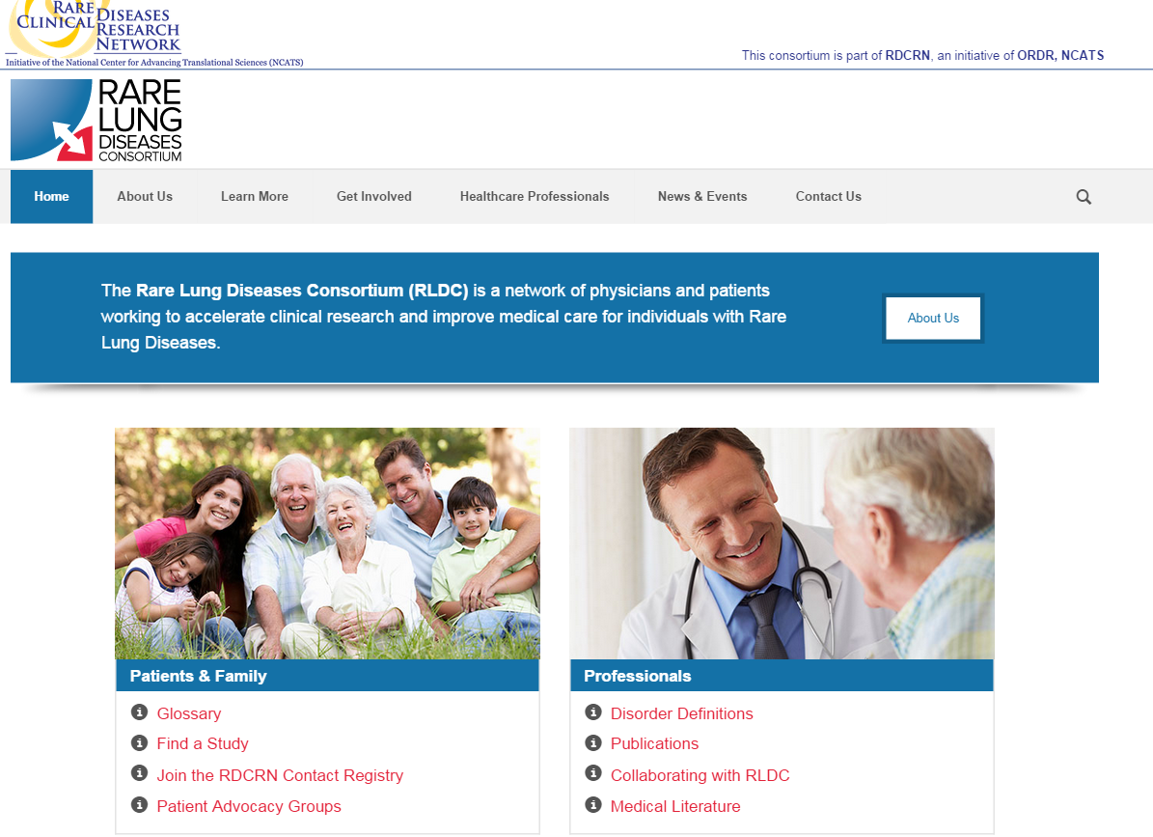
PI: Bruce Trapnell, M.D., M.S.
University of Cincinnati College of Medicine
Cincinnati Children’s Hospital Medical Center

Slide 22
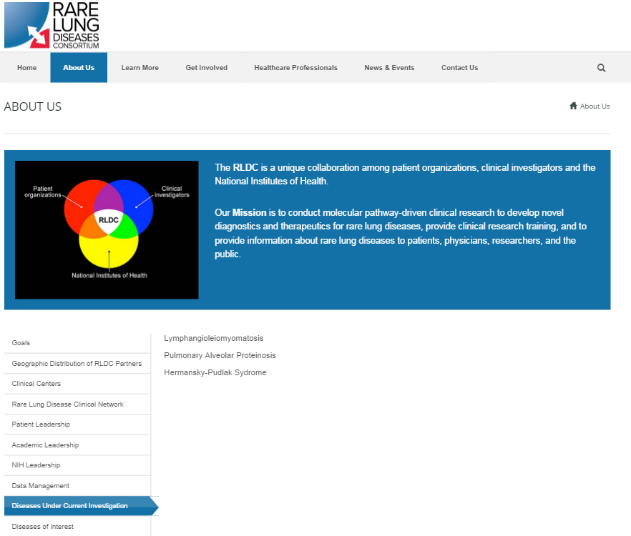

Slide 23
RDCRN-Rare Lung Diseases Consortium (RLDC)
Sirolimus Trial for LAM
Lymphangioleiomyomatosis (LAM) is a rare, progressive lung disease that primarily affects women of childbearing age that is often fatal
RLDC conducted Multicenter International LAM Efficacy and Safety of Sirolimus (MILES) trial
  PI: Dr. Francis McCormack
  Collaborative effort between RDCRN-RLDC, Pfizer, and LAM Foundation
In early 2015 FDA accepted sNDA via priority review
In March 2015 FDA approved sirolimus for LAM
  First drug approved by FDA for the treatment of LAM
Notes:
The MILES trail was a collaborative effort for RDCRN-RLDC, pharmaceutical industry and the LAM Foundation. The MILES trial was conducted by Dr. McCormack and conducted within the RDCRN Rare Lung Diseases Consortium. Pfizer provided study drug and a portion of the funding but had no involvement in the design or conduct of the study. The LAM Foundation assisted with the recruitment of patients and logistics for the study.

Slide 24
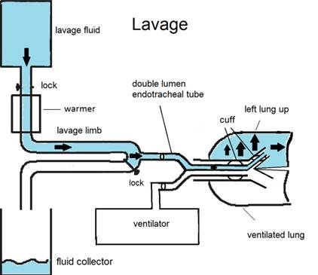
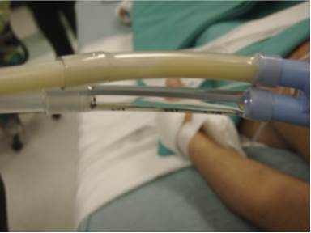
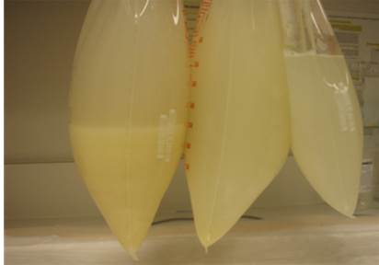
Autoimmune Pulmonary Alveolar Proteinosis (PAP)
Background: Autoimmune PAP is a rare lung disease caused ↑ circulating levels of neutralizing anti-GM-CSF auto antibodies → impairment of GM-CSF signaling in alveolar macrophages → abnormal surfactant homeostasis.
Clinical Manifestation: An accumulation of proteins and lipids (surfactant) in the narrow gas exchange pockets of the lung, ultimately leading to respiratory failure.
Autoimmune PAP:
  Prevalence: ~7/1,000,000
  Accounts for 90% of all PAP (aka idiopathic or acquired)
  Current Standard of Care: Whole Lung Lavage (WLL) under general anesthesia & mechanical ventilation; highly invasive; inefficient; not widely available; expensive
Patient undergoing WLL
Bronchoalveolar Lavage Fluid (BALF)
Courtesy of Dr. Bruce Trapnell
http://www.laeknabladid.is/media/2014-november/protein.mynd3.enska.png

Slide 25
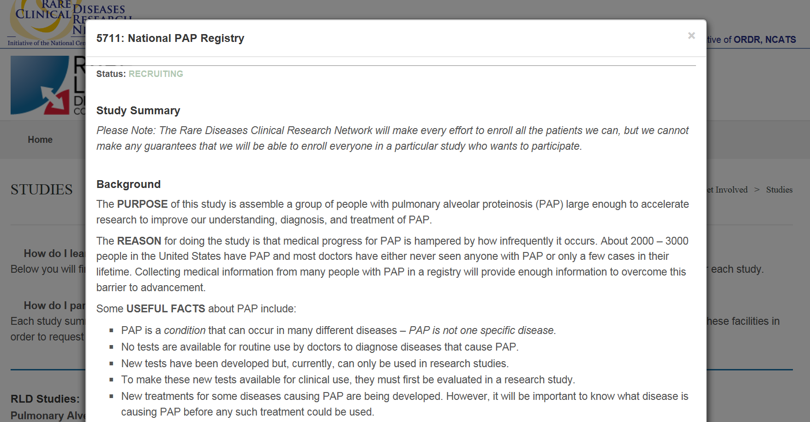
PAP in the RDCRN-RLDC

Slide 26
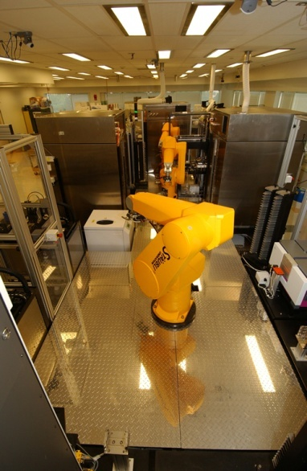
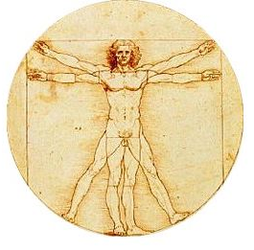
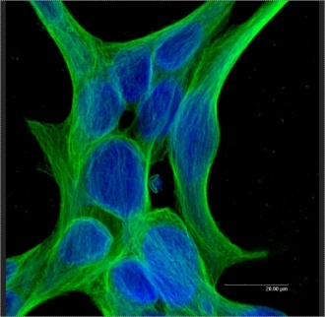

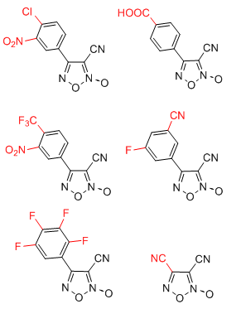
Steps in the drug development process
Make modifications to active chemicals to make suitable for human use
Create testing system (aka, “assay”
Test >100,000 chemicals for activity on target
Test in animals for safety, effectiveness
Test in humans for safety, effectiveness
Identify target
Assay Development
HTS
Medicinal Chemistry
Preclinical Development
Clinical Development
Basic research
Late clinical
Discovery
Preclinical and early clinical
$50-100K
$500K-1M
$5-10M
$50-100M
(Per project cost)

Slide 27
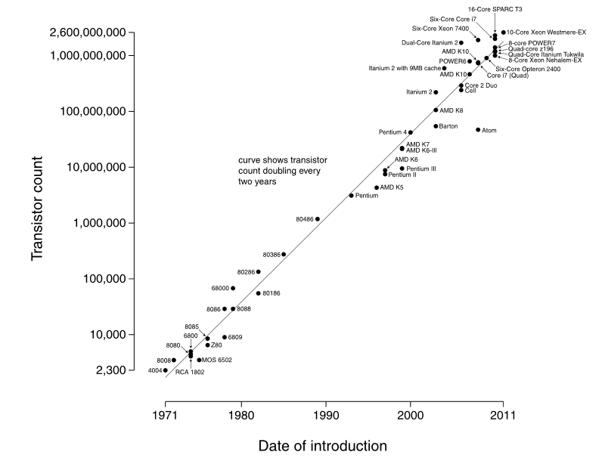
Moore’s Law
Source: Wikipedia

Slide 28
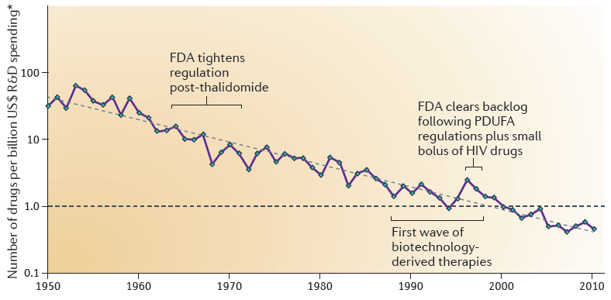
Eroom’s Law
The number of new drugs approved by the FDA per billion US dollars (inflation-adjusted) spent on research and development (R&D) has halved roughly every 9 years since 1950.
Scannell et al., Nature Reviews Drug Discovery 11:191, 2012

Slide 29
NCATS Division of Preclinical Innovation
Unvalidated target
Validated target
Target assay
Lead compound
Preclinical development candidate
Project
Entry Point
Target
Validation
Assay
Dev
Probe/Lead
Development
Lead
Optimization
Preclinical
Development
Clinical Trials
FDA approval
Target
I II III
RNAi
NCGC
Therapeutics for Rare/Neglected Dis (TRND)
Stem Cell Technology Facility
Assay , Chemistry Technologies
BrIDGs
DPI Program
Tox21 (Systems Toxicology)
Repurposing
Repurposing
Paradigm/Technology Development
Genome-wide RNAi systems biology data
Chemical genomics data
Leads for therapeutic development
Approved drugs effective for new indications
New drugs for untreatable diseases
Stem cell tools/data
Deliverables
Drugs suitable for adoption for further development
Predictive in vitro toxicology profiles
Novel clinical trial designs
Small molecule and siRNA research probes
More efficient/faster/cheaper translation and therapeutic development

Slide 30








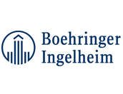















NCATS DPI Staff
Notes:
Able to do drug development work b/c staff has extensive drug development and industry experience prior to coming to NCATS
Next slide – how do applicants gain access to these resources?

Slide 31
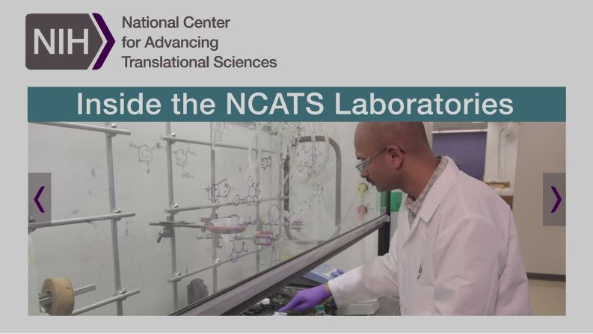
Video of NCATS Preclinical Innovation Laboratories
Released August 11, 2015
Featured on our home page
  www.ncats.nih.gov
Notes:
Bob/Zoie will have the 1-minute video loaded on the desktop of the podium computer.
When you get to this slide, they will click/toggle over to the video on the desktop to play and then toggle back.

Slide 32


Slide 33
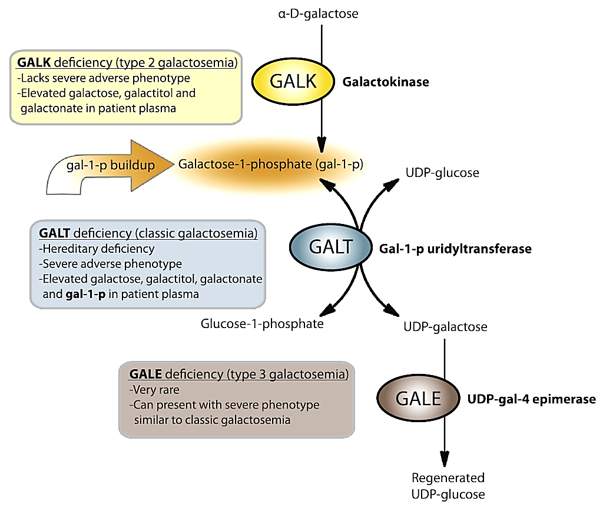
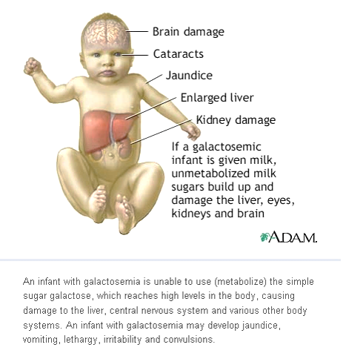
Developing drugs for Galactosemia
NCATS collaboration with Kent Lai, University of Utah)
Rare autosomal recessive, metabolic disorder caused by GALT deficiency (1 in 60,000)
Leloir Pathway
Currently diagnosed by testing newborns for GALT activity and galactose in blood spot test
Only treatment is to restrict galactose & lactose
Chronic complications
75%
mortality if untreated
Hypothesis: inhibition of GALK could prevent toxic buildup of gal-1-p and improve patient outcomes

Slide 34
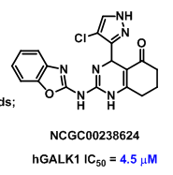
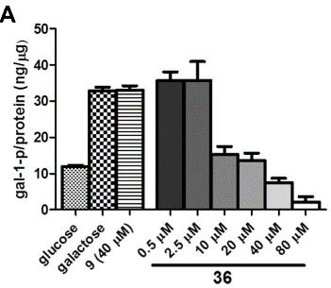
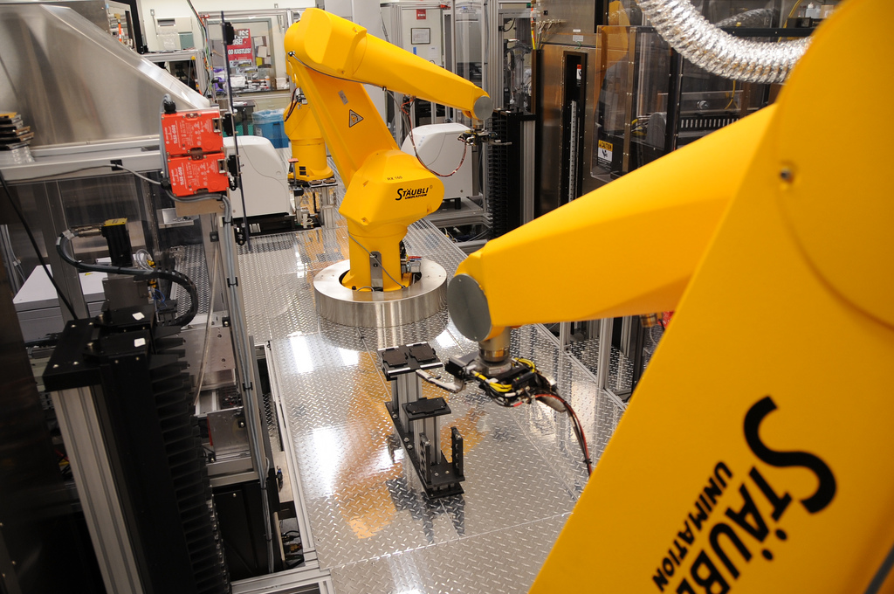
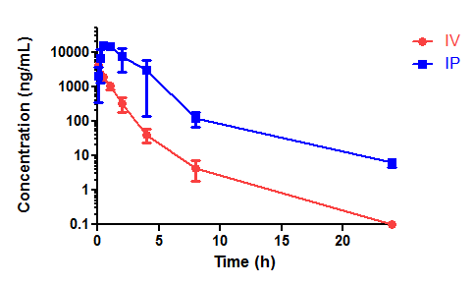
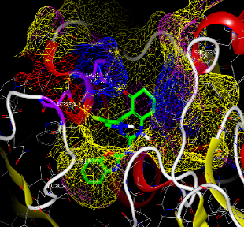
DEVELOPMENT OF GALK INHIBITORS
High-throughput screen
Selective GALK inhibition
Cellular efficacy
280,000+ compounds screened
Single chemical series identified
Inactive against GALK2
Clean in Kinome panel
Decreases gal-1-p levels in patient cells
No effect on cell viability
Medicinal chemistry optimization of series (GALK activity, ADME/PK properties)
Pharmacokinetic profiling
Co-crystal structure
Galactosemia mouse models
280,000+ compounds screened
Single chemical series identified
Possesses acceptable PK profile
Inhibitor/GALK co-crystal structure resolved
Only mouse model for galactosemia that closely mimics the human phenotype
Compounds currently being tested
GOAL: Preclinical
development
confidential

Slide 35
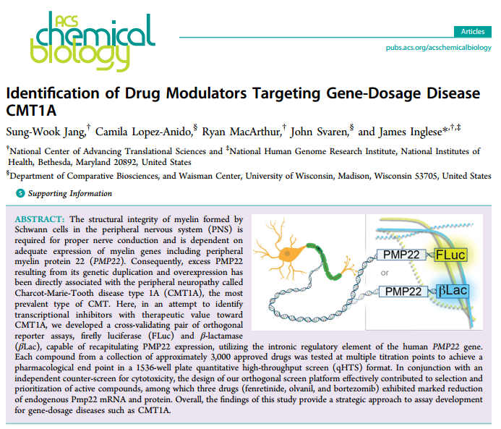
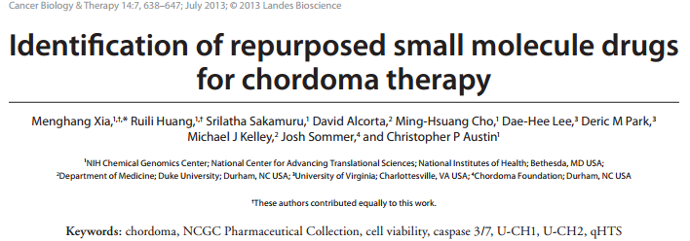
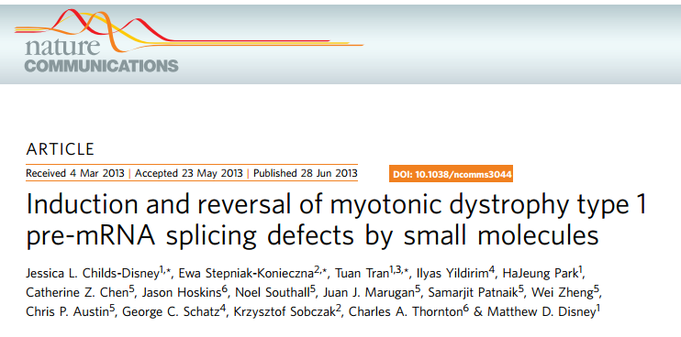
Patient-driven science
Notes:
You’ll hear more about probe development from Mindy shortly!

Slide 36
Why Repurposing?
1-2 years?
>500,000 compounds, 15 yrs
Screen
Hit
Lead
Lead
Optimization
Preclinical
Development
Clinical
Trials
FDA approval
Target
3000 drugs
Notes:
36

Slide 37
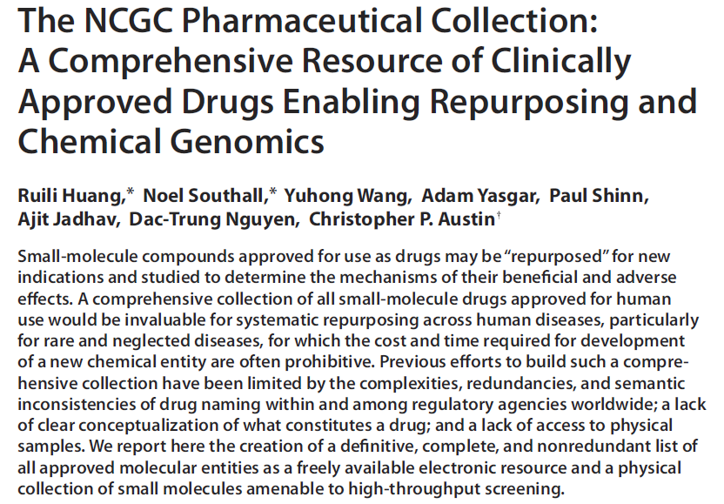
NCATS Comprehensive Repurposing Program
“Systematizing Serendipity”

Slide 38
Therapeutics for Rare and Neglected Diseases (TRND) Program
Model: Collaboration between NIH intramural labs with preclinical drug development expertise and extramural labs with disease-area / target expertise
Projects:
  May enter at various stages of development
  Taken to stage needed to attract external organization to adopt for final clinical development
  Serve to develop new generally applicable platform technologies and paradigms
Eligible Applicants:
  Academic, Non-Profit, Government Lab, Small Business, or Large Biotech / Pharma
  Ex-U.S. applicants accepted
Intellectual Property:
  Partnerships are creative
  TRND may generate intellectual property

Slide 39
TRND Portfolio
Therapeutic Area/Disease | Organization Name(s) | Partner Type(s)
Autoimmune pulmonary alveolar proteinosis | Cincinnati Children’s Hospital | Academic
Creatine Transporter Defect | Lumos Pharma, Inc. | Biotech
Chronic lymphocytic leukemia | Leukemia & Lymphoma Society, University of Kansas Cancer Center | Disease foundation, academic
Core binding factor leukemia | NHGRI | NIH intramural labs
Fibrodysplasia ossificans progressiva | Massachusetts General Hospital | Academic
GNE Myopathy (Hereditary Inclusion Body Myopathy NIBM) | New Zealand Pharmaceuticals, NHGRI | Biotech and NIH intramural clinical labs
Hemoglobinopathies | Phoenicia Biosciences, Inc. | Biotech
Hypoparathyroidism | Eli Lilly & Co. | Pharmaceutical
LEOPARD syndrome | Beth Israel Deaconess Medical Center | Academic
Malaria | Loyola University Chicago | Academic
Niemann-Pick disease type C | Ara Parseghian Medical Research Foundation, Niemann-Pick Type C Support of Accelerated Research (NPC-SOAR), Einstein College of Medicine, University of Pennsylvania, Washington University, Eunice Kennedy Shriver National Institute of Child Health and Human Development (NICHD) and National Human Genome Research Institute (NHGRI) | Disease foundation, academic, NIH intramural labs
Retinitis pigmentosa | University of California, Irvine | Academic
Schistosomiasis | CoNCERT Pharmaceuticals | Biotech
Sickle cell disease | Aes-Rx, National Heart, Lung and Blood Institute | Biotech, NIH intramural labs

Slide 40
Autoimmune Pulmonary Alveolar Proteinosis (PAP)
Background: Autoimmune PAP is a rare lung disease caused ↑ circulating levels of neutralizing anti-GM-CSF auto antibodies → impairment of GM-CSF signaling in alveolar macrophages → abnormal surfactant homeostasis.
Clinical Manifestation: An accumulation of proteins and lipids (surfactant) in the narrow gas exchange pockets of the lung, ultimately leading to respiratory failure.
Autoimmune PAP:
  Prevalence: ~7/1,000,000
  Accounts for 90% of all PAP (aka idiopathic or acquired)
  Current Standard of Care: Whole Lung Lavage (WLL) under general anesthesia & mechanical ventilation; highly invasive; inefficient; not widely available; expensive
Patient undergoing WLL
Bronchoalveolar Lavage Fluid (BALF)
Courtesy of Dr. Bruce Trapnell
http://www.laeknabladid.is/media/2014-november/protein.mynd3.enska.png

Slide 41
Developing Inhaled GM-CSF Therapy for Autoimmune PAP
Collaborators: NCATS/TRND, Dr. Bruce Trapnell (CCHMC) & Genzyme
Objective: Re-purpose GM-CSF as inhalation therapy for autoimmune PAP
Roadblocks:
  rhGM-CSF (sargramostim (Leukine)) approved IV for leukopenia
  PAP not approved indication ⬄ no standard treatment paradigm
  PAP requires inhalational delivery: Different route of administration
Scope: Pre-clinical program → Phase II trial
Status:
  Chronic GLP toxicology studies underway
  Formulation development ongoing
  FDA endorsed conduct of a small PK/PD Phase I safety trial in PAP patients
    Estimated start 2Q 2016
Notes:
TRND will be supporting the Ph1 PK/PD trial via collaboration with the Cincinnati CTSA. This was just decided last week; Carol Merchant has made contact with the Cincinnati PI for the CTSA, but she advises that no mentioned be made about the CTSA yet (she is fine with the content of this slide).

Slide 42
PAP in the RDCRN-RLDC

Slide 43
Discovering New Therapeutic Uses for Existing Molecules Program (NTU)
Problem: 80% of drugs that enter clinic never approved
Opportunity: potential for new treatments via ID of new indications for deprioritized investigational drugs
Program: matches investigational agents from pharma deprioritized for lack of efficacy or business reasons with new indication ideas from academia
  NIH provided: template Collaborative Research Agreements (CRAs) and Confidential Disclosure Agreements (CDAs), FOAs, review, funding, oversight
  Pharmaceutical partners provided: compounds, biologics, in kind support, pertinent data
  Academic researchers provided: deep understanding of disease biology, new concepts to test, access to appropriate patient populations
Notes:
Creation of template agreements to streamline negotiations between researchers and pharmaceutical companies

Slide 44
New Therapeutic Uses Program
9 projects in 8 diseases
Translational Innovation Success Measures
  Does use of template agreements speed negotiation time?
  Does crowdsourcing of indications generate new ideas?
  Do studies result in new indications/approvals?
Disease | Academic Partner | Pharma Partner
Alzheimer’s Disease | Yale | AstraZeneca
Alcoholism | U Rhode Island/NIAAA | Pfizer
Calcific Aortic Stenosis | Mayo Clinic | Sanofi
Duchenne Muscular Dystrophy | Kennedy Krieger/UWash | Sanofi
Lymphangioleiomyomatosis | Baylor | AstraZeneca
Peripheral Artery Disease | U Virginia | AstraZeneca
Smoking Cessation | VCU/Pittsburgh | Janssen
Schizophrenia (2) | Indiana U | Lilly
 | Yale | Pfizer
Notes:
Feedback
RFI completed
Survey of pharma partners completed
Survey of awardees completed
Overwhelming support for re-issuing another funding opportunity
Template agreements seen as very helpful by both parties

Slide 45
LAM NTU project therapeutic hypothesis
Src is activated in LAM cells
  increased Src activation contributes to down-regulation of E-cadherin
    raises the oncogenic properties of the LAM cells
Thus, Src inhibition represents a potential therapeutic strategy to up-regulate E-cadherin in LAM cells, suppress epithelial-mesenchymal transition and reduce oncogenic and metastatic potential

Slide 46
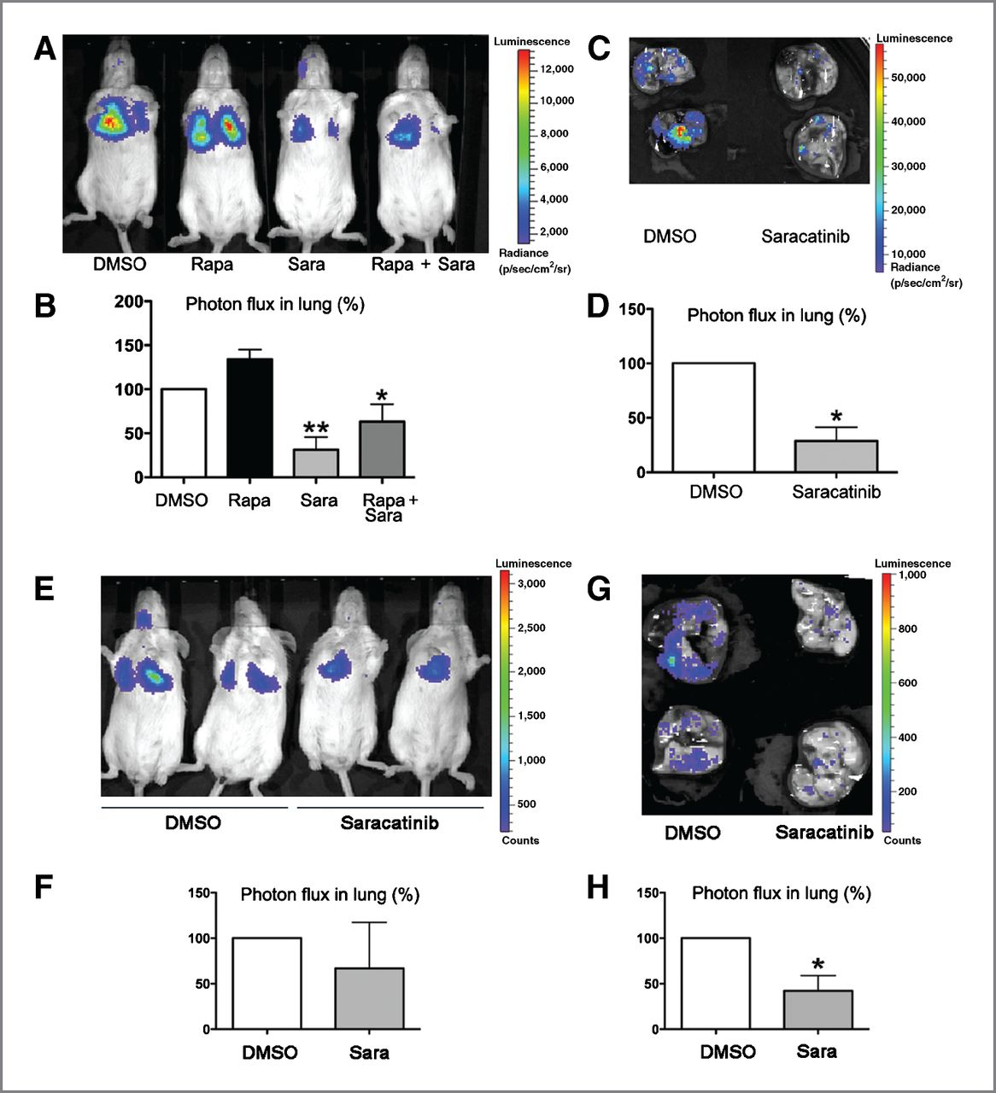

Effect of Src inhibition on lung colonization of EEF cells in vivo.
Alexey Tyryshkin et al. Cancer Res 2014;74:1996-2005
©2014 by American Association for Cancer Research
Notes:
Effect of Src inhibition on lung colonization of EEF cells [Eker rat embryonic fibroblasts (EEF)4 (TSC2^{+/+}) and EEF8 (TSC2^{−/−})] in vivo. EEF8-Luciferase cells were treated for 18 hours with DMSO, rapamycin (1 μg/mL), saracatinib (1 μmol/L), or by both rapamycin and saracatinib (A–D). EEF4-Luciferase cells were treated for 18 hours with DMSO or saracatinib (1 μmol/L; E–H). Cells were then injected intravenously into female CB17 SCID mice and after 6 hours, lung colonization was measured using bioluminescence. Representative images are shown (A and E). Total photon flux per second present in the chest region after injection of EEF cells is expressed as a percentage of DMSO-treated EEF cells (B and F). Lungs were dissected 24 hours after cell injection and bioluminescence was imaged in Petri dish (C and G). Total photon flux per second present in the dissected lungs after injection of EEF cells is expressed as a percentage of DMSO-treated EEF cells (D and H). Data, mean ± SD; n ≥ 3. *, P < 0.05; **, P < 0.001 compared with DMSO-treated cells.

Slide 47
NTU project repurpsoing
AZD0530 for LAM
Src Kinase inhibitor
Originally developed for treatment of cancer
Also being tested for treatment of Alzheimer’s Disease through NTU
LAM Phase 2a trial now beginning
  Baylor (Tony Eissa)
  University of Cincinnati (Frank McCormack)
  Stanford University (Stephen Rouss)
  Loyola University, Chicago, IL (Daniel Dilling)
  Brigham and Women’s Hospital (Elizabeth Henske and Souheil El-Chemaly)

Slide 48
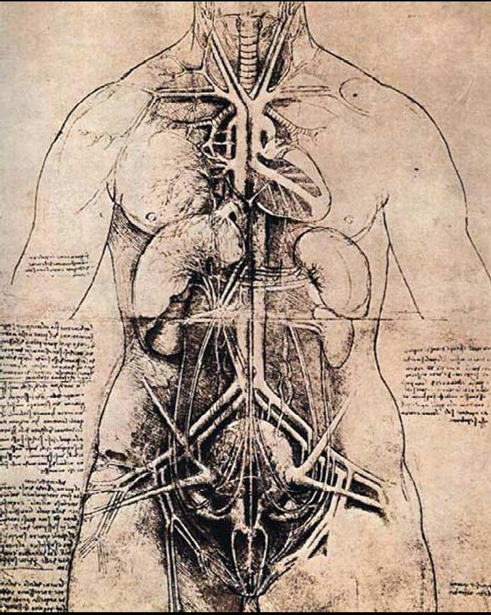
Tissue Chip Program
GOAL: Develop an in vitro platform that uses human tissues to evaluate the efficacy, safety and toxicity of promising therapies.
All ten human physiological systems will be functionally represented by human tissue constructs:
Circulatory
Endocrine
Gastrointestinal
Immune
Integumentary
Physiologically relevant, genetically diverse, and pathologically meaningful.
Modular, reconfigurable platform.
Tissue viability for at least 4 weeks.
Community-wide access.
Musculoskeletal
Nervous
Reproductive
Respiratory
Urinary

Slide 49
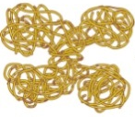
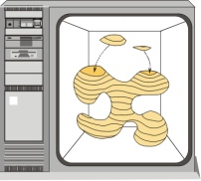
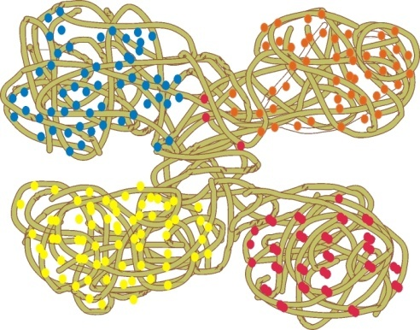
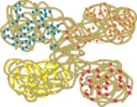

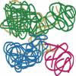

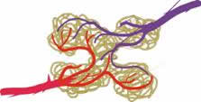
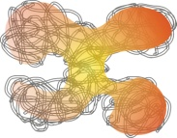


Microphysiological Systems
from Common Building Blocks
Computational Design
systems integration
multi-scale modeling
simulation
feedback
Scaffold
purified ECM
synthetic polymers
composites
Functional Readout
real-time, label-free, non-destructive sensing
imaging
Cells
stem/progenitor
differentiated
mixed cell types
Structure
porosity
topography
stiffness
Host Response
generalized inflammation
specific immunity
Perfusion
embedded channels
vascularization
Spatial/Temporal
Patterning
cytokine gradients
controlled release
Bioreactors
optimized culture conditions
biomechanical properties
blood mimetics
Innervation
signal propagation
coordinated response
Notes:
The vision for this program is the use of COMMON BUILDING BLOCKS that can be mixed, matched, and modified to build specific systems for sophisticated analysis.
The emergent paradigm for 3-D culture is the use of biocompatible matrices that allow input cells (differentiated or undifferentiated) to organize in ways that more closely approximate their in situ situation. Various components can be added to this basic concept to add functionality. For example:
STRUCTURE. The scaffold can be modified to have localized features such as the porosity and surface roughness to accommodate different cellular densities within it.
SPATIAL/TEMPORAL PATTERNING. Understanding how depots of growth factors control cell mobility and differentiation are key aspects of the developmental biology of any tissue/organ.
PERFUSION. Building a construct of greater that a few centimeters requires the ability to allow nutrient and metabolite mass transfer. This aspect is dealt with at two levels: microchannels within the basic scaffold and a simulated blood flow.
BIOREACTORS. Optimizing growth and conditioning is more than keeping a stable pH, gas exchange, and nutrient balance. The role of stress, strain, cyclic forces, etc. in dictating tissue structure and even cellular response is increasingly evident, especially in tissues that are generally exposed to biomechanical forces (e.g. connective tissue, nerves, blood vessels).
INNERVATION. Signal transduction and communication is increasingly important for understanding a tissue’s response to stimulus.
HOST RESPONSE. Tissue exist in complex environments. One of the ways to understand the interactions between complex systems, like pathogen or tumor cell invasion through an epithelial barrier is to model it. Incorporation of the responsive cells within a tissue models will be necessary to tease out the specific response patterns, and how they are controlled and controllable.
FUNCTIONAL READOUT. A key issue for sophisticated in vitro biology will be continuous (i.e. non-destructive, real time) monitoring of the test parameters.
COMPUTATIONAL DESIGN. Functional readouts allow iterative improvements in the overall system design, and perhaps the real time remodeling that could simulate disease progression.

Slide 50
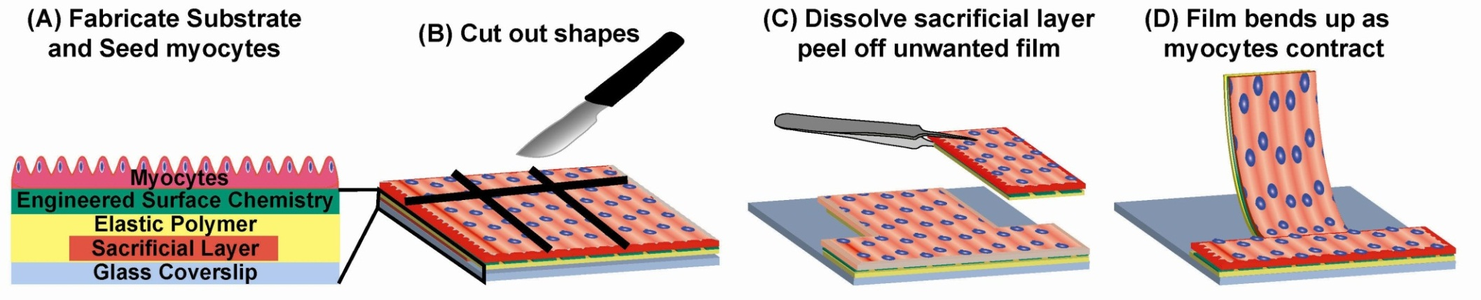
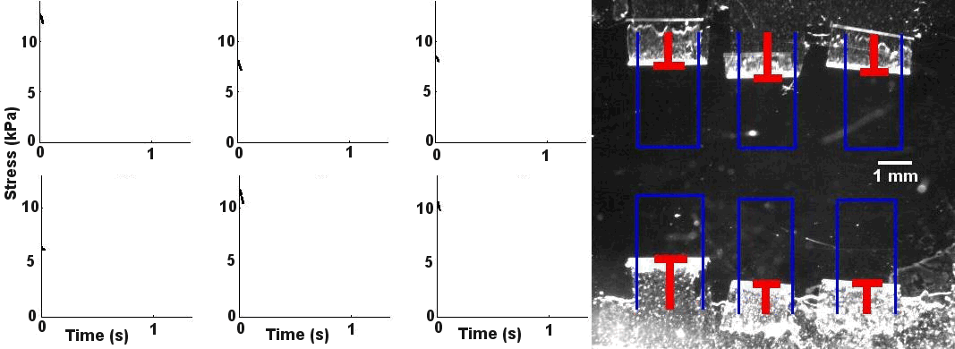
Engineered Cardiac Muscular Thin Films
_{Film length}
_{Automatic projection tracking}
Science 2007;317:1366 Biomaterials 2010;31:3613
Lab Chip 2011;11:4165 J Pharm Tox Methods 2012;65:126
Data provided by Dr. Kit Parker, Wyss Institute

Slide 51
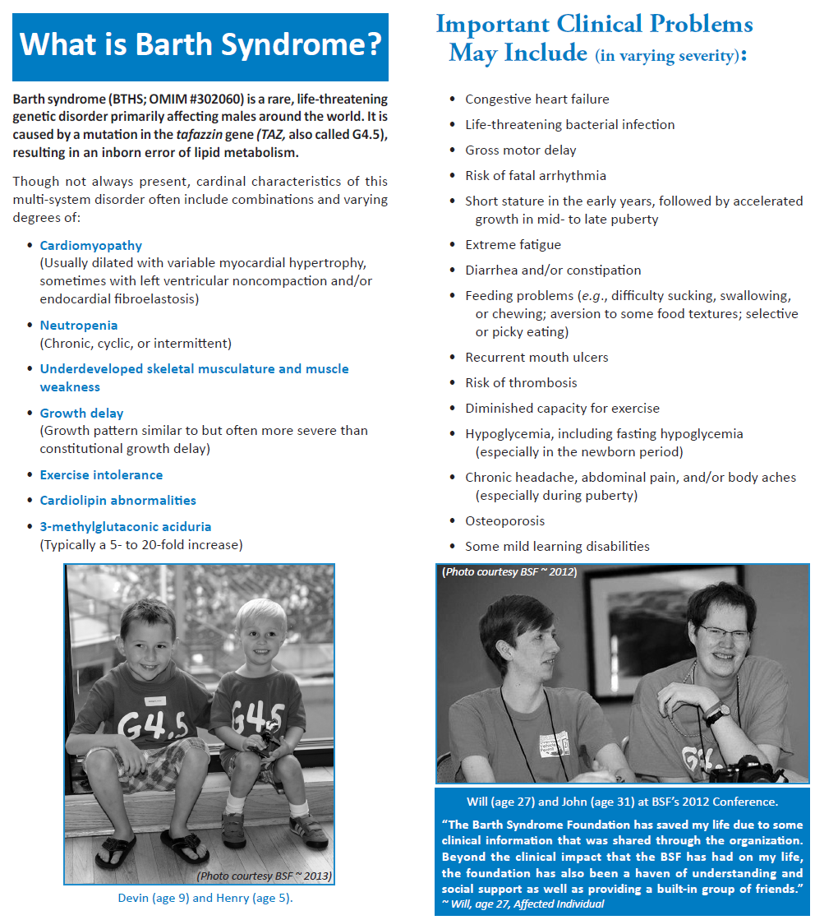

Slide 52
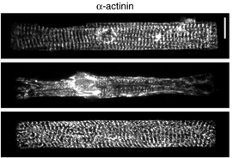
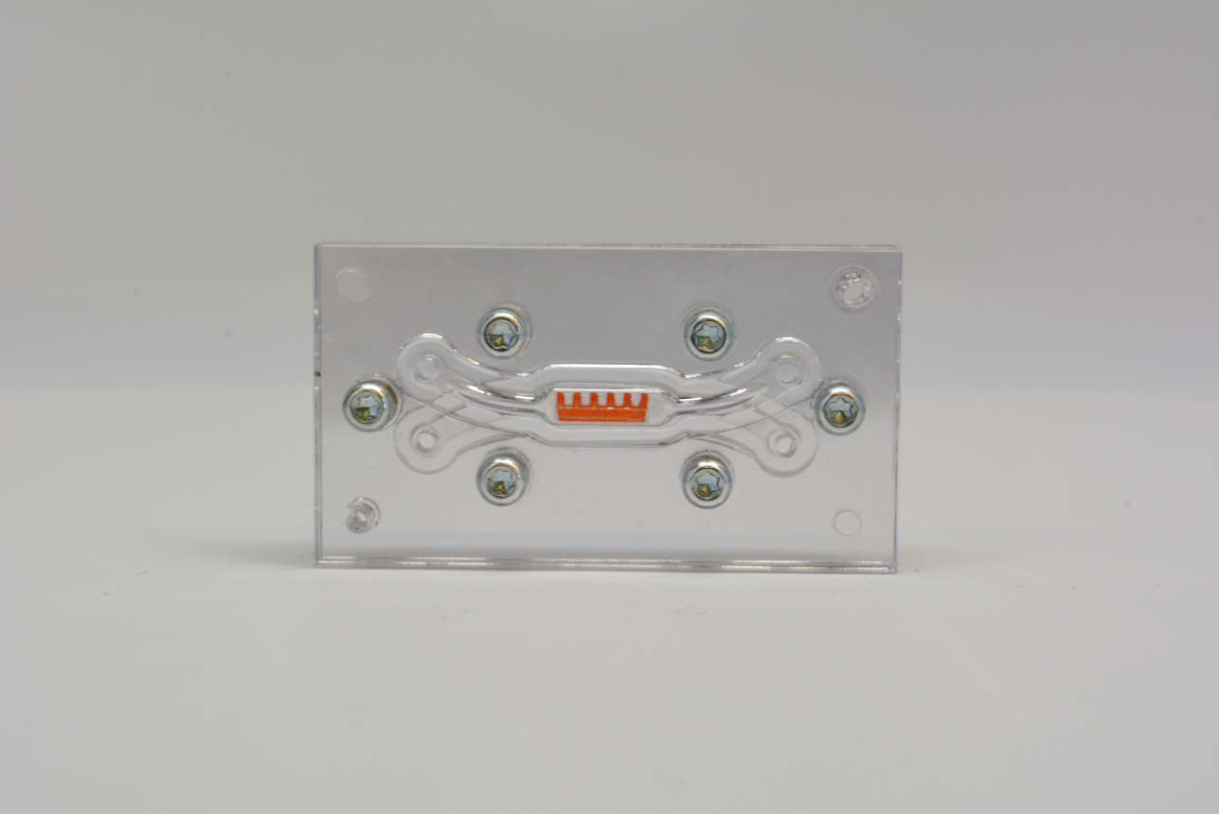
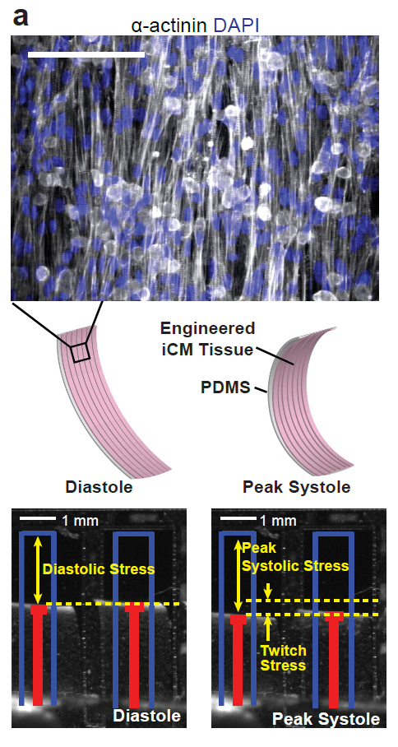
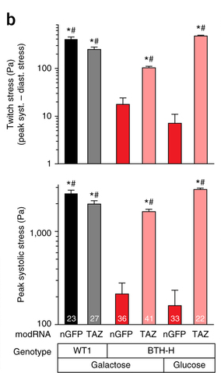
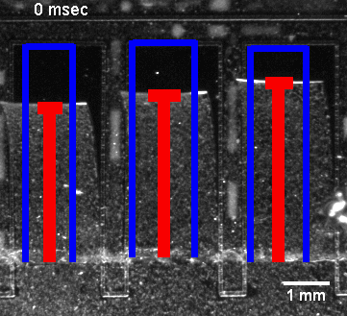


Heart on a Chip Barth Model
A
B
C
A
E
D
Normal Contractility of Wild Type Tissues
Impaired Contractility of Diseased Tissues
Rescued Contractility of Diseased Tissues
D
C
Dr. Kevin Parker, Harvard University:
http://diseasebiophysics.seas.harvard.edu
Notes:
One heart chip design from the Harvard Group
Barth Syndrome is a rare disease that has a gene mutation (TAZ), which causes skeletal and cardiomyopathy. This can be studied using the Harvard Heart-on-a-Chip and iPSC-derived cardiac tissue from a Barth Syndrome patient. A. An image of the cardiac chip. The cantilevers allows for cardiac contraction. B. Image of normal cardiac cells aligned on the device. C. Sarcomere organization. The top panel is control. The second panel (Barth) show disorganized sarcomeres. This phenotype can be rescued by adding normal TAZ into the diseased tissue, which is shown in the bottom panel. D. Video showing contraction of cardiac cells on the chip. Left panel shows normal cardiac contraction. There is significantly less contraction with Barth tissue (middle), but can be rescued when the normal gene (TAZ) is added (right panel). E Twitch stress and Peak systolic measurements

Slide 53




Slide 54





Learn More About NCATS
    Website: www.ncats.nih.gov
    Facebook: facebook.com/ncats.nih.gov
    Twitter: twitter.com/ncats_nih_gov
    YouTube: youtube.com/user/ncatsmedia
    E-Newsletter: ncats.nih.gov/news-and-
events/e-news/e-news.html
Email us! info@ncats.nih.gov

