Slide 1
Opportunities for Rare Disease Research Funding at PCORI
Danielle Whicher
Program Officer, Clinical Effectiveness Research
September 29, 2015

Slide 2

Presentation Overview
  About PCORI
  PCORI’s Research Portfolio
  Research Awards
  Programmatic Awards
  PCORI’s Engagement Rubric

Slide 3
About PCORI

Slide 4

Mission and Strategic Goals
PCORI helps people make informed healthcare decisions, and improves healthcare delivery and outcomes, by producing and promoting high-integrity, evidence-based information that comes from research guided by patients, caregivers, and the broader healthcare community.
Our Strategic Goals:
  Increase quantity, quality, and timeliness of useful, trustworthy research information available to support health decisions
  Speed the implementation and use of patient-centered outcomes research evidence
  Influence research funded by others to be more patient-centered

Slide 5
PCORI Funds…
    Patient-Centered Comparative Effectiveness Research
      Compares two or more options for prevention, diagnosis, or treatment
      Considers the range of clinical outcomes relevant to patients
      Conducted in real-world populations and real-world settings
      Attends to differences in effectiveness and preferences across patient subgroups
      Often requires randomized trial design

Slide 6










PCORI Funds Research That…
    Focuses on high-priority conditions
    Affecting large numbers of people across a range of populations
    Placing a heavy burden on individuals, families, specific populations, and society
    This includes many rare diseases, which are difficult to study

Slide 7
PCORI’s Advisory Panel on Rare Disease
Advises and provides recommendations to PCORI’s Board of Governors, Methodology Committee, and staff on the conduct of patient-centered comparative clinical effectiveness research in rare diseases and on coordination and engagement with the rare disease research community
15 members –
  7 Patient Caregiver and Advocates
  3 Clinicians
  1 Payer
  2 Researchers
  2 Industry Representatives

Slide 8
  PCORI’s Research Portfolio

Slide 9
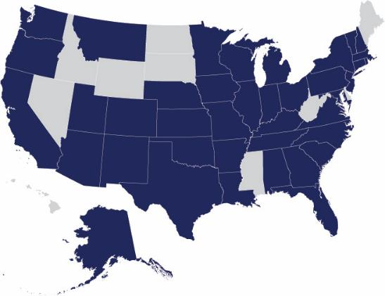
Overview: Funded Research Projects
Number of projects:
440
Amount awarded:
$1.08 billion
Number of states where
PCORI is funding research:
40 (plus the District of Columbia)
As of August 18, 2015

Slide 10
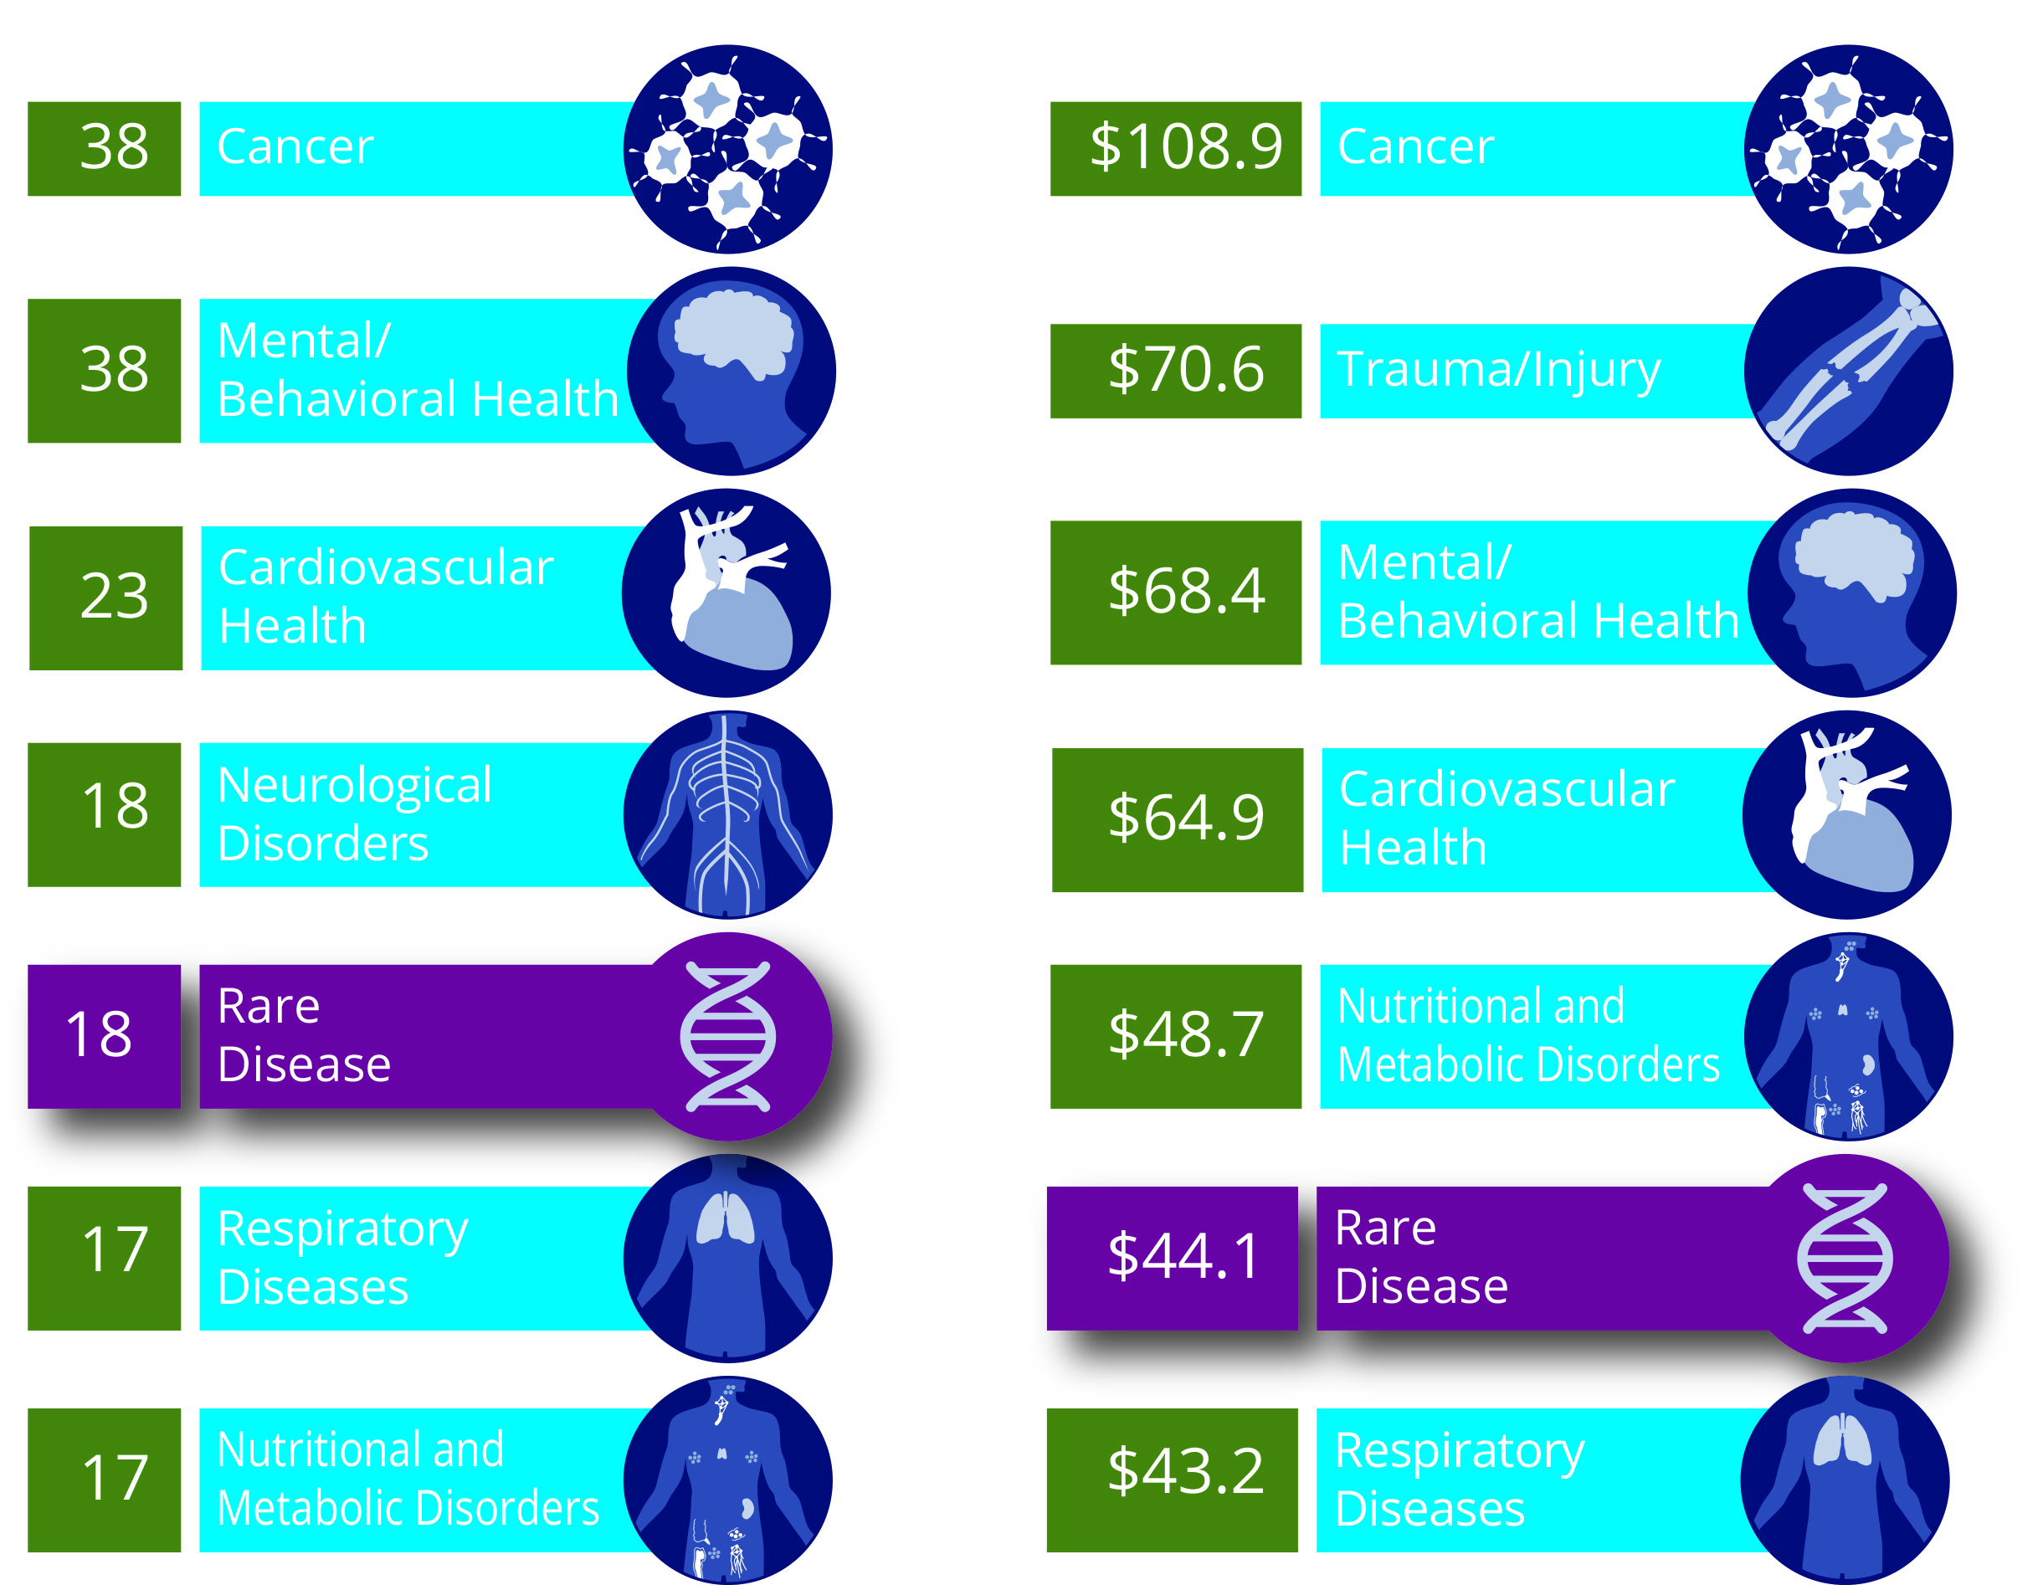
Research Awards Portfolio Analysis: Primary Condition
Where are funded projects concentrated?
Where is the most funding (in millions)?
As of August 18, 2015

Slide 11
Research Awards

Slide 12
Funding Mechanisms
Broad Funding Announcements
Pragmatic Clinical Studies
Targeted Funding Announcements

Slide 13
Broad Funding Announcements
Overview
Topics are investigator initiated, representing the research community’s interests.
The announcements include 5 different types of awards that align with PCORI’s National Priorities for Research (see next slides).
Funds Available per Cycle: TBD
Project Duration: Generally 3 Years
Direct Costs per Project: $750,000 – $5,000,000
Competitive LOI Review

Slide 14
National Priorities for Research – Broad Funding Announcements
Assessment of Prevention, Diagnosis, and Treatment Options
Research that:
  Compares the effectiveness and safety of alternative prevention, diagnosis, and treatment options
  Determines which ones work best for different people with a particular health problem

Slide 15
National Priorities for Research – Broad Funding Announcements
Assessment of Prevention, Diagnosis, and Treatment Options
Research that:
  Compares health system–level approaches to improving access
  Supports patient self-care, innovative use of health information technology, care coordination for complex conditions, and effective workforce deployment
Improving Healthcare Systems

Slide 16
National Priorities for Research – Broad Funding Announcements
Assessment of Prevention, Diagnosis, and Treatment Options
Research on:
  Providing information produced by CER
  Empowering people to ask for and use the information
  Supporting shared decision making between patients and their providers
Improving Healthcare Systems
Communication and Dissemination Research

Slide 17
National Priorities for Research – Broad Funding Announcements
Assessment of Prevention, Diagnosis, and Treatment Options
Research on:
  Best prevention, diagnosis, or treatment strategies/options to reduce or eliminate disparities
  Target populations at risk for disparities: racial/ethnic minorities; rural populations; low literacy, numeracy, and LEP populations; populations with special healthcare needs (disabilities); LGBTQ populations; low income groups
Improving Healthcare Systems
Communication and Dissemination Research
Addressing Disparities

Slide 18
National Priorities for Research – Broad Funding Announcements
Assessment of Prevention, Diagnosis, and Treatment Options
  Research on:
  Building data infrastructure
  Improving analytic methods
  Training researchers, patients, and other stakeholders to participate in this research
Improving Healthcare Systems
Communication and Dissemination Research
Addressing Disparities
Accelerating Patient-Centered Outcomes Research and Methodological Research

Slide 19



Comparing Patient -Centered Outcomes in the Management of Pain between Emergency Departments and Dedicated Acute-Care Facilities for Adults with Sickle Cell Disease
Engagement
Individuals with SCD, community-based organizations, and stakeholders participated in the development and design of the study, and will continue to play a role by participating in quarterly meetings throughout the study
Potential Impact
Could change practice by demonstrating the effectiveness of the infusion clinic (IC) model to improve healthcare delivery for adults with SCD; expanding access to ICs will allow patients in pain to have their needs met more effectively
Methods
Prospective observational study
Compares patient-centered
outcomes, as well as the time it
takes to be treated for pain, between care received at emergency departments (EDs) and the IC model. ED care for SCD is marked by long delays and lack of efficacy. ICs are alternatives to ED care that provide rapid pain control and frequent reassessments.
Sophie Lanzkron, MD, MHS,
Johns Hopkins University
Baltimore, Maryland
Improving Healthcare Systems,
awarded September 2014

Slide 20
Pragmatic Clinical Studies
Seeks to produce information that can be directly adopted by providers:
  Compares two or more options for prevention, diagnosis, treatment, or management of a disease or symptom
  Addresses critical clinical choices faced by patients, caregivers, clinicians, and systems
  Often conducted in routine clinical settings
  Though often large, usually less complex protocols than traditional trials
  Topics of special interest from stakeholders, Institute of Medicine, Agency for Healthcare Research and Quality
Overview
Anticipated Awards per Funding Cycle: Six to Nine
Funds Available per Cycle: Up to $90 Million
Maximum Project Duration: 5 Years
Maximum Direct Costs per Project: $10 Million

Slide 21

Anti-TNF Monotherapy versus Combination Therapy with Low-Dose Methotrexate in Pediatric Crohn’s Disease
Engagement
Parents and patients will provide input on all aspects of the trial: planning, conducting, and future dissemination.
Potential Impact
Could address a significant knowledge gap and have substantial impact on patient decision making, care, and outcomes. The advantage of conducting this trial within ICN is that the same network that generates the research can also be used to implement evidence into practice.
Methods
Randomized controlled clinical trial.
Compares which of two
treatments—anti-TNF plus methotrexate or anti-TNF therapy alone—is more effective in inducing and maintaining long-term (two-year) steroid-free remission, and improving patient-reported outcomes among anti-TNF naïve patients with moderate-severe Pediatric Crohn’s Disease (PCD).
Michael Kappelman, MD, MPH
University of North Carolina at Chapel Hill
Chapel Hill, NC
Assessment of Prevention, Diagnosis, and Treatment
Options, awarded April 2015

Slide 22
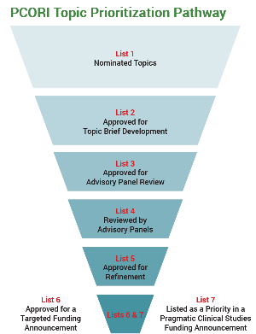
Targeted Funding Announcements
These announcements seek research proposals on the single, highest-priority questions identified through PCORI’s topic generation and research prioritization process.
http://www.pcori.org/get-involved/suggest-patient-centered-research-question

Slide 23
Infrastructure Awards: PCORnet
  PCORnet, the National Patient-Centered Clinical Research Network, includes Clinical Data Research Networks (CDRNs), based in healthcare systems, and Patient-Powered Research Networks (PPRNs), led by patient groups with an interest in a particular condition such as heart disease or multiple sclerosis.
PCORnet’s Goals:
  Improve the nation’s capacity to conduct clinical research faster, more efficiently, and less expensively, with greater power
  Establish a large, highly representative, national patient-centered clinical research network with a focus on conducting interventional and observational comparative studies
  Support a learning US healthcare system, which would allow for large-scale research to be conducted with greater accuracy and efficiency within real-world care-delivery systems

Slide 24
PCORnet Rare Disease Cohorts: 13 CDRNs (in Phase II)
Network | PI Name | Rare Disease/Condition
ADVANCE | Jennifer DeVoe | Alpha-1-antitrypsin deficiency
CAPriCORN | Terry Mazany | Sickle cell disease; recurrent C. difficile colitis
GPC | Russ Waitman | Amyotrophic lateral sclerosis (ALS)
LACDRN | Tom Carton | Sickle cell disease; rare cancers
LHSNet | Veronique Roger | Osteogenesis imperfecta
Mid-South CDRN | Russell Rothman | Sickle cell disease
NYC-CDRN | Rainu Kaushal | Cystic fibrosis
OneFlorida | Elizabeth Shenkman | Duchenne muscular dystrophy
PaTH | Kathleen McTigue | Idiopathic pulmonary fibrosis
PEDSNet | Chris Forrest | Hypoplastic left heart syndrome
PORTAL | Elizabeth McGlynn | Severe congenital heart disease
pSCANNER | Lucila Ohno-Machado | Kawasaki disease
SCIHLS | Ken Mandl | Pulmonary arterial hypertension
PCORI Contact: Maryan Zirkle mzirkle@pcori.org

Slide 25
PCORnet Rare Disease Cohorts: 9 PPRNs (in Phase II)
Network | Rare Disease/Condition
CENA | Alström syndrome, dyskeratosis congenital, Gaucher disease, hepatitis, inflammatory breast cancer, Joubert syndrome, Klinefelter syndrome and associated conditions, metachromatic leukodystrophy, pseudoxanthoma elasticum (PXE), psoriasis
DuchenneConnect | Duchenne and Becker muscular dystrophies
ImproveCareNow | Pediatric Crohn’s disease and ulcerative colitis
NephCure | Primary nephrotic syndrome
PARTNERS Consortium | Juvenile rheumatic disease
PMS_PPRN | Phelan-McDermid syndrome
PI-CONNECT | Primary immunodeficiency diseases (more than 185 related rare genetic diseases)
REN | Aicardi syndrome, Lennox-Gastaut syndrome, Phelan-McDermid syndrome, Dravet syndrome; hypothalamic hamartoma; tuberous sclerosis (rare epilepsy is a symptom)
The Vasculitis PPRN | Vasculitis

Slide 26
Programmatic Awards

Slide 27
Pipeline to Proposal Awards
  Strengthen relationships between researchers, patients, and other healthcare stakeholders in communities not typically involved in clinical research
  Build capacity for community partnerships to ultimately submit research questions to considered for PCOR funding
  Engage community partnerships in the research process and development of dissemination and implementation plans
  Establish an infrastructure for dissemination and evaluation of CER information
Three Tiers of Awards
Tier I: Up to $15,000 per award for 9 months to individuals or groups
Tier II: Up to $25,000 per award for 12 months to recipients of Tier I funding
Tier III: Up to $50,000 per award for 12 months to patient-researcher partnerships

Slide 28

Supporting Latino Families with Children with Spina Bifida
Create a collaborative network
of patient and family stakeholders, as well as researchers who are invested in using action research methodology. Gather information from adolescents with SB and their parents regarding attitudes toward obesity, diet, and lack of mobility to identify areas for future intervention.
Engagement
Hosting a series of structured focus meetings facilitated by a nutritionist and a bilingual assistant
Potential Impact
Facilitate the development of a comparative effectiveness research agenda
Ruth Bush, PhD, MPH,
University of San Diego
Baltimore, Maryland
Pipeline to Proposal

Slide 29
Eugene Washington PCORI Engagement Awards
    Knowledge Awards* increase knowledge about how consumers of healthcare information view, receive, and make use of PCOR and CER.
    Training and Development Awards* build capacity for participating in PCOR and CER and create ways to connect patients, caregivers, clinicians, and other healthcare stakeholders with the research community.
    Dissemination Awards develop and strengthen channels for disseminating and implementing PCOR and CER findings
    PCOR/CER Meeting and Conference Support Awards* provide organizations with funding for meetings and conferences that align with PCORI’s mission and aim to facilitate expansion of PCOR and CER
Awards of
up to $250,000
per project, up to two years in duration

Slide 30
ENGAGEMENT

Slide 31

PCORI’s Goals for Engagement
To influence research to be patient-centered, relevant, and useful
  To establish trust and a sense of legitimacy in research findings
To encourage successful uptake and use of research results
http://www.pcori.org/funding-opportunities/what-we-mean-engagement/pcoris-stakeholders

Slide 32
Patient Partners and Other Stakeholders
Patient Partners: Patients who are representative of the population of interest in a particular study, as well as their family members, caregivers, and the organizations that represent them.
Stakeholder Partners: Members of constituencies based on professional, rather than personal, experience. This could include, for example:
  clinicians,
  healthcare purchasers,
  payers,
  industry,
  hospitals and other health systems,
  policy makers,
  training institutions, and
  researchers

Slide 33
Engagement Resources
PCORI’s “Engagement Rubric”
    http://www.pcori.org/sites/default/files/PCORI-Engagement-Rubric-with-Table.pdf
Sample Engagement Plans
http://www.pcori.org/sites/default/files/PCORI-Sample-Engagement-Plans.pdf
PCORI Compensation Framework
http://www.pcori.org/sites/default/files/PCORI-Compensation-Framework-for-Engaged-Research-Partners.pdf
Engagement in Research website page
    http://www.pcori.org/content/engagement-research
PCORI’s Methodology Standards PC-1 to PC-4
    http://www.pcori.org/assets/PCORI-Methodology-Standards1.pdf

Slide 34




Elements of the Rubric
Planning the Study
Conducting the Study
Disseminating the Study Results
PCOR Engagement Principles

Slide 35
Embodying the Engagement Principles
Six Engagement Principles
- Partnership
- Co-learning
- Reciprocal relationships
- Trust
- Transparency
- Honesty

Slide 36
Group Activity: Engagement in Rare Disease CER
Consider a CER question that focuses on a rare disease
What types of patient partners and other stakeholders could you engage?
  How would you go about identifying patient partners?
  Are there national advocacy groups you might consider?
  What types of stakeholders are likely to be impacted by the results of your study? Who do you hope would use the results?
How will you engage those patient partners and other stakeholders in the planning of your study?
  Consider the six principles when designing your plan
How can you keep your patient partners and other stakeholders engaged throughout the project and involve them in dissemination and implementation of the results?
What barriers do you anticipate to effective engagement?
  What are some factors that make engagement particularly important or challenging in the area of rare disease?

Slide 37
Thank You
Danielle M. Whicher, PhD, MHS
Program Officer, Clinical Effectiveness Research
Patient Centered Outcomes Research Institute (PCORI)
dwhicher@pcori.org
www.pcori.org

