Slide 1
LearnRD.com
Portal Features Overview

Slide 2

Overview
LearnRD.com is an online learning tool that allows users to access, create, share, and exchange information, ideas, and multimedia related to clinical and translational science in rare diseases.
The site allows for the creation and exchange of user-generated content.”

Slide 3
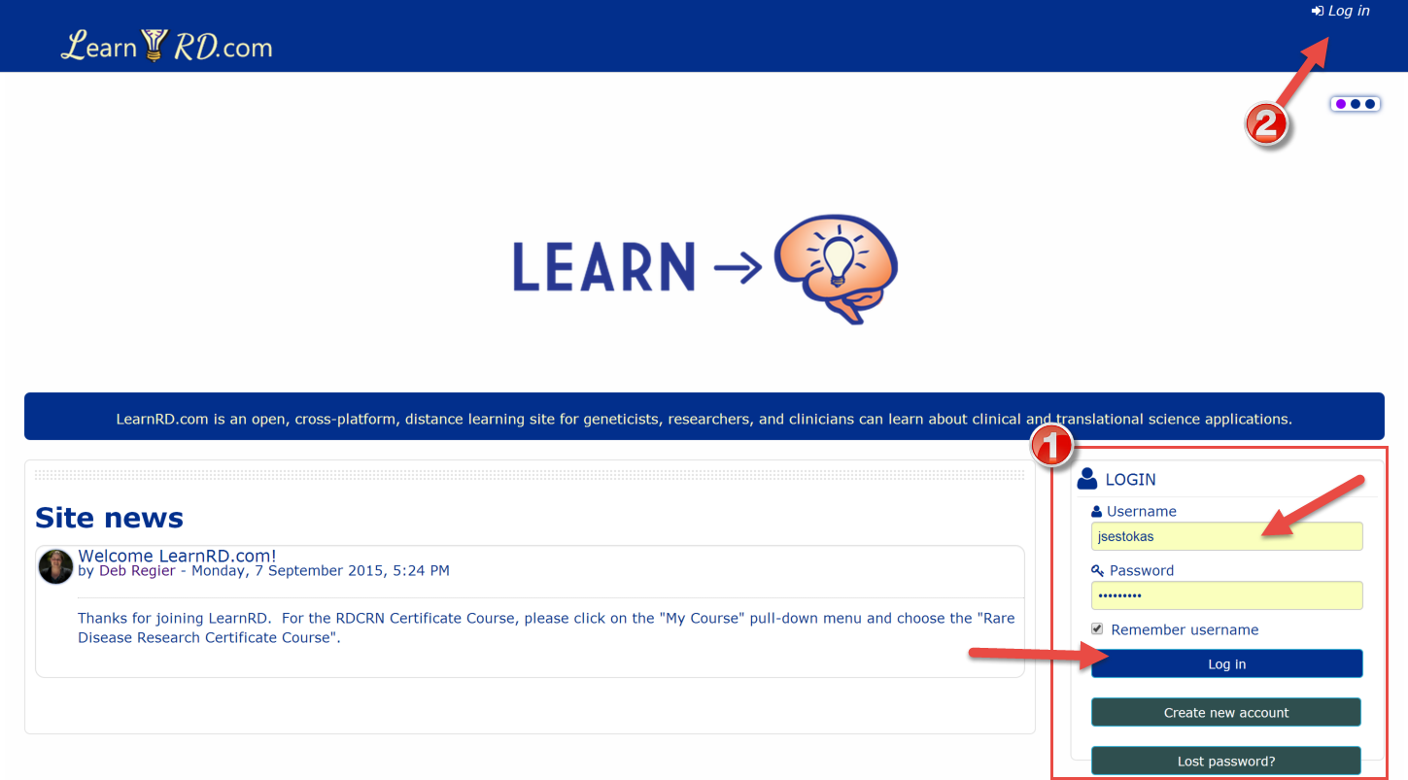
Logging into LearnRD.com
Users can log into the site from the front page or by clicking on the “Login” button located in the upper right-hand corner of their screen.

Slide 4
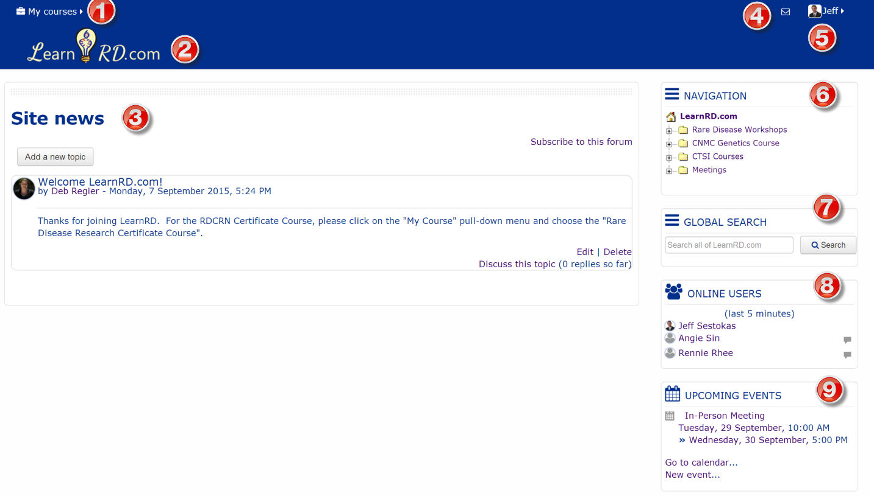
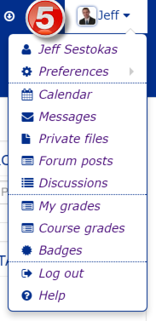
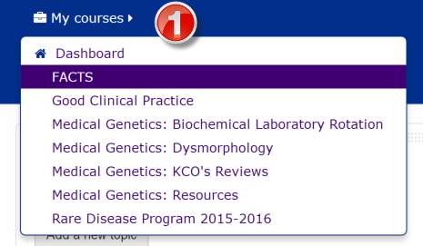
Dashboard
Users can access courses from the “My Courses” tab or the navigation menu.

Slide 5
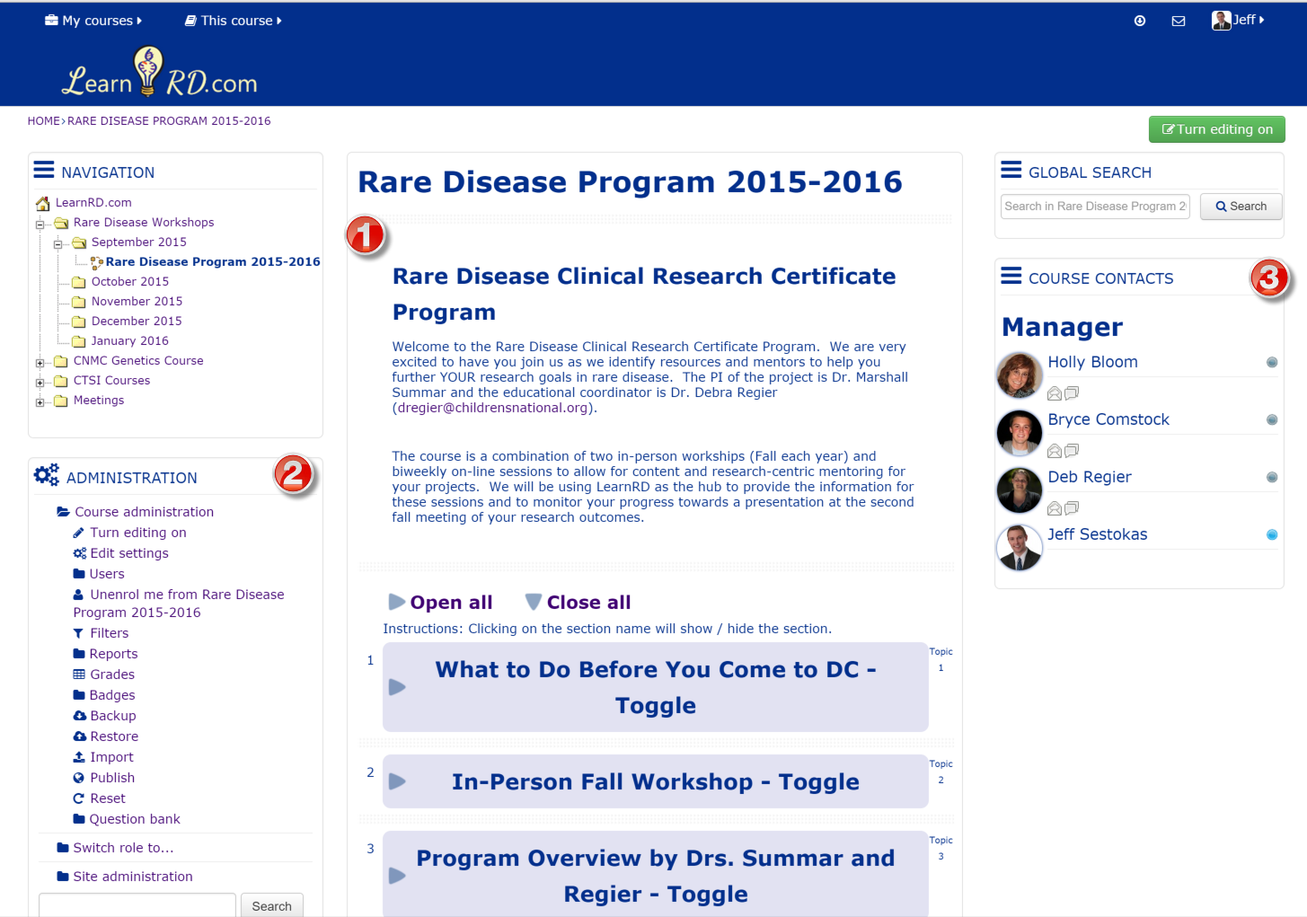
Course Layout

Slide 6
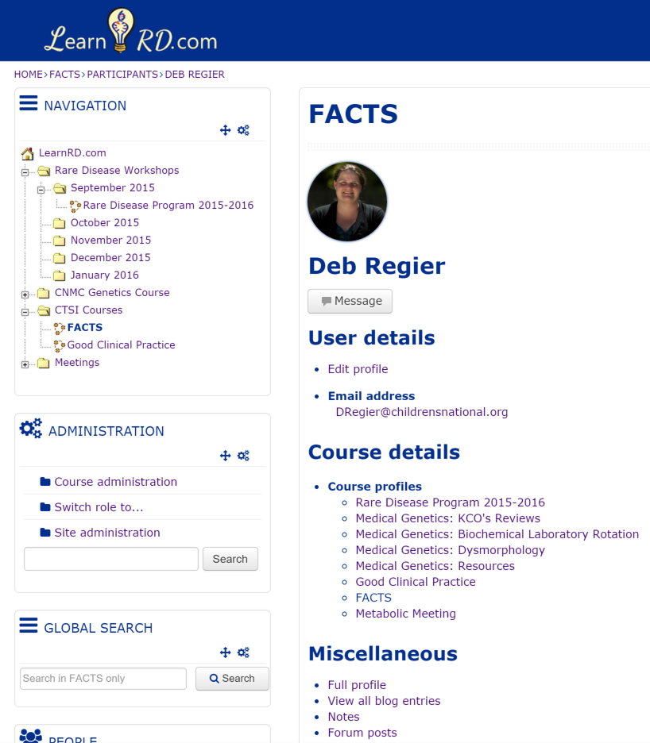
User Profile
LearnRD.com allows users to customize their profile. Administrators can create tailored roles and assign permissions too!
Communication, files, and learner performance are tracked and reported in the user’s profile.

Slide 7
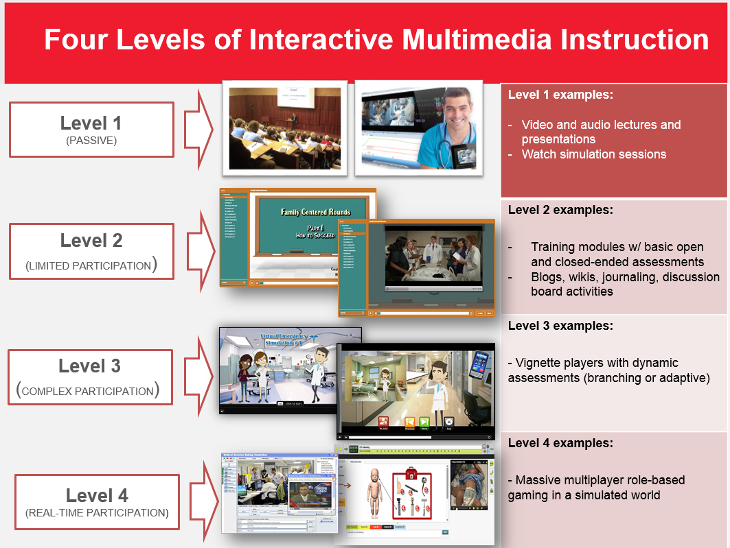
Different levels of User-Generated Content

Slide 8
Communication
LearnRD.com is equipped with both active and passive communication methods
Active | Passive
Live Virtual Conference (webex-like feature) | Discussion boards
Instant Messenger | Blogs, wikis, twitter-like comment posts
Document Share | Glossaries, Journaling

Slide 9
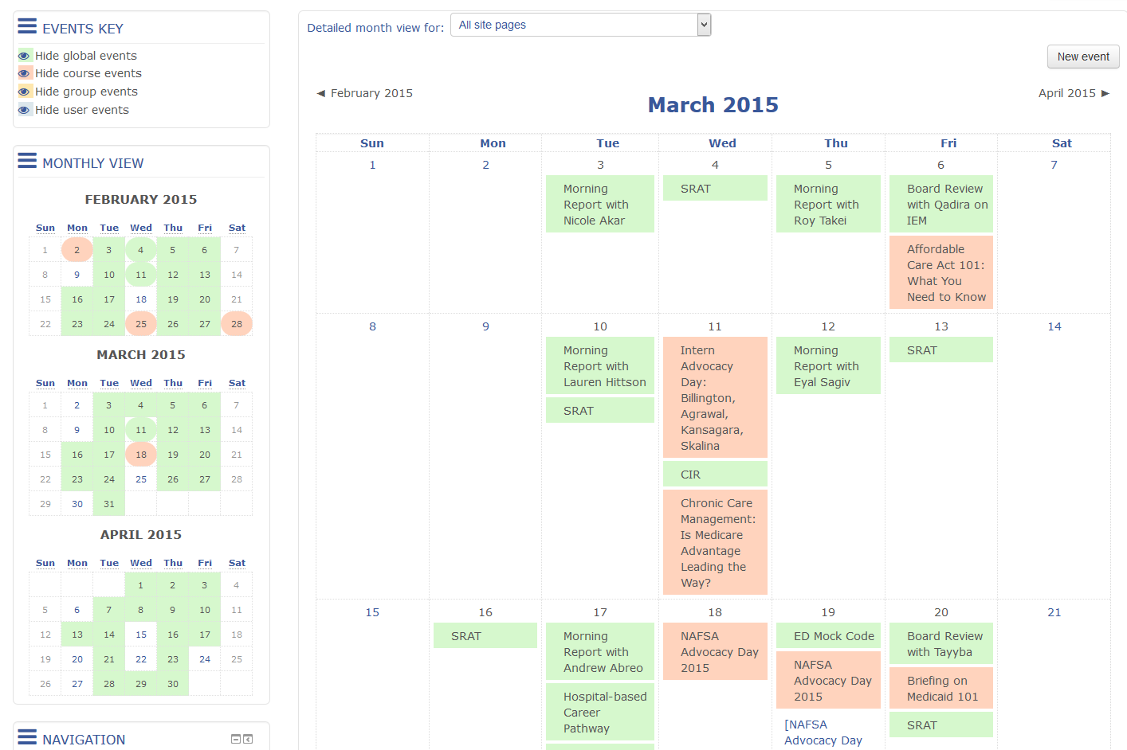
Calendar
LearnRD.com has a built-in calendar system. Events can be tied to course or site pages and exports to MS Outlook

Slide 10
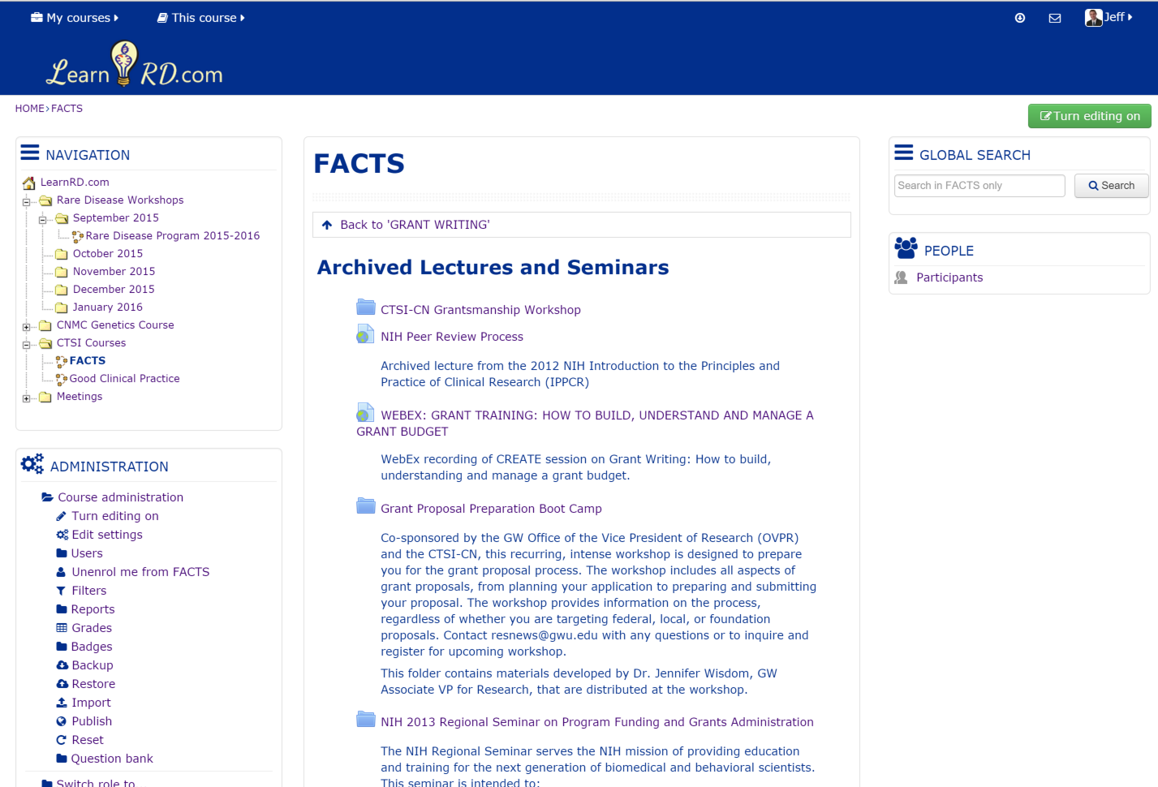
File/Folder Repository
LearnRD.com allows users to upload and manage files/folders

Slide 11
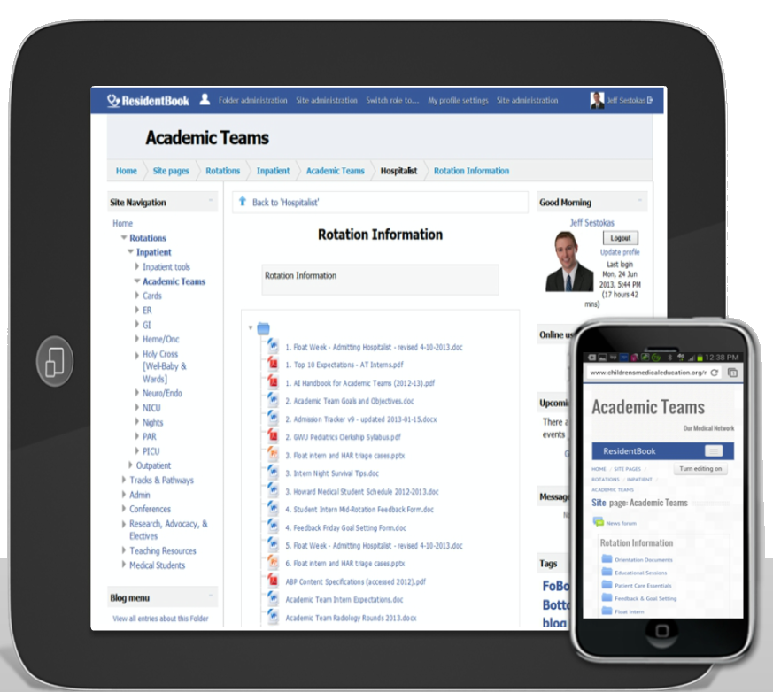
Any Device
LearnRD.com is built on a responsive architecture; meaning it can be accessed on any device (computer, tablet, or smart phone).

Slide 12
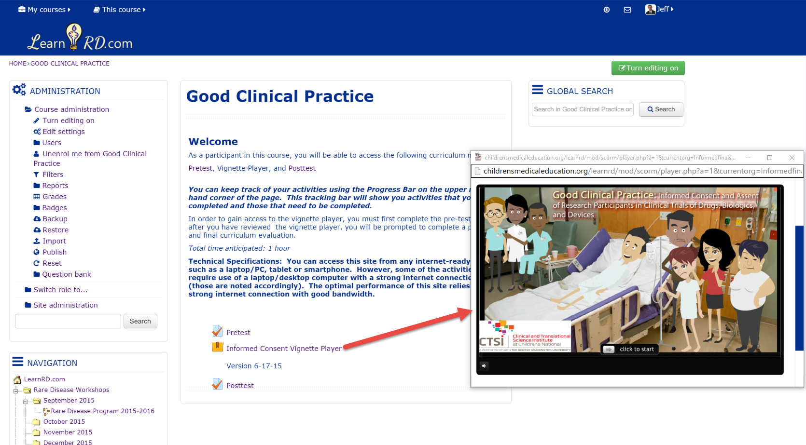
Multimedia/SCORM
LearnRD.com can play SCORM-compliant training modules and other multimedia objects.

Slide 13
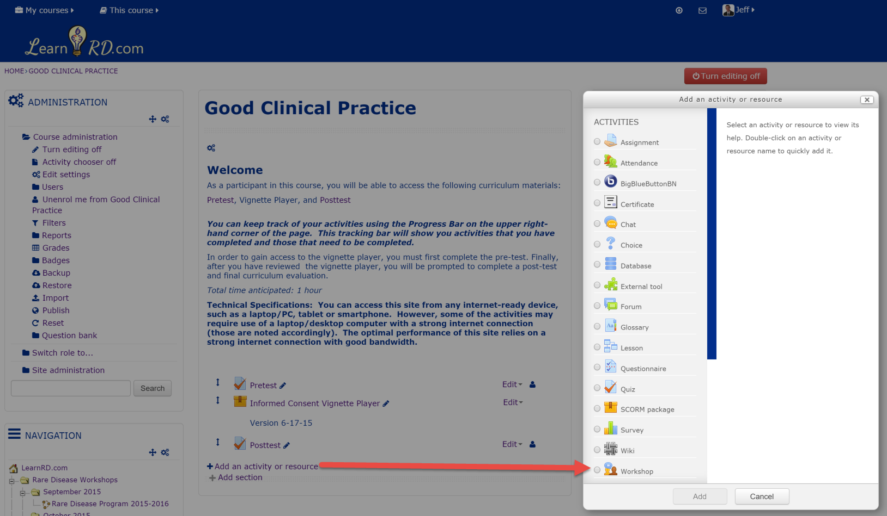
Plugins
There are over 100 external plugins integrated into LearnRD.com including virtual conferencing, game and quiz makers, and more.

Slide 14
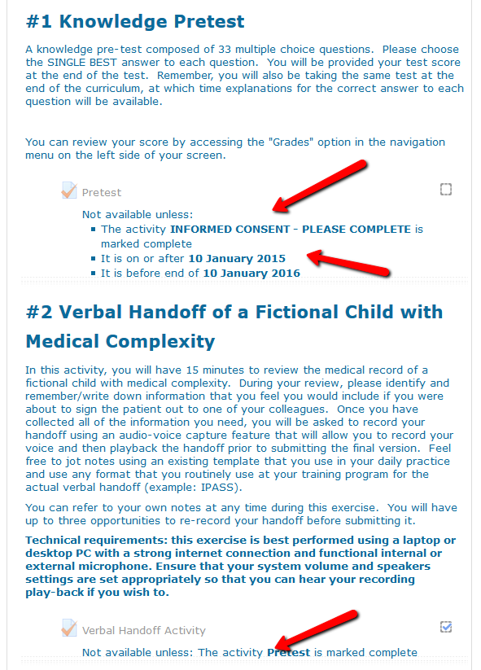
Intelligent Learning Objects
Learning objects can have custom restrictions sets place on them such as activity completion, date, grade, user profile field, experience points or other custom restrictions.

Slide 15
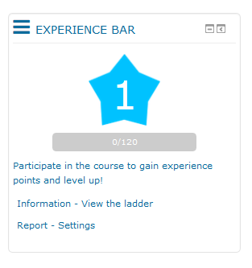
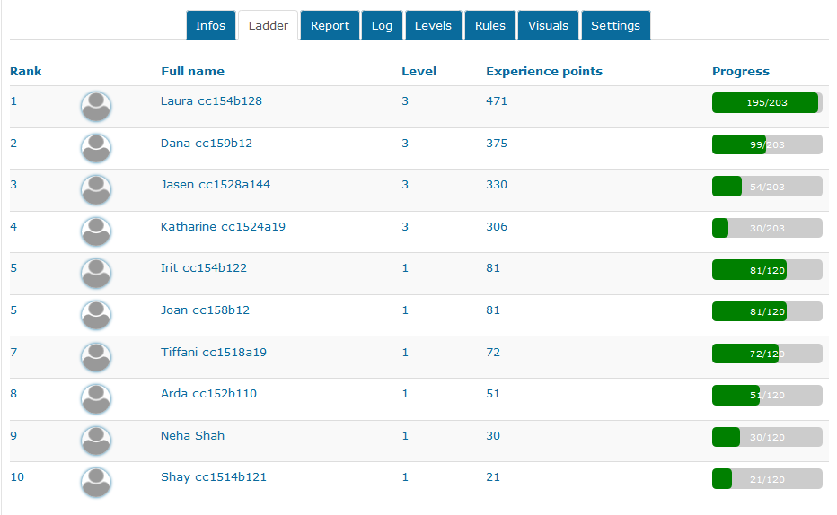
Gamifying the Learning Environment
Administrators can create and define levels based on experience points and then set level conditions to learning objects

Slide 16
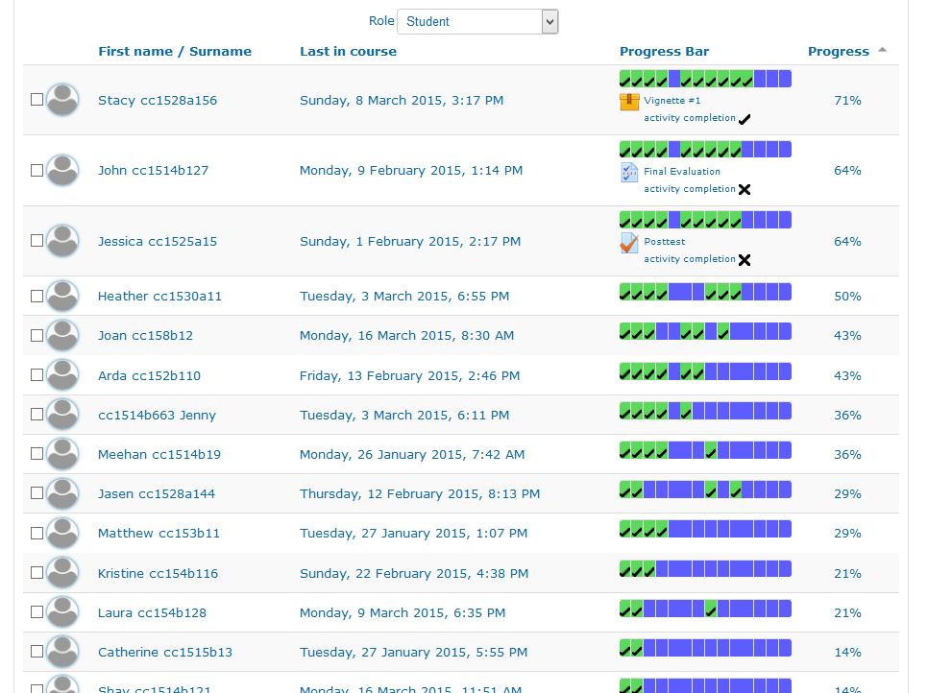
Analytics
Administrators can see data at the site, site page or course, and learning object levels. They can even have colorize progress dashboards that can be filtered by system role.

Slide 17
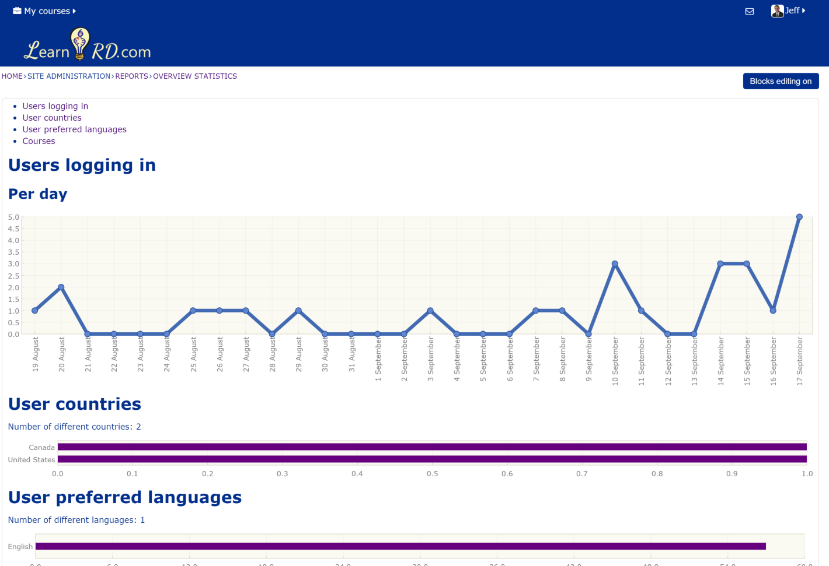
Site-wide Analytics

Slide 18
Contact
For more information please contact
Jeff Sestokas
Research Scientist/Instructional Technologist
Children’s National Medical Center
111 Michigan Ave NW 3.5 WW Suite 600
202-476-3264
937-367-3197

