Slide 1
Rare Diseases Research:
From Study Budgets to Patient Recruitment
Pablo Cure, MD, MPH
Children’s National Health System
Clinical and Translational Science Institute
RDCRN
September, 2015

Slide 2
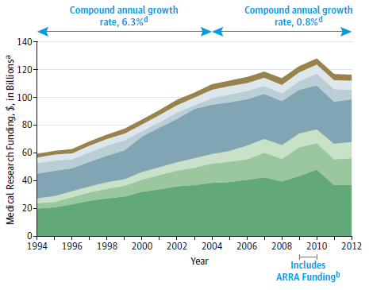
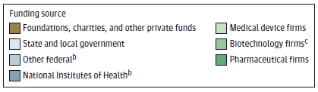
US Funding for Medical Research by Source, 1994-2012
Mosses, H

Slide 3
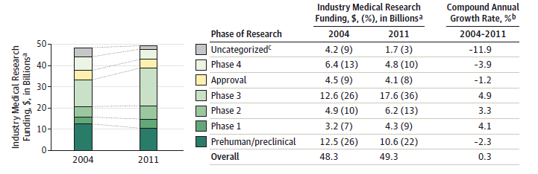
Pharmaceutical Industry Research Funding by Phase 2004-2011
Mosses, H

Slide 4
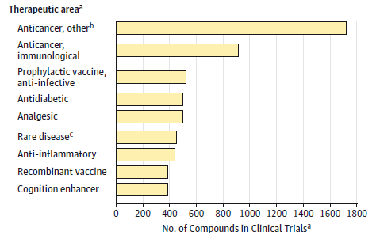
Compounds in Development for Top10 Therapeutic Areas, 2013
a Number of compounds in clinical trials or under review by the US Food and
Drug Administration. This includes a total of 10 479 compounds in 2013.
b Includes all nonimmunological anticancer compounds.
c Rare diseases were defined as those affecting 200 000 or fewer people in the
United States.
Mosses, H

Slide 5
Study process
Initial Contact/ Confidentiality Agreement
Clinical Trials Agreement/ Budget Development
Study Start-Up
Patient Screening- Enrollment
Study Visits
Study Completion
Pre-Award
Post-Award
IRB approval and follow up

Slide 6
Study process
Initial contact/ confidentiality agreement
Budget Development
Study Start-Up
Patient Screening- Enrollment
Study Visits
Study Completion
Pre-Award
Post-Award
IRB approval and follow up

Slide 7
Where do we start…
Developing a comprehensive study budget, first step is to know:
Type of study
Number of patients to be enrolled
Schedule of Events/Visits

Slide 8
Type of Study
Retrospective:
Simple, usually inexpensive. Basically amount of FTE required for data extraction, data entry/management and analysis. Use resources from the CTSI at your institution or partner with a CTSI institution for the use of data collection tools (REDCap, data analysis and publication of results)
In general, costs are less than $100 per patient

Slide 9
Type of Study
Prospective Observational:
Simpler, not too expensive. Also amount of FTE dedicated and costs of testing, blood draws, lab tests, sample storage, study coordination/data collection and analysis. Again, use existing resources at each institution: i.e. Freezers, sample processing, DNA extractions, other services.
Costs are from $100 – $1,000 or more per patient

Slide 10
Type of Study
Prospective Interventional:
Complex, more expensive. Usually per visit budget. Again, use existing resources at each institution: i.e. Freezers, sample processing, DNA extractions, other services. Standard of Care vs. Research.
Costs from 1,000 – 10,000 or more per patient

Slide 11
In General
Study costs are inversely proportional to patient age:
Neonates > Toddlers> Children> Adolescents>Adults
$$$$$ $$$$ $$$ $$ $
But it also depends on the disease and field of study

Slide 12
Things to add in your budget (1)
Your time
Coordinator time
Data entry time (for you or coordinator)
Non-standard of care procedure costs
Phlebotomy
Laboratory processing
Shipping costs
Training time

Slide 13
Things to add in your budget (2)
Preparation of IRB submission
Preparation of Amendments
Adverse event reporting
Marketing materials
Patient incentives (meals, transportation, etc.)
Traveling time

Slide 14
A Word about F&A
Facilities & Administrative (F&A) are costs for general support expenses relating to a university/institution function (in this case, research) that cannot be specifically identified to a project.
Examples include utilities, the departmental administrator overseeing research, and research support staff in central administration.

Slide 15
Set up Study Milestones
Be realistic, yet ambitious
Assures sponsor that you’ll stay motivated
Make them financially sound
Discuss incentives for early completion
Milestones will keep you on TRACK!

Slide 16
Milestones Example
Study Start up and IRB approval
Enrollment of ½ patients
Enrollment 2nd ½ patients
Data Entry Completion
Data Analysis and Results
Set up incentives for early completion of milestones

Slide 17
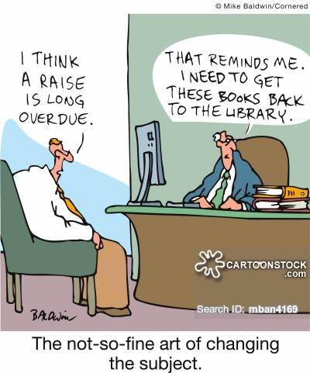
Changing subject…

Slide 18
IOM Report CTSA Program
Changing Research Ecosystem
• Enhanced collaborations
• Emerging data and technology
• Streamlined IRB review processes and enhanced
patient protections
• Broader research participant recruitment
• Development of a dynamic research workforce
http://iom.nationalacademies.org/Reports/2013

Slide 19

The Valley of Death

Slide 20
Recruitment
One of the most common reasons for study failure in the US
Many studies in the US do not reach recruitment goals
NIH/NCATS committed to improve recruitment in CTR
It is also an issue of Retention!

Slide 21
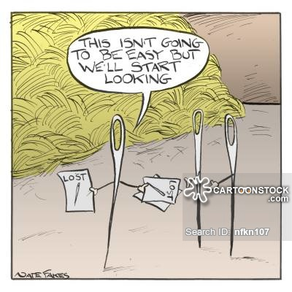
Where to look for patients?

Slide 22
Recruitment Strategy
Multi-pronged approach (EMR, Clinician Referral, Active search)
Utilize specialized resources at your institution (CTSI, Marketing, Bioinformatics, etc.)
Develop solid Pre-screening programs and patient education in CTR

Slide 23
Pre-screening Rule Development
Wider vs. Narrow rules
Cast a big net
Narrow down to specific criteria
Add key partnerships in the process
Creative rule/strategy development
Pre-screening inform consent/study

Slide 24
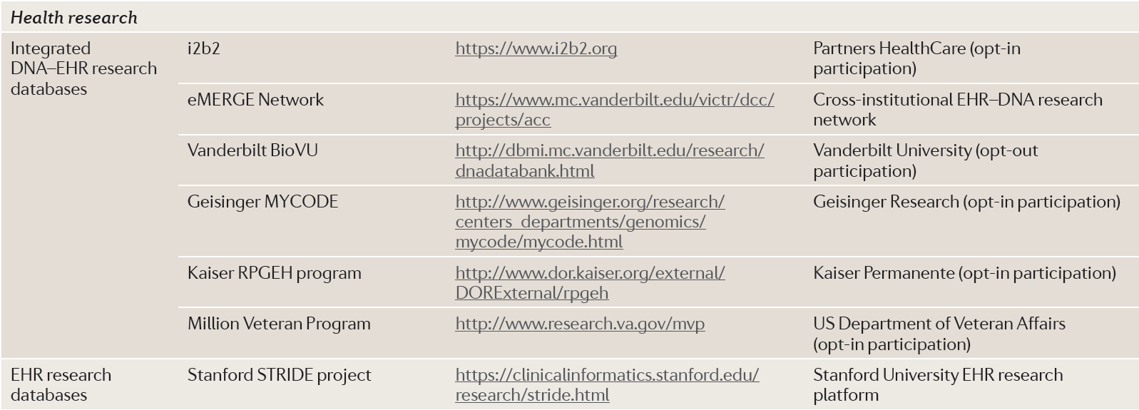
Resources and Initiatives
396 | JUNE 2012 | VO LUME 13
www.nature.com/reviews/genetics

Slide 25
Even the best need to be updated!
Databases become obsolete
Update them every 2 to 4 years
Patient Registries for multipurpose
Recruitment and Retention Team – KEY
Meals, time and transportation solutions

Slide 26
Opt-in versus Opt-out in Pre-screening
Opt-in: Patient has to actively “accept” to participate
Advantages: only interested to participate will be taken into consideration
Disadvantages: Basically consent everybody. Takes time to develop a good number of patients to pre- screen
Opt-out: Patient has to actively “not accept” to participate
Advantages: all patients participate unless they reject participating
Disadvantages: some patients may not know they are part of a pre-screening

Slide 27
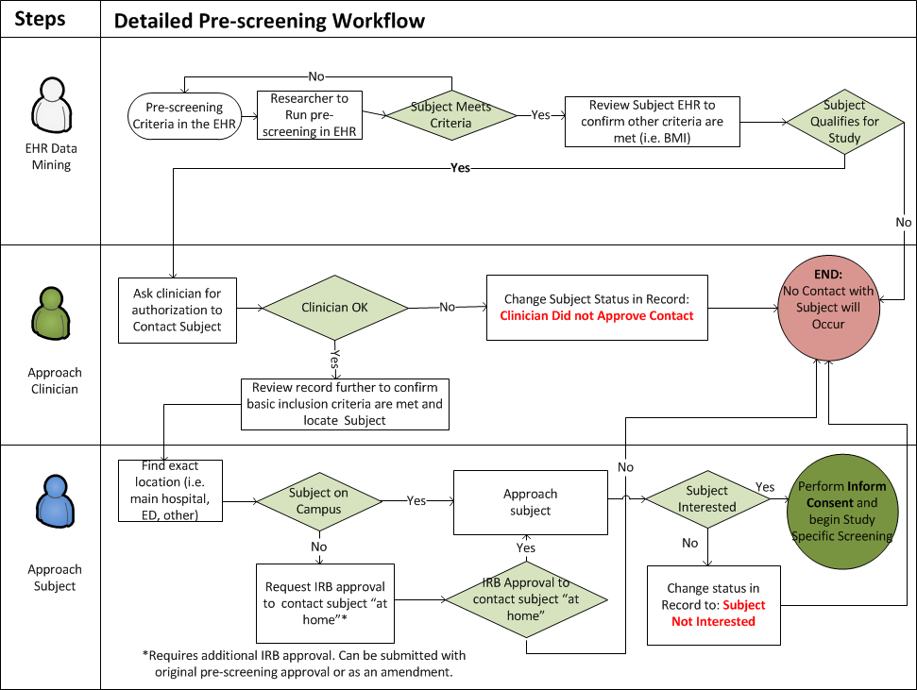
Not currently used

Slide 28
Integrated Thoughts
The more a study is integrated with patient standard of care the more compliant the patient is going to be in terms of recruitment and retention AND the less expensive your study will be!

Slide 29

Thank You!

