Slide 1
Advocacy Groups and Rare Diseases
Jana A. Monaco
Advocacy Liason, Organic Acidemia Association
www.oaanews.org
Jana.monaco@verizon.net

Slide 2
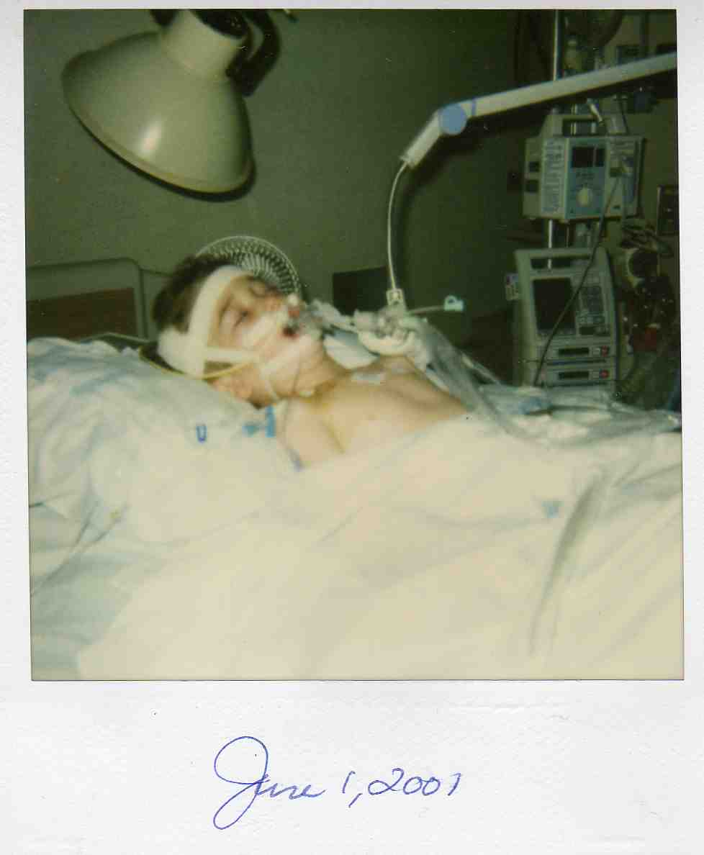
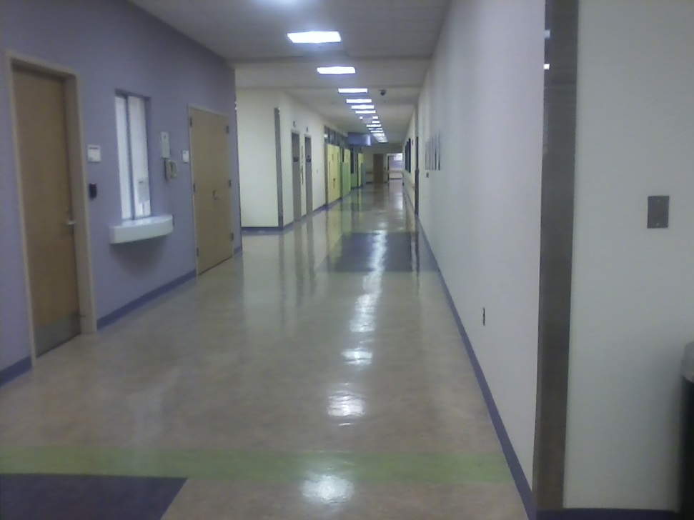
The Diagnosis
Diagnostic Odyssey
Acute Episode

Slide 3
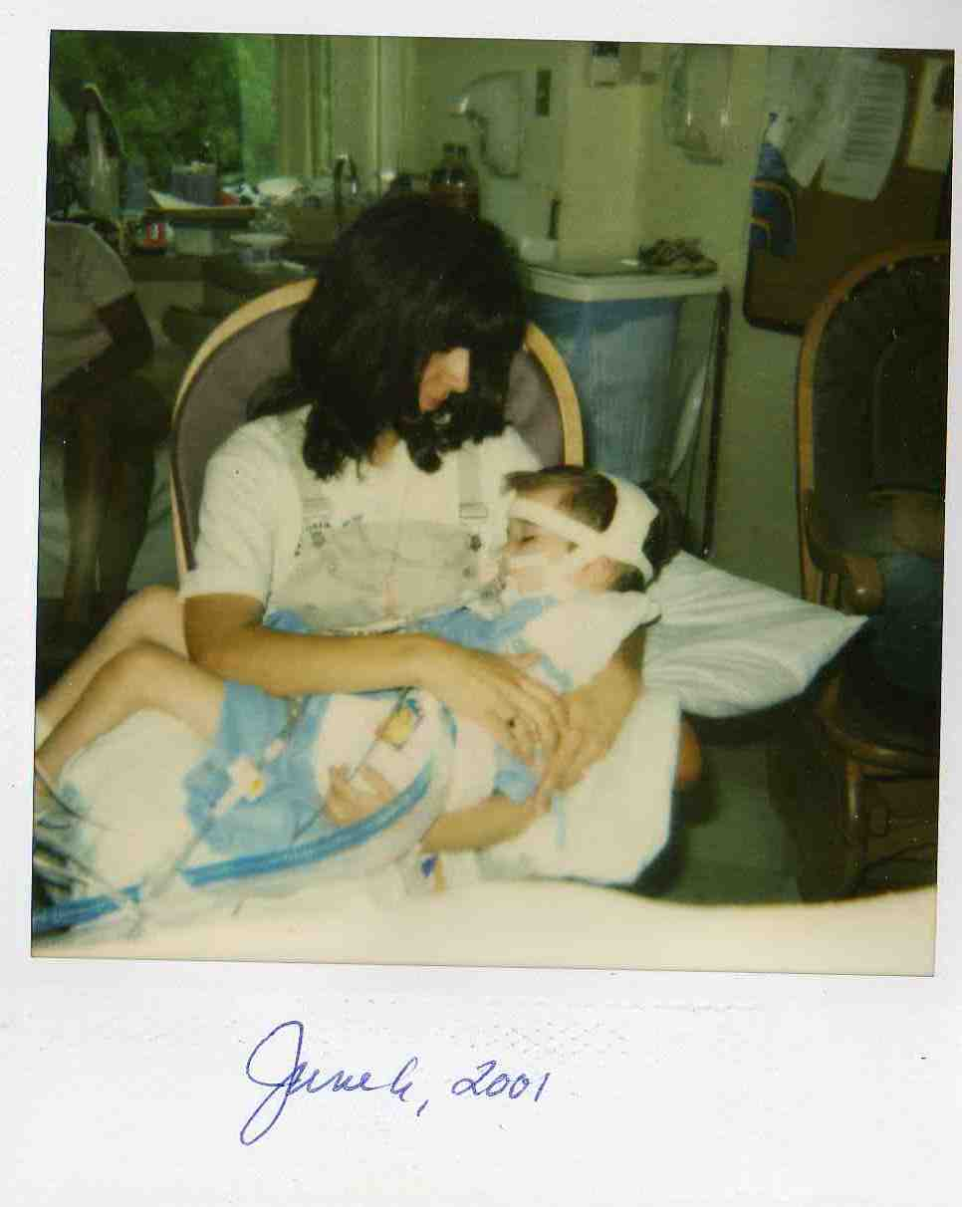
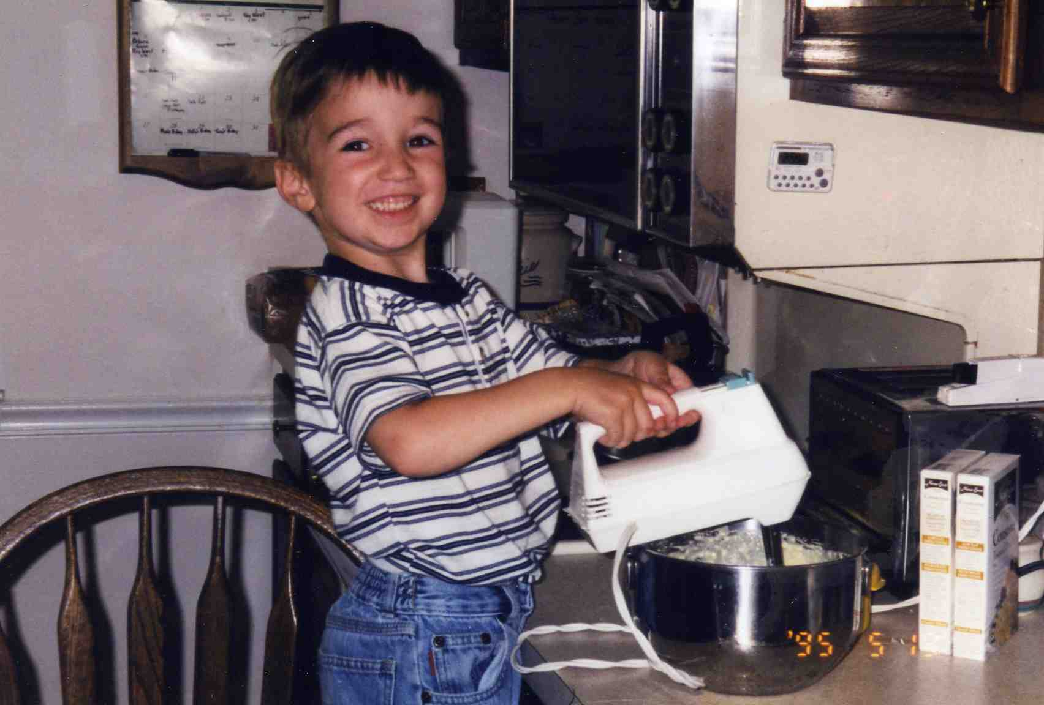
Monaco Story

Slide 4
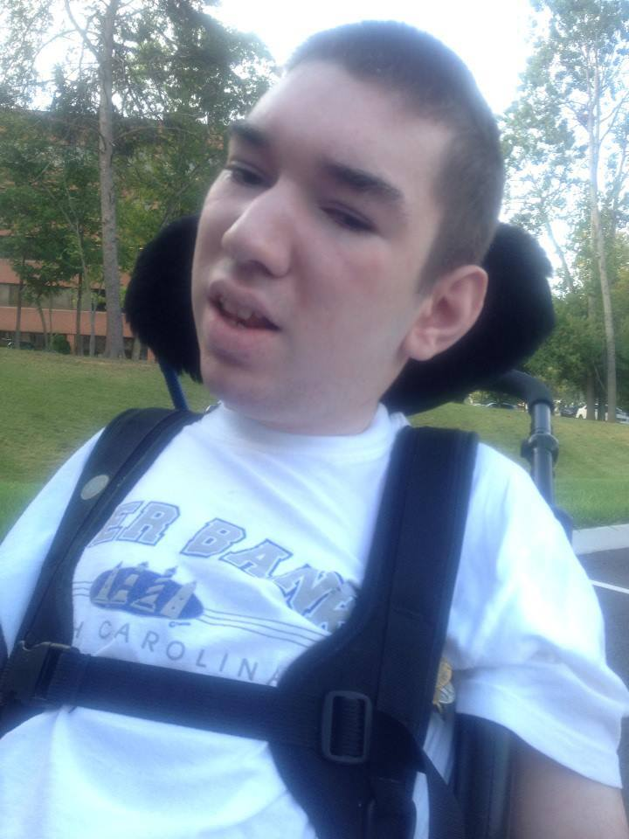
Stephen Monaco

Slide 5
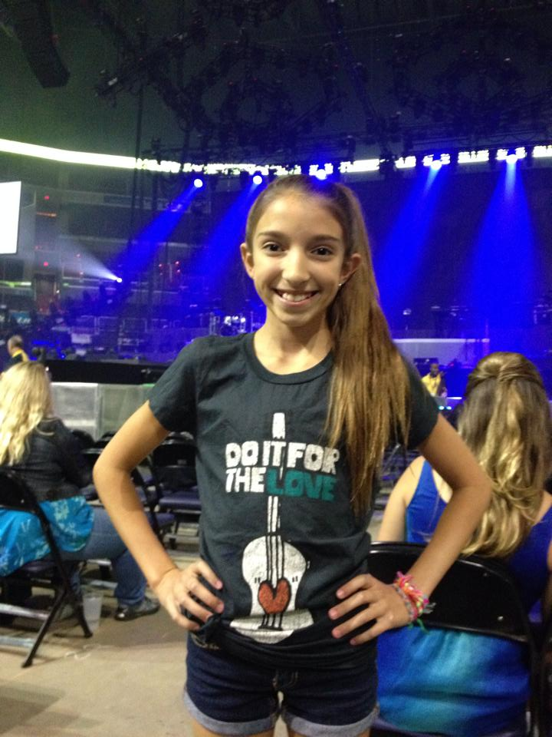
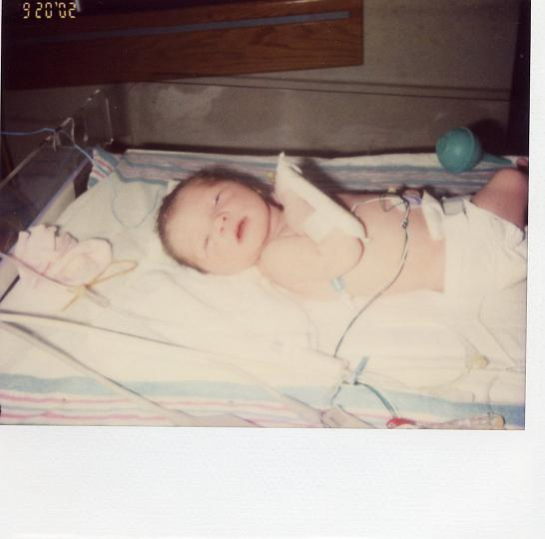
Caroline Monaco

Slide 6
Organic Acidemia Association
We are a volunteer non-profit organization whose mission is to empower families and health care professionals with knowledge in organic acidemia metabolic disorders. We support early intervention through expanded newborn screening, solicit contributions and distribute funding that supports research toward improved treatment and eventual cures in the areas of Organic Acid disorders.

Slide 7
Personal Benefits
Life saving
Have a common bond
Learn from one another
Trust
Understanding
Connection to larger organizations like NORD
Path to advocacy

Slide 8
Patient Advocacy Groups
Patient engagement
Patients come to them for emotional support diagnosis is scary
Knowledge
Day to day support : multiple layers, ie education, finance, guardianship,
Improve disease management
Link to research and latest news on disease or disorder
access to care, policy issues, and medical advances.
Trust
Access to medical supplies, medication
Access to medical experts-medical board of directors

Slide 9
Discussion Points
Collaboration
Ease of recruitment and retention
EMR data collection-families assume this is happening
patients want the end result-new drug development
Can’t assume costs for new drugs

Slide 10
Patient Barriers for Research Studies
Lack of awareness of studies-some clinicians don’t bring them to their attention
Study not proven beneficial to patient
Physical barriers –inaccessibility; can’t travel,etc.
No local studies

Slide 11
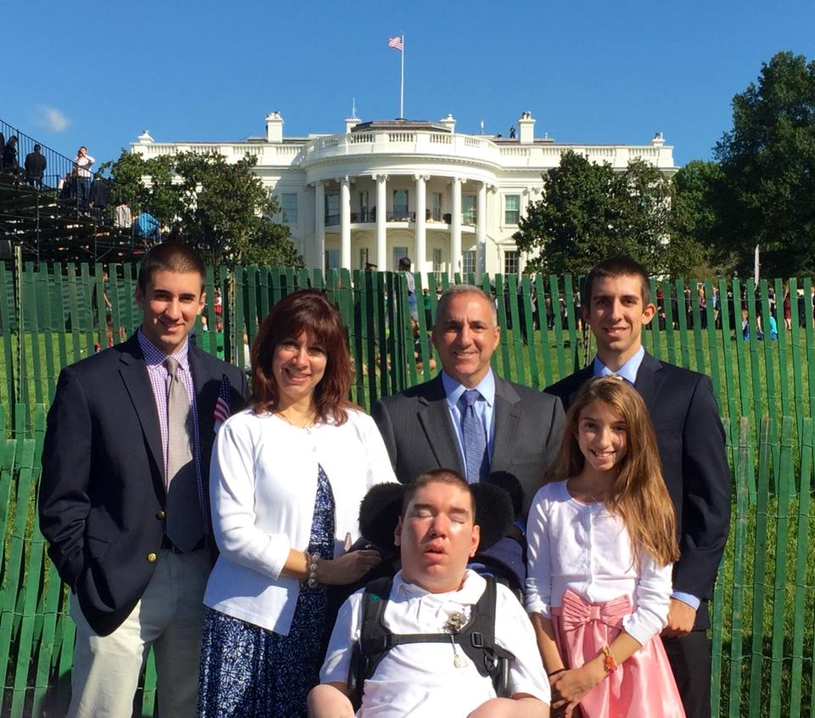
Family of Rare Disease

