Slide 1

Rare Disease Policy and Advocacy
RDCRN Certificate Program In-Person Meeting
September 29-30, 2015
Paul Melmeyer
Associate Director of Public Policy
www.rarediseases.org

Slide 2
Overview
Introduction to NORD and Rare Diseases
NORD’s Offerings for Researchers and Physicians
Review of Government Structure and Processes
Congress and Healthcare
The Executive Branch and Healthcare
History of Rare Disease Policy
The 21st Century Cures Act
How you can help

Slide 3
Introduction to NORD and Rare Diseases

Slide 4
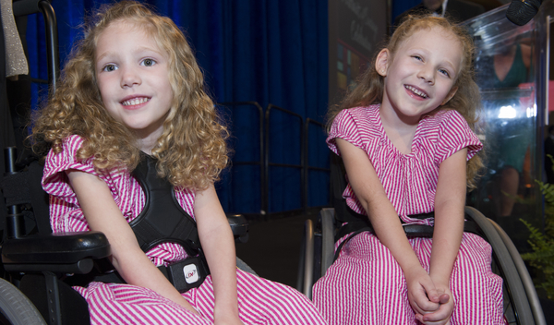
Facts About Rare Diseases
There are an estimated 7,000 rare diseases
1 in 10 or nearly 30 million Americans have one or more rare diseases
A rare or “orphan” disease in the US affects less then 200,000 people in a year
Two-thirds of people with rare diseases are children
80% of rare diseases have a genetic component
Orphan drugs are drugs used to treat rare diseases
Only about 350 diseases have an FDA approved treatment

Slide 5
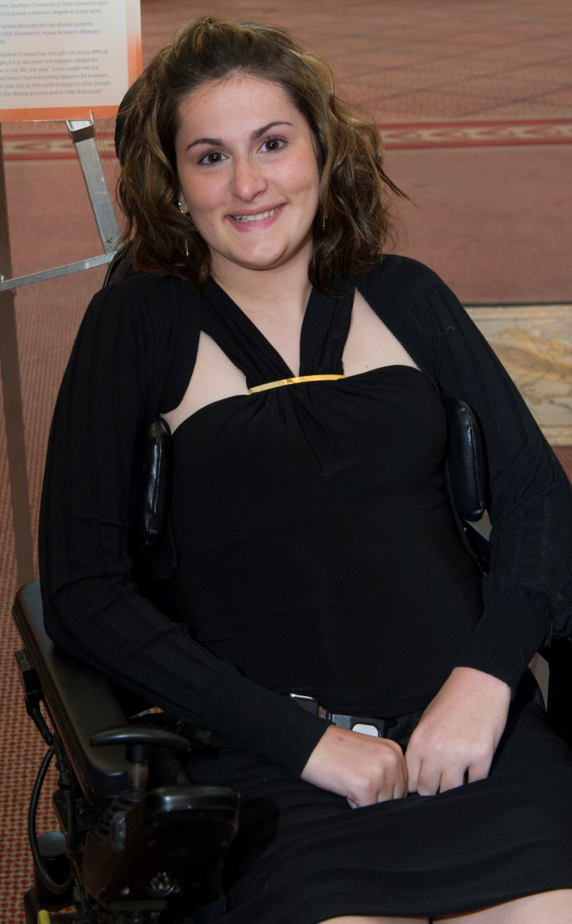

Experience of Patients
It can take years for patients to obtain an accurate diagnosis
There are limited treatment options for most rare diseases
Lack of knowledge among many medical professionals
Treatments are generally more expensive than for regular diseases
Reimbursement issues related to private insurance, Medicare and Medicaid

Slide 6
Our History
In the decade before 1983, only 10 new treatments were brought to market by industry for diseases that today would be defined as rare.
Leaders of rare-disease patient organizations began to realize that there were certain problems their patients and families shared…problems that were common to all people with rare diseases.
The Orphan Drug Act passed in 1983 and the patient leaders who had worked to bring national recognition to the problem founded NORD as an umbrella organization to represent the rare disease community.
Today, NORD provides information, advocacy, research, and patient services to help all patients and families affected by rare diseases.
A small story in the LA Times led to an episode on a popular TV show, Quincy ME. Then letters began to arrive from people all over the nation who had rare diseases and thought they were alone in their struggles.

Slide 7
Our Mission
The National Organization for Rare Disorders (NORD), a 501(c)(3) organization, is a unique federation of voluntary health organizations dedicated to helping people with rare "orphan" diseases and assisting the organizations that serve them. NORD is committed to the identification, treatment, and cure of rare disorders through programs of education, advocacy, research, and service.

Slide 8
Our Vision
NORD’s vision and guiding principles on which our advocacy initiatives are based:
A national awareness and recognition of the challenges faced by people living with rare diseases and the associated costs to society.
A nation where people with rare diseases can secure access to diagnostics and therapies that extend and improve their lives.
A social, political, and financial culture of innovation that supports both the basic and translational research necessary to create diagnostic tests and therapies for all rare disorders.
A regulatory environment that encourages development and timely approval of safe and effective diagnostics and treatments for patients with rare diseases.

Slide 9

Major NORD Programs and Initiatives
Policy and regulatory advocacy
State advocacy and alliance partnerships
Patient representation (FDA, NIH, SSA)
Education (patients, professionals, public)
Mentoring (patient organizations)
Patient assistance programs
Patient Networking (disease specific meetings, online communities, creation of new patient organizations)
Increase disease understanding (Research grants, patient registries)
International Partnerships
US Sponsor of International Rare Disease Day

Slide 10
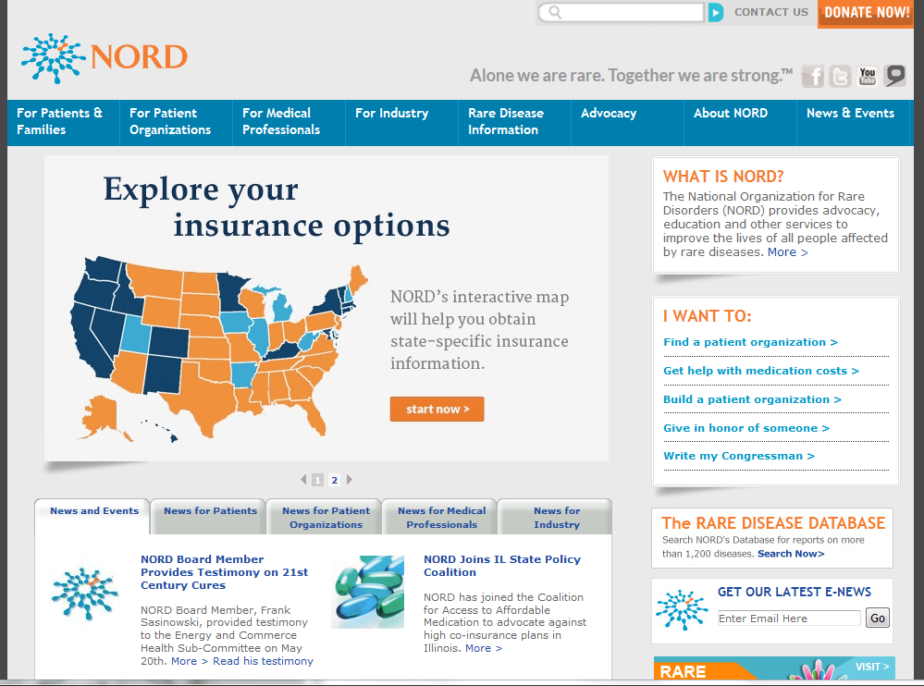
Rarediseases.org

Slide 11
Social Media
NORD Facebook
  facebook.com/NationalOrganizationforRareDisorders
NORD Twitter
  @RareDiseases
YouTube
  youtube.com/user/raredisorders
Linked-In
  http://www.linkedin.com/groups/Friends-National-Organization-Rare-Disorders-4239161
  http://www.linkedin.com/company/national-organization-for-rare-disorders
Rare Disease Day Twitter
  @RareDayUS
Rare Disease Day Facebook
  facebook.com/RareDiseaseDay.US

Slide 12
NORD’s Offerings for Researchers and Physicians

Slide 13
NORD’s Registry Program
Empowering disease-specific advocacy organizations to launch patient reported outcome registries to gain a better understanding of rare diseases.
  Patients can revoke consent and remove data at anytime
  Patient organizations encouraged to facilitate data sharing
Collaborating with the FDA to ensure quality and interoperability

Slide 14
NORD’s Research Grant Program
Provides seed grants to academic scientists for translational or clinical studies related to development of potential new diagnostics or treatments for rare disease.
At least two FDA-approved orphan therapies have originated in NORD’s Research Grant Program
Both domestic and international
List of current and past recipients:
  http://rarediseases.org/for-clinicians-and-researchers/research-opportunities/research-grant-recipients/

Slide 15

NORD Physician Guides
NORD Online Physician Guides are a free, easy-to-access resource for clinicians written by medical experts to promote diagnosis and treatment for patients.
http://nordphysicianguides.org/

Slide 16
NORD Rare Disease Database
Provides brief introductions for patients and their families to more than 1,200 rare diseases
Developed through collaborations with medical experts
Information includes:
  Signs and symptoms
  Causes
  Affected populations
  Available therapies
  Supporting organizations

Slide 17
NIH Undiagnosed Disease Program Patient Assistance Program
Provides financial support for diagnostic testing required for applicants to the program when patients' insurance wouldn't cover this testing and the patients couldn't afford it
Patients will be referred to us from the six new satellite centers currently being established for the NIH Undiagnosed Diseases Program
Funded by volunteer Boston Marathon runners from Genzyme

Slide 18
Review of Government Structure and Processes

Slide 19
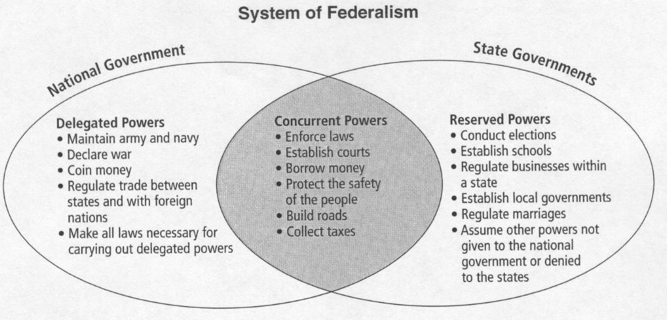
System of Federalism

Slide 20
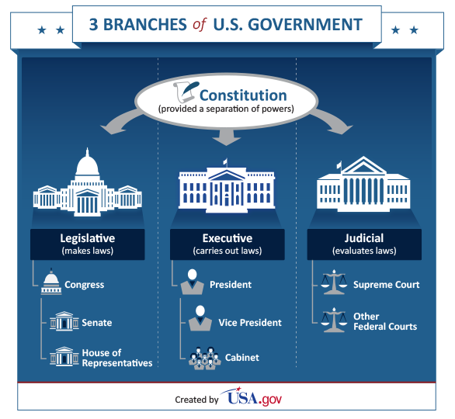
The Federal Government

Slide 21
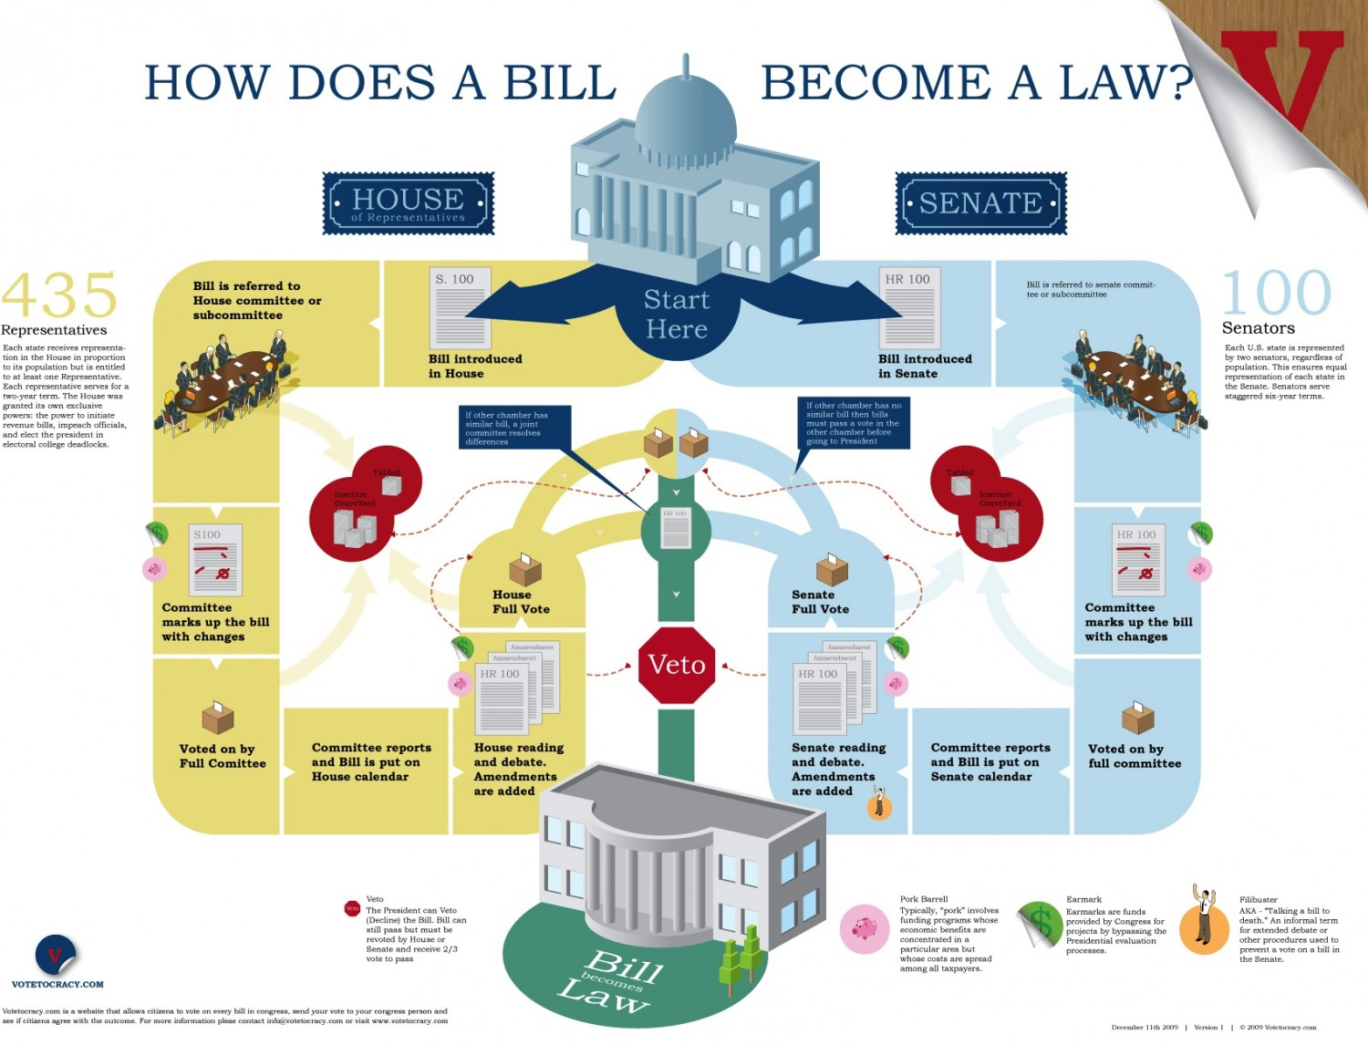
Legislative Process

Slide 22
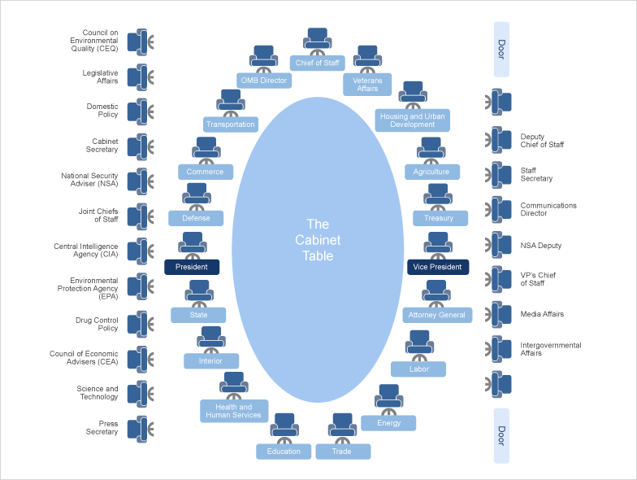
Executive Branch: The Cabinet

Slide 23
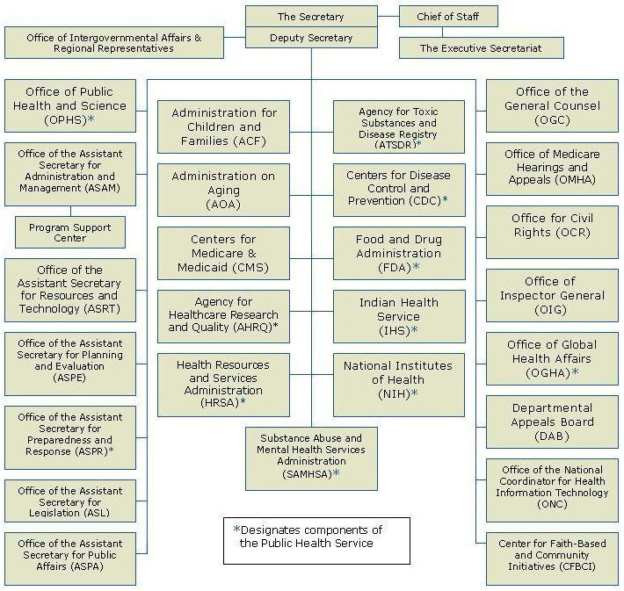
Department of Health and Human Services

Slide 24
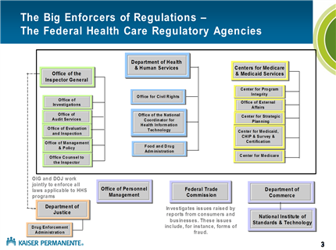
Healthcare Regulatory Agencies

Slide 25
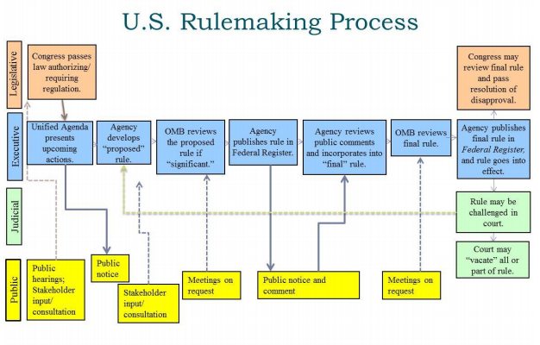
Regulatory Process

Slide 26
The State Governments
Policies under the States’ jurisdiction include:
  Health Insurance
    Individual Plans
    Employer-sponsored insurance
  Medicaid Programs
  Long-term care
  Hospital and care facilities accreditation and review
  Newborn Screening
  Genetic Testing
  Many other healthcare regulation that does not cross state lines

Slide 27
Congress and Health Care

Slide 28
The Committees of Jurisdiction: Senate
Health, Education, Labor, and Pensions Committee
  Jurisdiction over most of the agencies, institutes, and programs of the Department of Health and Human Services,
    Food and Drug Administration
    Centers for Disease Control and Prevention
    National Institutes of Health,
    Administration on Aging
    Substance Abuse and Mental Health Services Administration
    Agency for Healthcare Research and Quality
Finance
  Jurisdiction over health programs under the Social Security Act and health programs financed by a specific tax or trust fund.
    Centers for Medicare and Medicaid Services [Medicare Parts A & B; Medicare Advantage (Part C); Medicare Drug Benefit (Part D); Medicaid; Children’s Health Insurance Program]
    Administration for Children and Families

Slide 29
The Committees of Jurisdiction: Senate
Appropriations
  Appropriates funds that are authorized by the authorizing committees
Armed Services
  Military health research
  Health insurance for military members and their families
Commerce, Science, and Transportation
  Science, engineering, and technology research and development and policy.
Homeland Security and Governmental Affairs
  Health insurance for government employees
Veterans’ Affairs
  The Veterans’ Administration and the VA healthcare system

Slide 30
The Committees of Jurisdiction: House
Energy and Commerce
  Jurisdiction over most of the agencies, institutes, and programs of the Department of Health and Human Services,
    Food and Drug Administration
    Centers for Disease Control and Prevention
    National Institutes of Health,
    Administration on Aging
    Substance Abuse and Mental Health Services Administration
    Agency for Healthcare Research and Quality
    Centers for Medicare and Medicaid Services
  Private health insurance
  Health IT
  Medical malpractice
  Public Health

Slide 31
The Committees of Jurisdiction: House
Ways and Means
  “The jurisdiction shall include bills and matters referred to the Committee on Ways and Means that relate to programs providing payments (from any source) for health care, health delivery systems, or health research. More specifically, the jurisdiction of the Subcommittee on Health shall include bills and matters that relate to the health care programs of the Social Security Act (including titles V, XI (Part B), XVIII, and XIX thereof) and, concurrent with the full Committee, tax credit and deduction provisions of the Internal Revenue Code dealing with health insurance premiums and health care costs.

Slide 32
The Committees of Jurisdiction: House
Appropriations
  Appropriates funds that are authorized by the authorizing committees
Armed Services
  Military health research
  Health insurance for military members and their families
Science, Space, and Technology
  Science, engineering, and technology research and development and policy.
Oversight and Government Reform
  Health insurance for government employees
Veterans’ Affairs
  The Veterans’ Administration and the VA healthcare system

Slide 33
The Executive Branch and Health Care

Slide 34
Food and Drug Administration
Center for Drug Evaluation and Research
  Primary Responsibility: Reviews applications for new drugs
  Office of Rare Diseases
Center for Biologics Evaluation and Research
  Primary Responsibility: Reviews applications for new drugs
Center for Device and Radiological Health
  Primary Responsibility: Reviews applications for new medical devices and diagnostics
  Patient Engagement Advisory Committee
Office of Orphan Product Development

Slide 35
National Institutes of Health
27 Institutes and Centers (ICs)
  24 ICs Provide Separate Funding for Research Projects and Activities
Conduct both extramural and intramural research
NCATS
Office of Rare Diseases Research

Slide 36
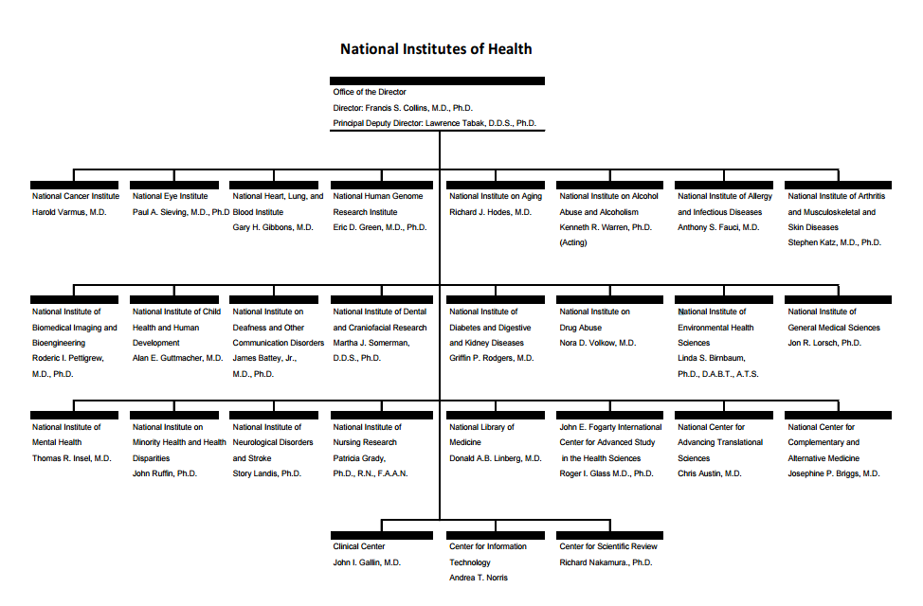

Slide 37
Additional Agencies and Entities
Centers for Disease Control and Prevention
Centers for Medicare and Medicaid Services
Health Resources and Services Administration
Agency for Healthcare Research and Quality's
Patient Centered Outcomes Research Institute (PCORI)
Social Security Administration
Various other HHS agencies

Slide 38
A Brief History of Rare Disease Policy

Slide 39
The Orphan Drug Act
  In the decade before 1983, only 10 new treatments were brought to market by industry for diseases that today would be defined as rare.
  A total of 38 orphan therapies approved by the FDA

Slide 40
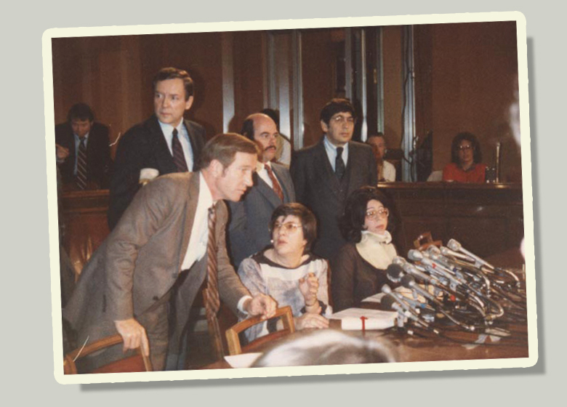
The Orphan Drug Act
Leaders of rare-disease patient organizations began to realize that there were certain problems their patients and families shared…problems that were common to all people with rare diseases.

Slide 41

The Orphan Drug Act
On January 4th, 1983, the Orphan Drug Act was signed by President Ronald Reagan

Slide 42
The Orphan Drug Act
Orphan Drug Designation:
  FDA determines whether the drug is “intended to treat a rare disease or condition”.
  Defined by:
    “Affects less than 200,000 people in the U.S.
  Once designated, patent protection!
    The FDA grants 7 years of patent protection to the drug
      The FDA cannot approve the “same drug” from another company

Slide 43
The Orphan Drug Act
The Orphan Products Grant Program
  “The goal of the Orphan Products Grants Program is to encourage clinical development of products for use in rare diseases or conditions. The products studied can be drugs, biologics, medical devices, or medical foods.”
  The Orphan Products Grant Program since 1983 has:
    Received over 1800 applications
    Reviewed over 1400 applications
    Funded over 500 studies
    45 drugs on the market originated from the Orphan Grants Program

Slide 44
The Orphan Drug Act
Orphan Drug Tax Credit (ODTC):
  Allows companies to claim a tax credit of up to 50% of their qualified clinical testing expenses.
  Not all companies opt to take the ODTC, instead choosing to take the R&D credit

Slide 45
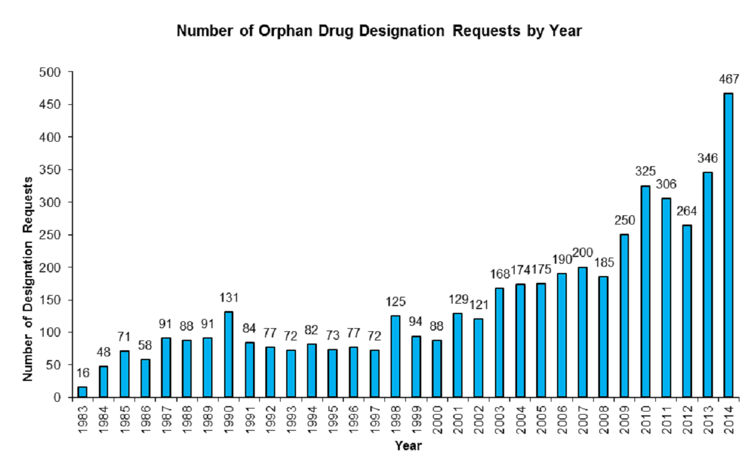
The Orphan Drug Act
Has it worked? Yes!
                FDA Law Blog

Slide 46
The Rare Diseases Act
Two Key Provisions:
  Establishment of the Office of Rare Diseases at the NIH
  Establishment of the Rare Disease Regional Centers of Excellence

Slide 47
The Rare Diseases Act
The NIH Office of Rare Diseases:
  Recommends an agenda for conducting and supporting research on rare diseases through the national research institutes and centers.
  Promote coordination and cooperation among the national research institutes and centers and entities whose research is supported by such institutes
  Enter into cooperative agreements with and make grants for regional centers of excellence on rare diseases
  Promote the sufficient allocation of the resources of the National Institutes of Health for conducting and supporting research on rare diseases.
  Promote and encourage the establishment of a centralized clearinghouse for rare and genetic disease information

Slide 48
The Rare Diseases Act
Rare Disease Regional Centers of Excellence:
  “The NIH will enter into cooperative agreements with and make grants to public or private nonprofit entities to pay all or part of the cost of planning, establishing, or strengthening, and providing basic operating support for regional centers of excellence for clinical research into, training in, and demonstration of diagnostic, prevention, control, and treatment methods for rare diseases.”

Slide 49
Incentives by Exemption
FDA User Fees
Annual Fee on Branded Prescription Drug Manufacturers and Importers
The 340B Program
Notes:
FDA User Fees
“The Prescription Drug User Fee Act (PDUFA) was created by Congress in 1992 and authorizes FDA to collect fees from companies that produce certain human drug and biological products. Since the passage of PDUFA, user fees have played an important role in expediting the drug approval process.” – FDA website
FY2015 User Fees –
$2,335,200 for an application requiring clinical data
$1,167,600 for an application not requiring clinical data or a supplement requiring clinical data
$569,200 for an establishment
$110,370 for a product
Annual Fee on Branded Prescription Drug Manufacturers and Importers
Passed under the Patient Protection and Affordable Care Act (ACA)
Fee calculation available at: http://www.irs.gov/Businesses/Corporations/Annual-Fee-on-Branded-Prescription-Drug-Manufacturers-and-Importers
Orphan products are exempt
The 340B Program
Requires drug manufacturers to provide outpatient drugs to health care organizations (usually hospitals) that treat specific, disadvantaged communities at a discounted price.
Orphan drugs are exempted from the required discounted pricing.

Slide 50
Incentive by Expedited FDA Review
Priority Review (1992)
Fast Track (1997)
Accelerated Approval (1992, amended in 2012)
Breakthrough Therapy (2012)
Rare Pediatric Disease Priority Review Voucher Program (2012)
Notes:
A drug that treats a serious condition and would make a significant improvement in safety or effectives.
Qualified Infectious Disease Product
Shorter clock for review of marketing application (6 months instead of 10 months)
Most rare diseases qualify
Fast Track (1997)
A drug intended to treat a serious condition and meets an unmet medical need
Also qualified infectious disease
Rolling review
Again, most rare diseases qualify
Accelerated Approval (1992, amended in 2012)
A drug intended to treat a serious condition and provides a meaningful improvement over available therapies AND uses a surrogate endpoint or early clinical endpoint.
Many rare disease therapies qualify
Breakthrough Therapy (2012)
A drug intended to treat a serious condition and may demonstrate a substantial improvement on a clinically significant endpoint
FDA offers intensive guidance on drug development, rolling review, and a “all hands on deck” approach.
Many rare disease therapies qualify
Rare Pediatric Disease Priority Review Voucher Program (2012)
FDA Priority Review Voucher given to a company that develops a treatment for a rare pediatric disease currently without a treatment
Two companies have sold their vouchers for $67.5 million and $125 million respectively

Slide 51
21st Century Cures Act

Slide 52
21st Century Cures
Chairman Fred Upton (R-MI) & Diana DeGette (D-CO)
Discovery: clues in basic science
Development: Streamlining the drug & device development process
Delivery: unleashing the power of digital medicine & social media
http://energycommerce.house.gov/cures

Slide 53
21st Century Cures
What’s in the Bill?
  Additional NIH Funding – NIH Innovation Fund
  Natural history registries for rare diseases
  Precision Medicine Initiative Funding
  Support for young “emerging” scientists
  Greater coordination of pediatric research
  Capstone Grant program
  Various FDA reforms
Next stop: The Senate

Slide 54
How can you help?

Slide 55
How can you help?
Speak up!
You have the “on-the-ground” experience of what works and what does not.
  Congress clamors for this expertise
You and your patients are the experts in the rare diseases you treat.
No one is against pro-rare disease policy.
  It is all about priority setting.

Slide 56
Thank You! pmelmeyer@rarediseases.org

