Slide 1
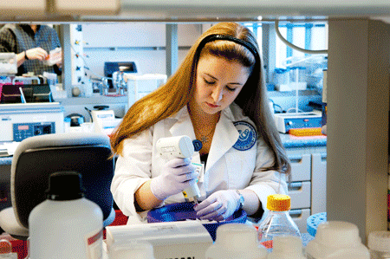

Career Development Plan: the cornerstone of the K award
Paula Gregory, Ph.D.

Slide 2


Slide 3

What is unique about the K awards?
  The candidate and career plan are about a third of what is scored

Slide 4
NIH Career Development Awards
K series of awards
Lead to independent research career
Provide additional training and intense mentoring
  strong mentor key to successful application
Provide 3-5 years of partial salary support and limited research funding
75% protected time for research
  Must be feasible/supported by department

Slide 5
Types of K Awards
There are 14 different types of K awards
Mentored (KO1, KO8,KO7, K12, K23, K99)
Independent (KO2,K22, and ROO)
Mid-Career (K24)
Supports clinicians and basic scientists
Spans from senior postdoc to junior faculty
EVERY INSTITUTE USES THE K MECHANISM A LITTLE DIFFERENTLY

Slide 6
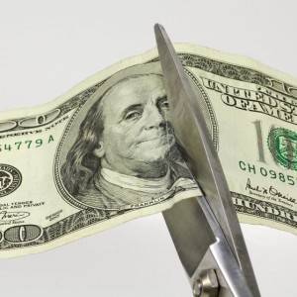
In the current budget climate, even the best grants may not be funded on the first submission!

Slide 7

Timeline for the application

Slide 8

My suggested timeline
Identify appropriate mechanism and make decision to apply 6 months prior to submission deadline
Print and highlight the K Award instructions
Check out other Ks http://projectreporter.nih.gov/reporter.cfm

Slide 9


Slide 10
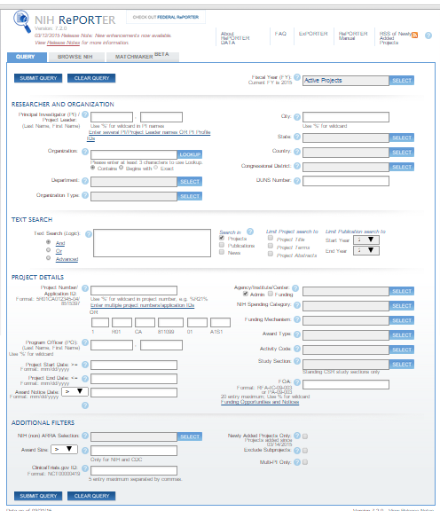
RePORTer allows you to search all NIH funded grants (current & past)

Slide 11
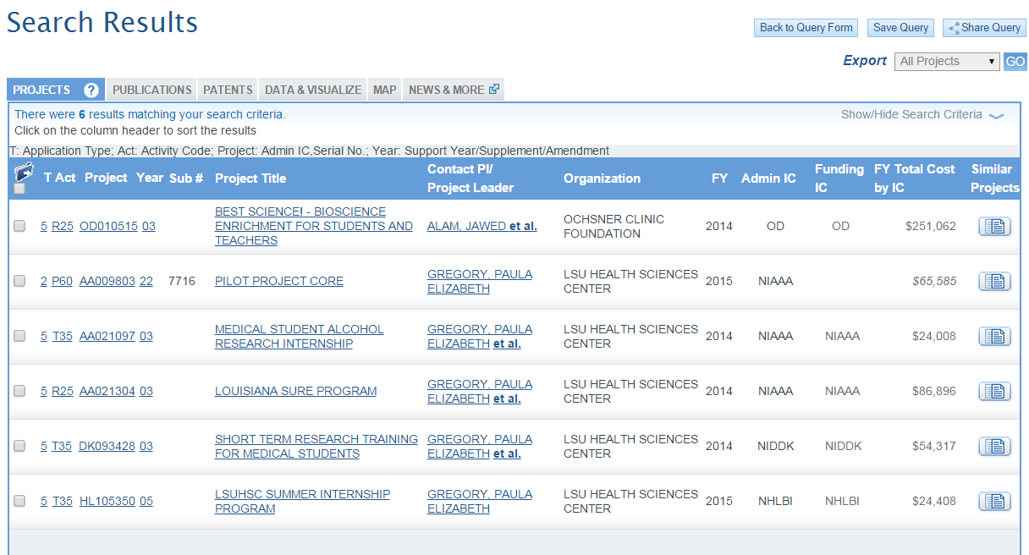

Slide 12
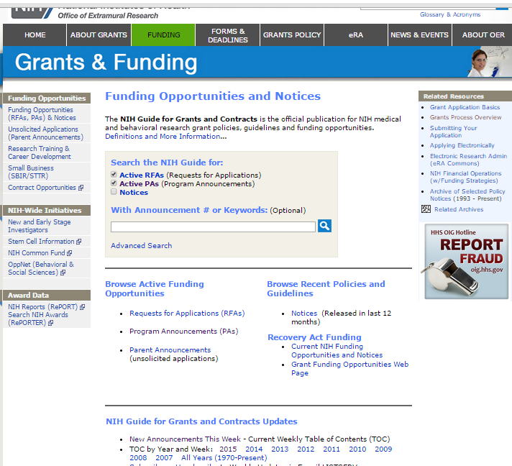

Slide 13
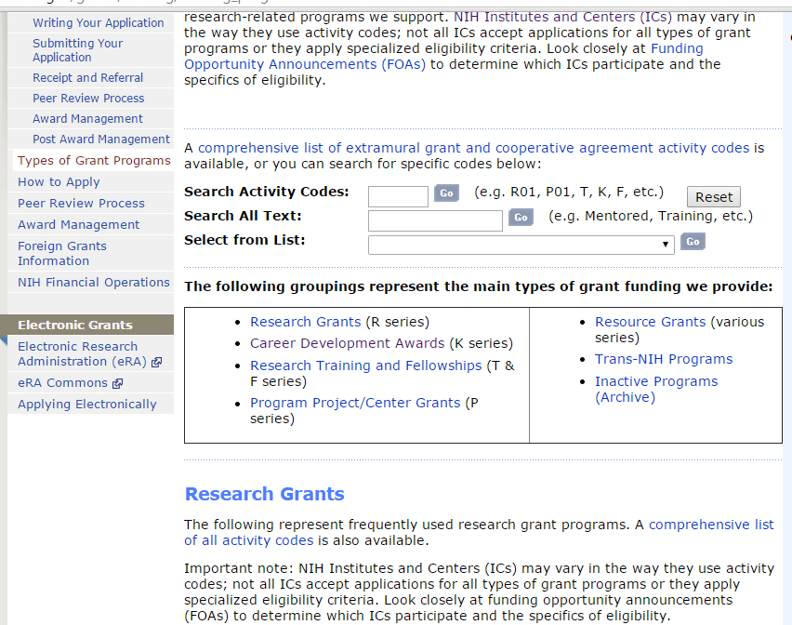

Slide 14
NIH Grant Funding Success Rates
Look at the last four years of funded projects (remember, 2012 the government shutdown)
Compare success rates for different funding mechanisms
Compare success rates for different institutes (same mechanism)
Be sure to check any “unique” rules about that funding mechanism that are unique to one institute.

Slide 15
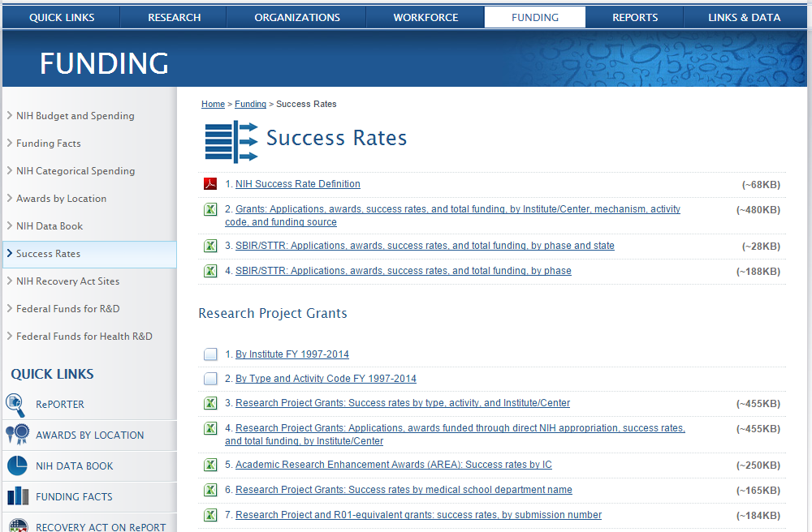

Slide 16
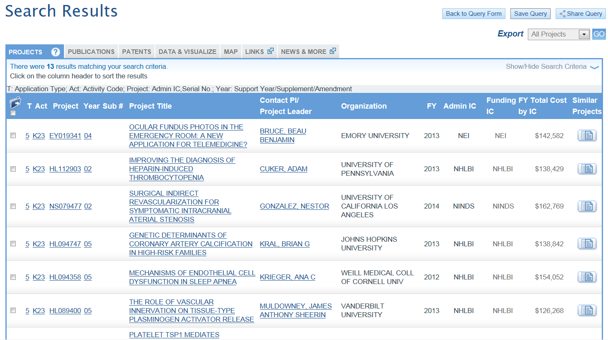
http://projectreporter.nih.gov/reporter.cfm

Slide 17

The Career Development Plan
Candidate Background
Career Goals and Objectives
Career Development/training Plan
Mentor letters
Biosketch (new format)

Slide 18
Candidate Information
YOU and your mentor are the most important pieces of the application
Sell yourself!
Don’t just reiterate your Biosketch, use this section to highlight your unique qualifications
Explain why you need this award to get to the next level

Slide 19
Candidate’s Background
Describe your training which enables you to engage in this research-include examples of prior research experience (basic or clinical).
Describe evidence of productivity- abstracts, papers, awards.
Describe any formal research training-degree programs (MS, MPH) and/or courses.

Slide 20
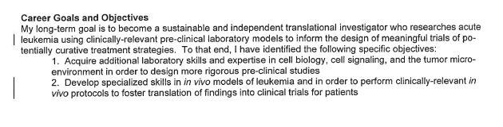
Career Goals and Objectives
The goal of the “K” is help you to transition to independent investigator, you need to reflect this goal in this section.

Slide 21
Career Development Activities During Award Period
Mentors and Mentoring Committee
Essential to demonstrate mentor has a track record of K-trainees or similar
Outside/co-mentors are allowed and may be ideal for applicants from institutions without a long K history
Clearly defined roles for the committee
  What expertise each mentor brings
Specific mentoring activities (incl in letters, too)
  How frequently will you meet
  Expectations in terms of pubs, abstracts, etc.

Slide 22
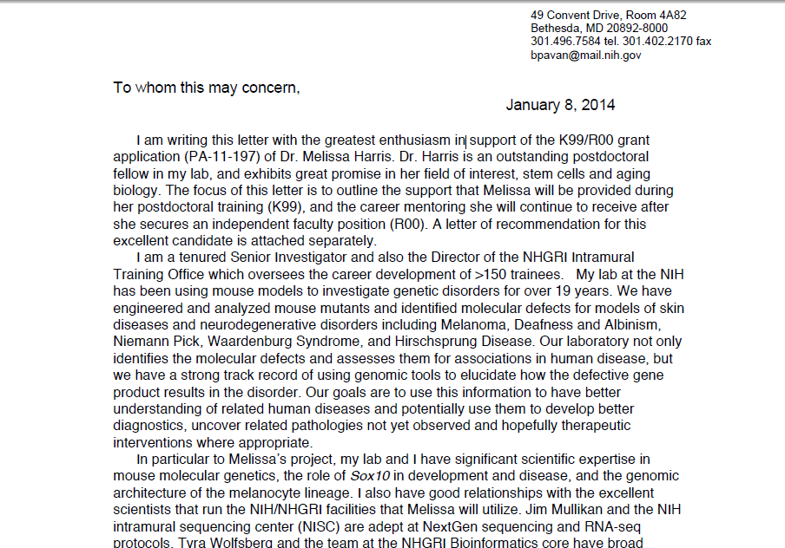
Mentor’s letter should tie in with their Personal Statement and with the Career Development Plan and with the research

Slide 23
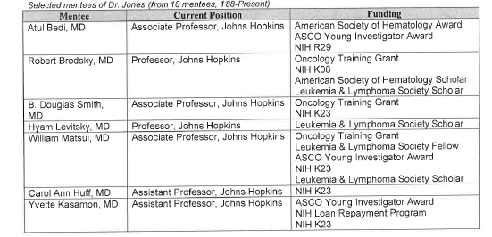
Career Development Activities During Award Period
Mentors and Mentoring Committee

Slide 24
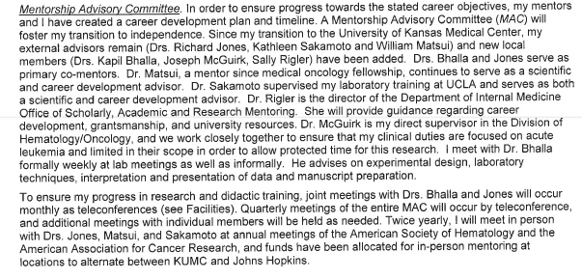
Career Development Activities During Award Period
Mentors and Mentoring Committee

Slide 25
Career Development Activities During Award Period
Education and Activities
Be specific!!
Course/course numbers/description
Conferences/seminars
  Will you attend?
  Present data locally how often?
  National presentation goals?
  Meetings with outside mentors at national meetings

Slide 26
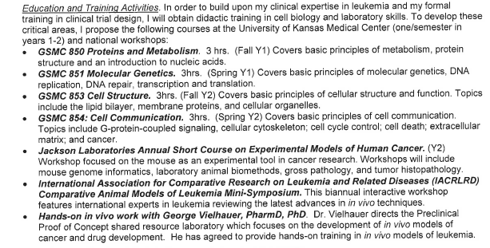
Career Development Activities During the Award Period
Education and Activities

Slide 27
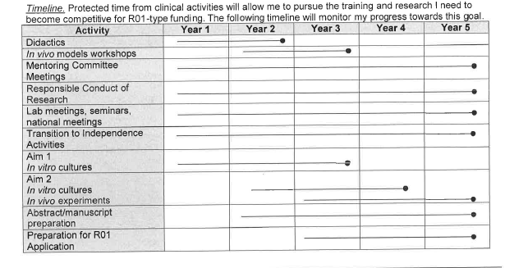
Timeline of Career Development Activities During Award Period
Weakness noted: no specific details of the intended publications

Slide 28
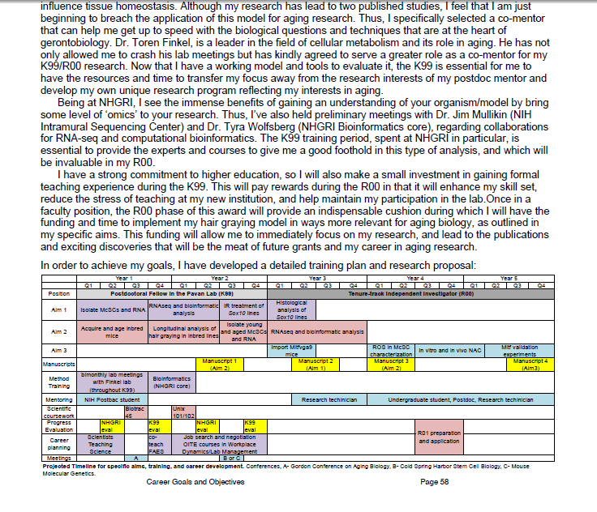
A timeline that pulls together the training and research

Slide 29
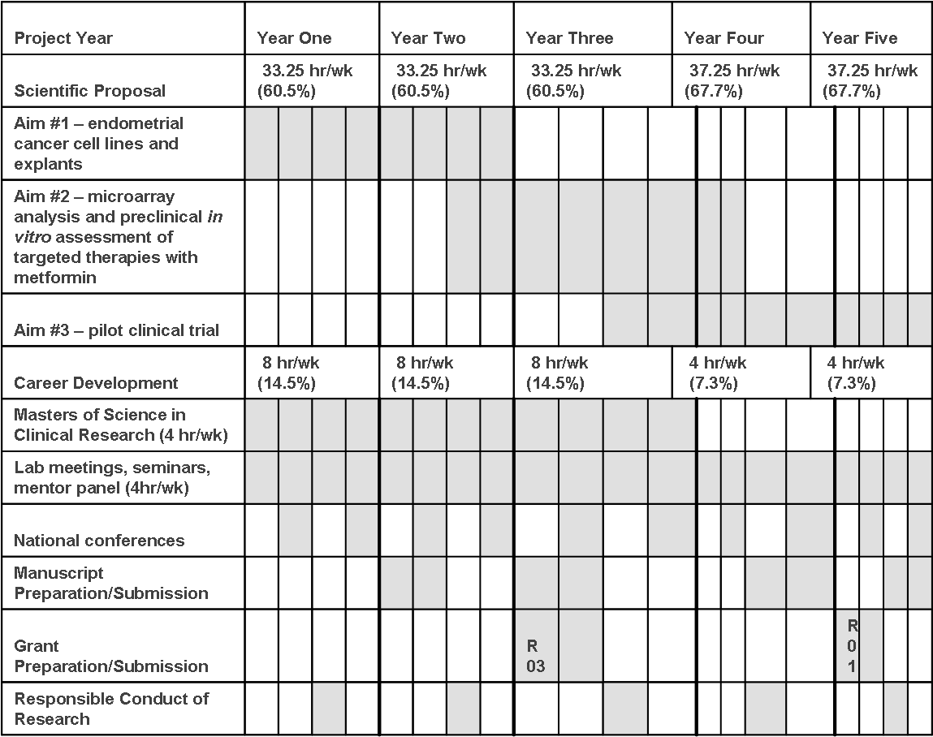
TIMELINE FOR PROPOSED K23 PERIOD

Slide 30
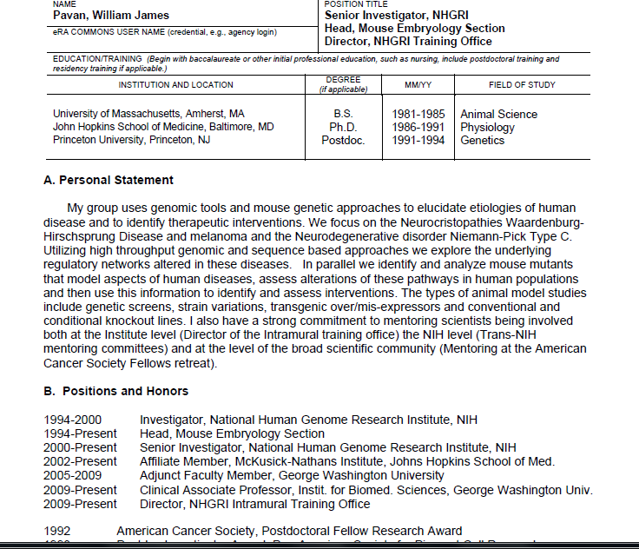
The mentor’s Personal Statement should mention their qualifications as a MENTOR

Slide 31
Changes in the NIH Biosketch
The new NIH Biosketch format must be used for due dates on/after May 25, 2015

Slide 32
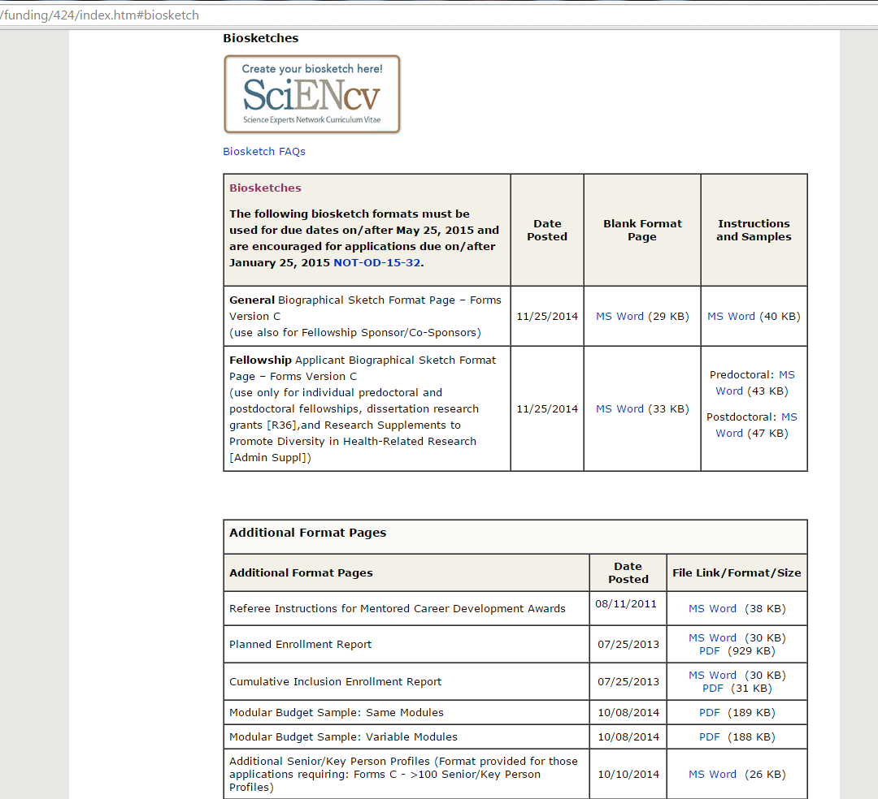

Slide 33
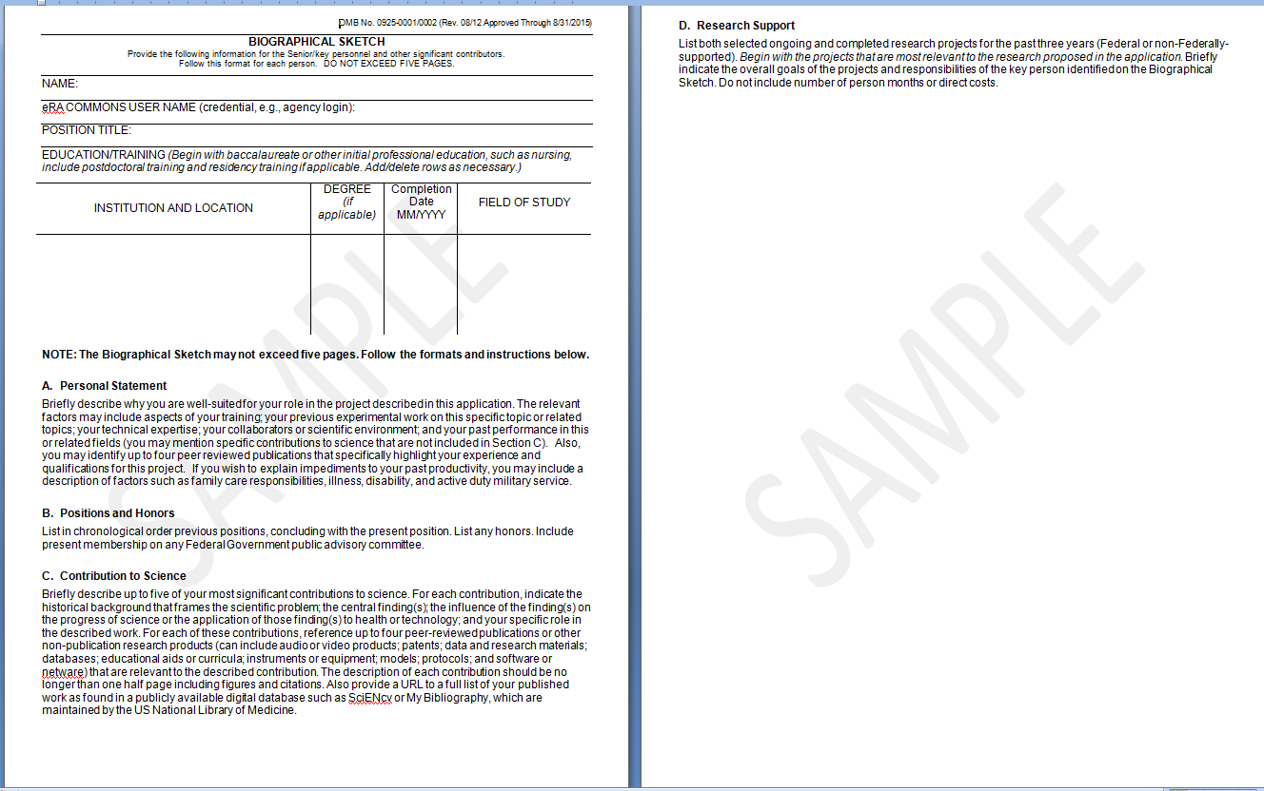

Slide 34
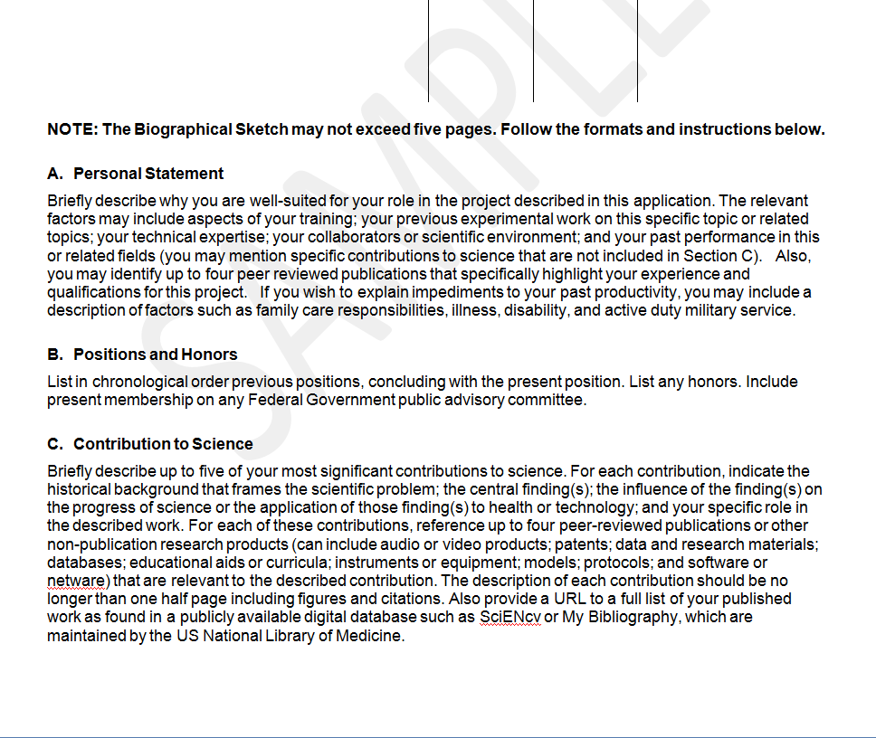

Slide 35
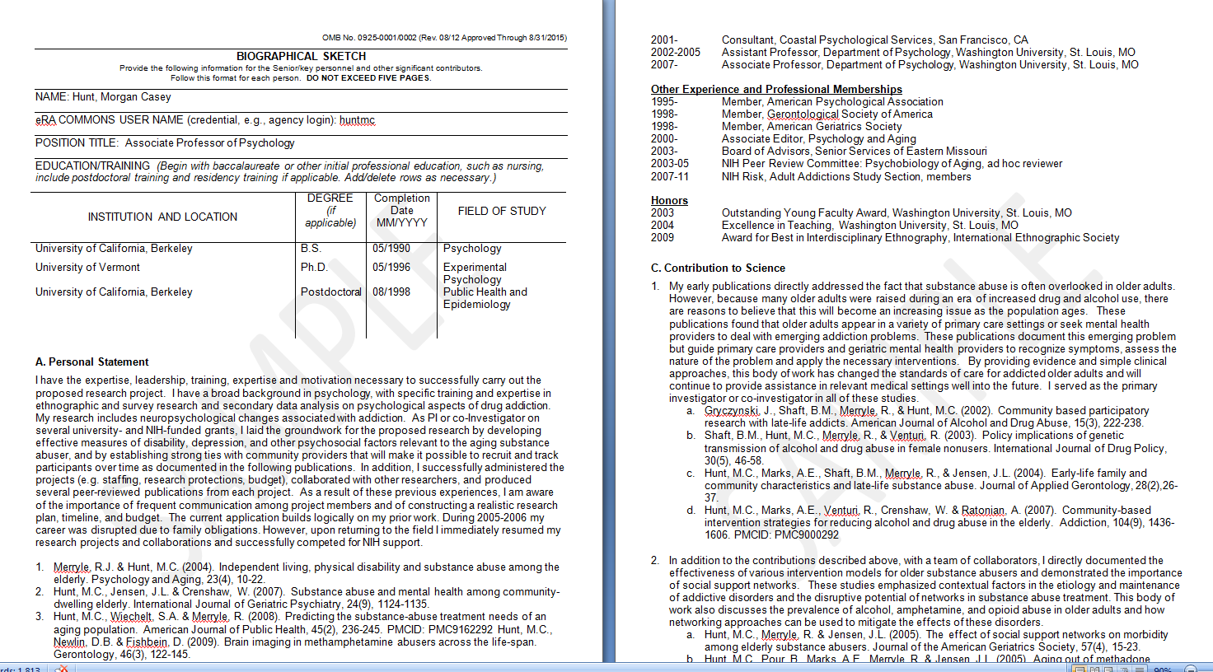

Slide 36
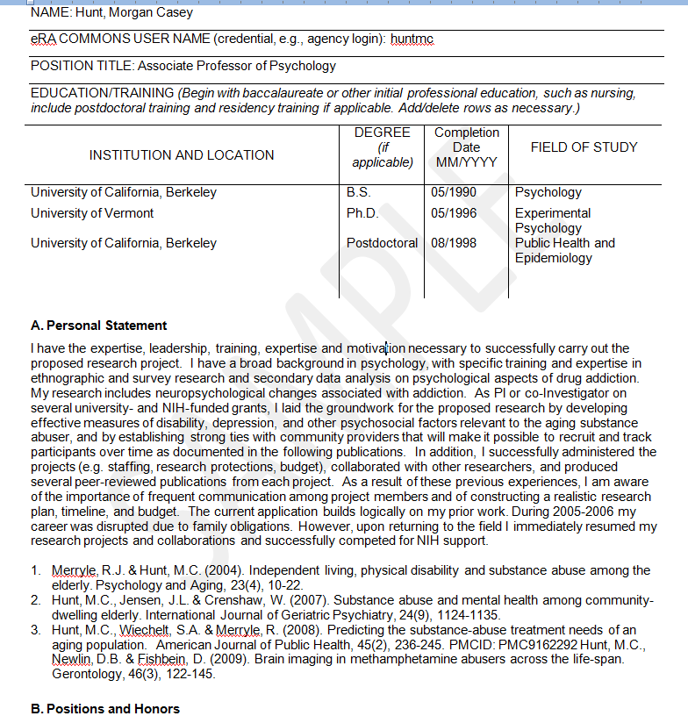

Slide 37
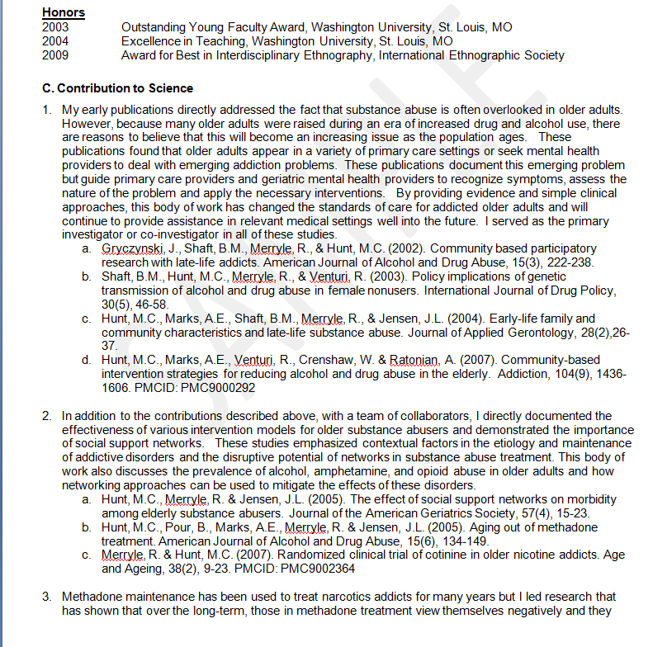

Slide 38
Research Plan
Restate what you will be doing
Always provide:
  Expected results
  Potential pitfalls/Alternative approaches
  Future work and implications
Get a statistician to help
Make it easy to see how this will roll in to an RO1 (in fact, spell it out)

Slide 39
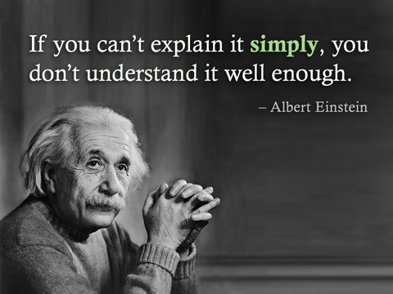

Slide 40
Research Plan
Tight, organized
Feasible, not overly ambitious
Well-defined objectives
How will this research prepare you to be an independent investigator/compete for independent funding/sustainable career?

Slide 41
Research Plan
Detail ownership
  “Our lab was the first to show….”
  “Preliminary studies by our lab”
  “These data generated by applicant”
  “These data generated from collaborator”

Slide 42
Things you need to know…
It takes a LONG time to complete the application
Leave more time for mentors to review/comment and revisions
Work with the grants office EARLY
Do not leave the random parts til the end
It’s okay to ask for help – ask for applications to read for sample language, etc.

Slide 43

Edit, edit, edit!

