Slide 1
You Have More Time Than
You Think!
Mary C. Ottolini MD, MPH, MEd
Professor of Pediatrics
Vice Chair of Education
Children’s National Medical Center and
George Washington University

Slide 2
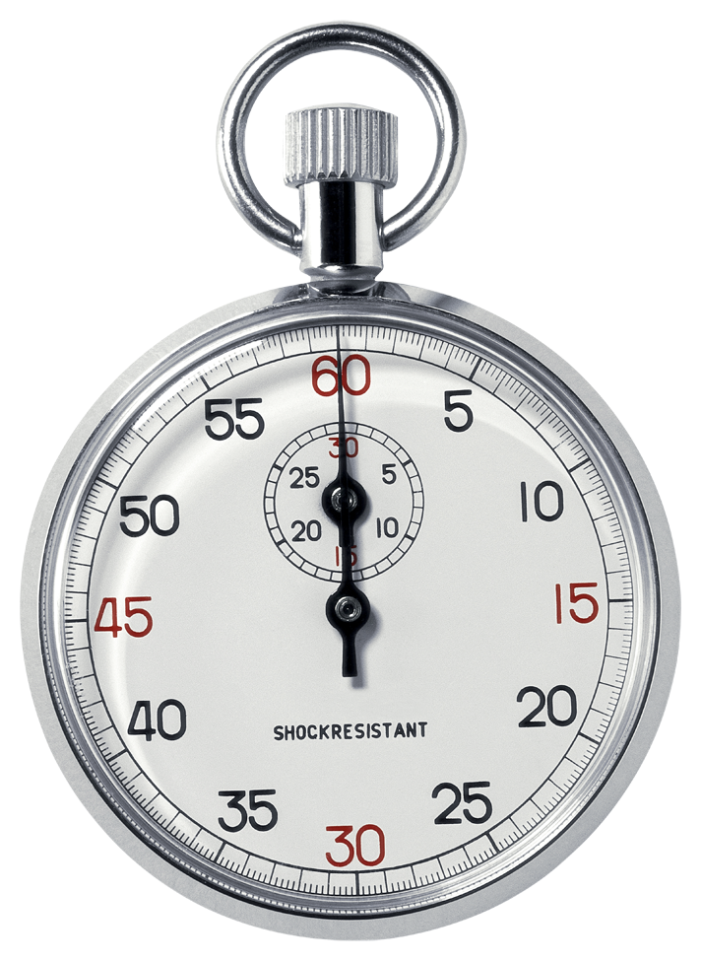
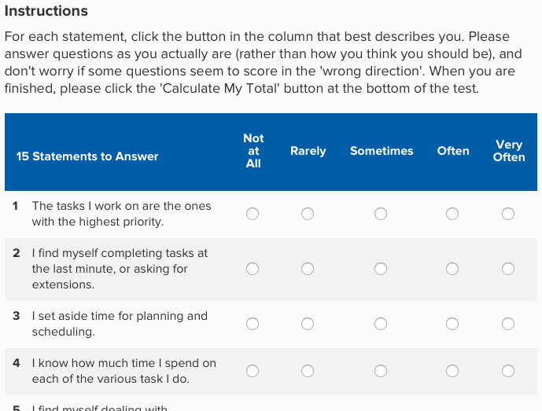
Start with a quiz
https://www.mindtools.com/pages/article/newHTE_88.htm
Notes:
Alison

Slide 3
How did you do?
15-30
31-45
46-75
Notes:
Mary

Slide 4
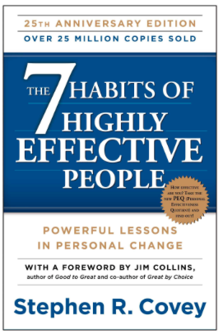
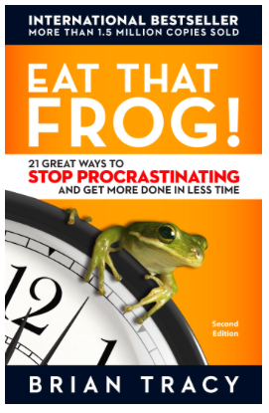
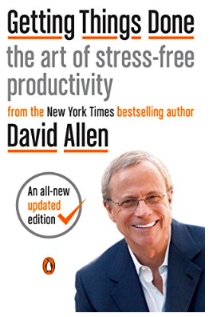
Different frameworks
Covey
Allen
Tracy
Notes:
Alison
Covey – if you find yourself spending a lot of time in things not yielding fruit for you
Adai– if you are a procrastinator
Allen—advanced– if you want to get on top of things and live more “zen”– totla time management
Read one book– stick with it– use fomr this workshop

Slide 5
If you want to lose weight, keep a food diary . . .
Time diaries
15 minutes chunks
Paper, electronic, whatever works so you can see where you are
What is my best time of day?
Things you have control over: When do I best write? Review/read? Have a meeting?

Slide 6
Covey: 7 Habits--philosophical
Be proactive
Begin with the end in mind
Put first things first
Think win-win
Seek first to understand . . .
Synergize
Sharpen the saw
Notes:
Alison: More philosophical

Slide 7
The four quadrants: Covey
I. Firefighting
II Quality time
III. Distractions
IV. Time wasters
I
M
P
O
R
T
A
N
C
E
URGENCY

Slide 8
The four quadrants: Covey
I. Firefighting:
--Urgent clinical
--Kids to bus
II Quality time
--write manuscript
--exercise
III. Distractions
--email
--interruption
IV. Time wasters
--waiting
--meetings
I
M
P
O
R
T
A
N
C
E
URGENCY

Slide 9
Worksheet 2: Time diary
Think back to your last workday—hard to do by memory– do in live time once home
Take out your calendar if you need its help
Try to remember all the silly things you did (could check your “sent folder”)
Try to fill in at least 4, if not up to 10 activities
How many clinical day? Break into chart review, rounds, billing, waiting, writing notes—any other non-clinical activities (meetings, teaching, commuting)
How many other day? Break into reading, writing, meetings, data analysis, administrative tasks (commuting, cooking, shopping)
6 minutes
Notes:
Sent folder: How many critical emails, did you batch emailinto chucnks of the day or let it interrupt you?

Slide 10
Worksheet 3: 4 quadrants
Now break it down into 4 quadrants
Place each activity into one of the 4 quadrants
Share with a neighbor
What can you do to shift away from 1 and 3 and into quadrant 2? And eliminate quadrant 4?
Notes:
Sent folder: How many critical emails, did you batch emailinto chucnks of the day or let it interrupt you?

Slide 11


Slide 12
Worksheet 1
Revisit long-term goals:
Turn sheet over: Pick one of three, break into smaller steps
Share with a different neighbor
Now– can you put some time in your calendar next week for some of these? Or build it into your task list?
Remember: If you don’t have goals, some one else would be happy to lend you theirs!

Slide 13
Calendars and task lists

Slide 14
Eat that frog!—for procrastinators
Plan your day
To do list on calendar with time blocks
Do the most important thing that you least want to do first in the day
Lay out small term goals as blocks of time on your calendar
Don’t let anyone else fill that space

Slide 15
Allen: Getting things done--advanced
Start: Set up time, space and goals
Capturing: Corralling your “stuff”
Clarifying: getting “in” to empty
Organizing: set up the right buckets
Reflecting: Keeping it all fresh and functional
Engaging: Making the best action
Getting projects under control
Notes:
Advanced– preventing things from bouncing around in your head

Slide 16
Allen: Have a management system
Leave space in each day for things to occur
Keep tasks with due dates in a filing system
Let your highest priority tasks come to the top
Can match tasks to urgency, or mood, or energy level, or time of day
Can be paper, can be a checklist, can be a task manager “Todoist”
Frees your brain
Notes:
Need Monday/Friday review

Slide 17
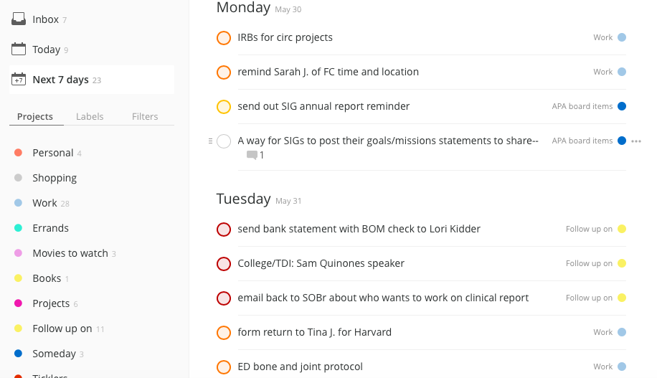
Task list system
Notes:
Mary on strategy– Alison for specifics, since it is her calendar
Can consider pulling up todoist demo if time

Slide 18
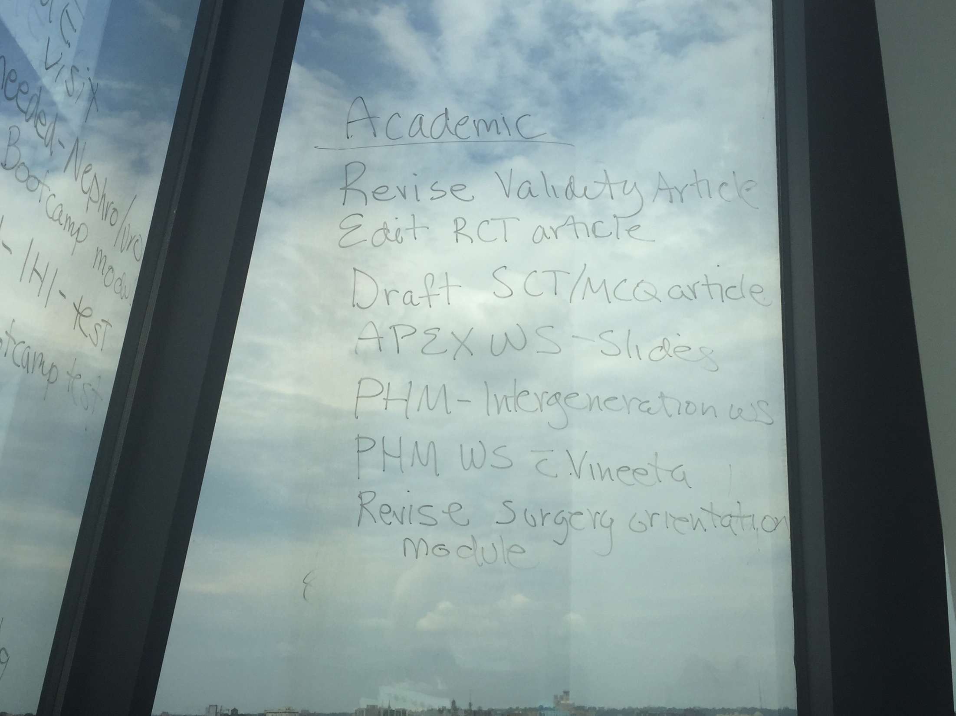

Slide 19
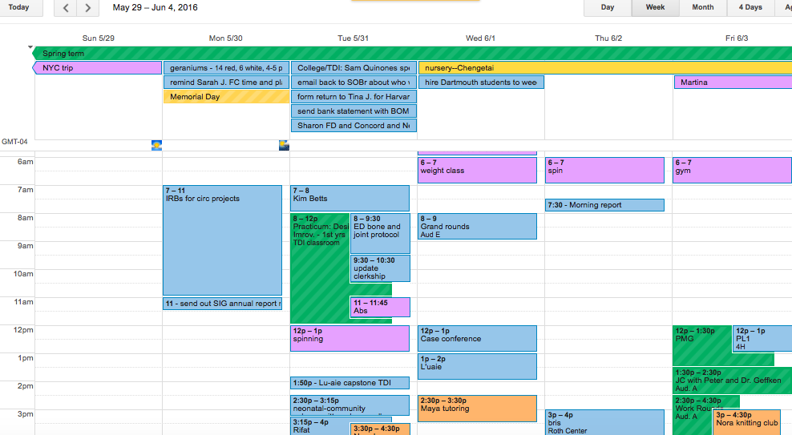
Calendar system
Notes:
Mary on strategy– Alison for specifics, since it is her calender

Slide 20
Taming your email
Turn off auto alert feature
Touch most of it once—delete, respond if takes less than 2 minutes, file (reading or projects), or on to to do list/calendar/management system
Don’t make email a priority
Depending on your responsibilities, find between 2 and 4 discrete times a day to check your email
Notes:
Mary

Slide 21
Productivity Apps
Livescribe pen and app
Notes plus
BrowZine
Voice Dream

Slide 22
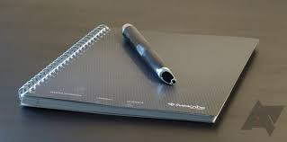
LIVESCRIBE

Slide 23
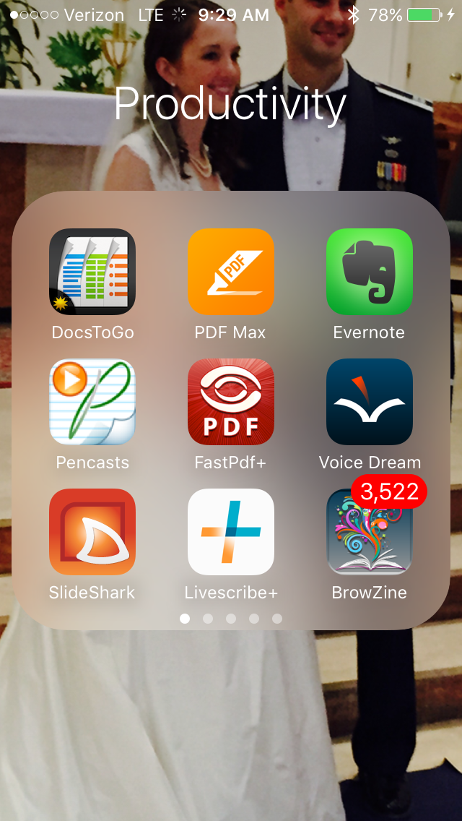

Slide 24
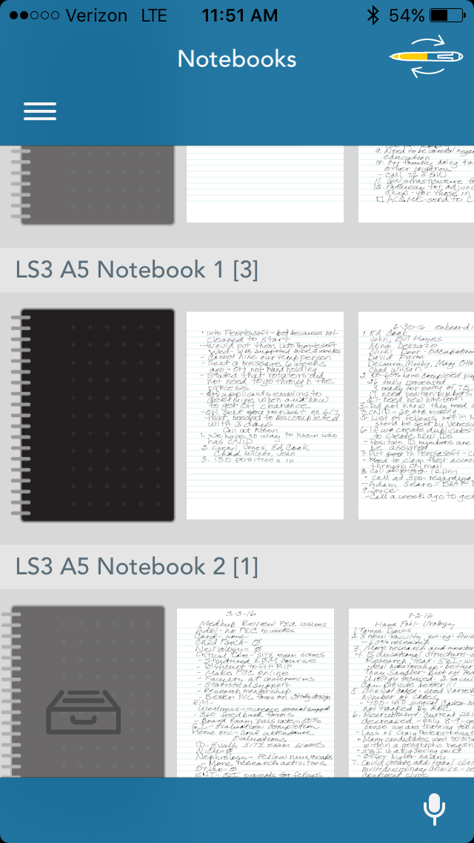

Slide 25
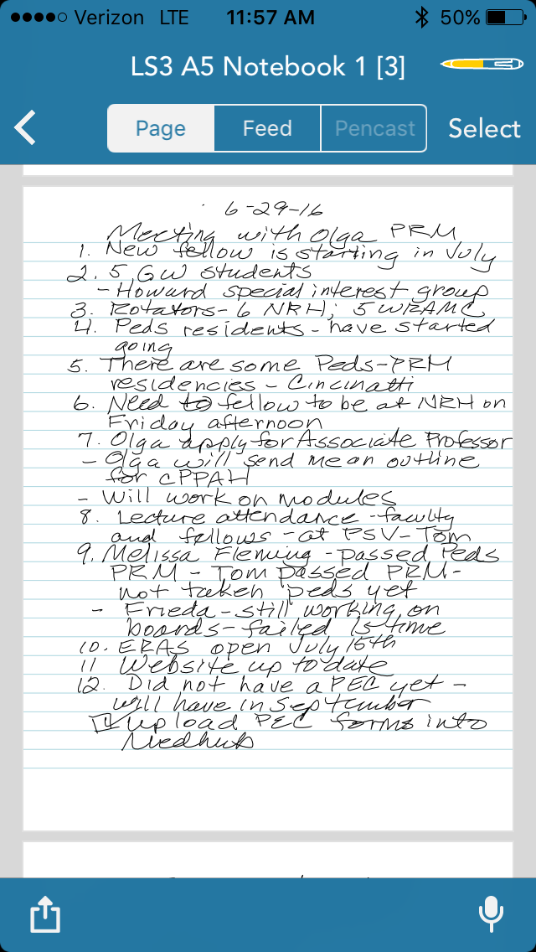

Slide 26
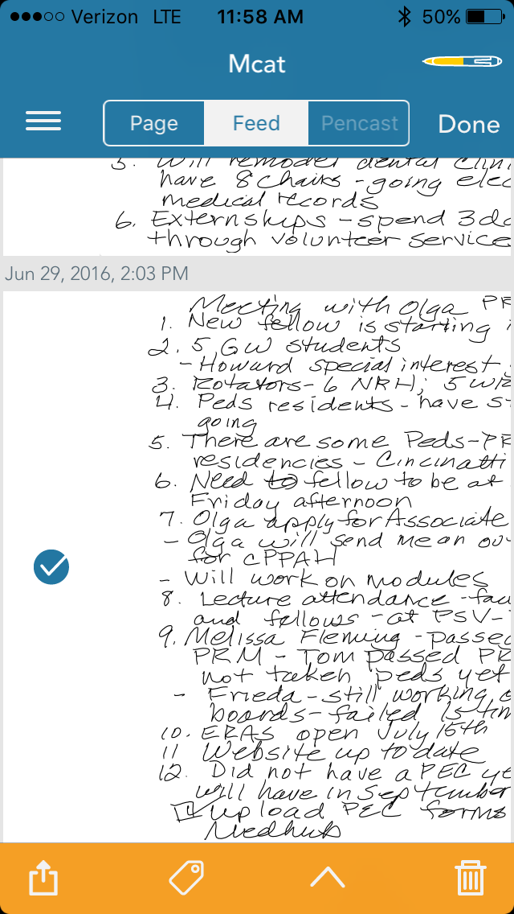

Slide 27
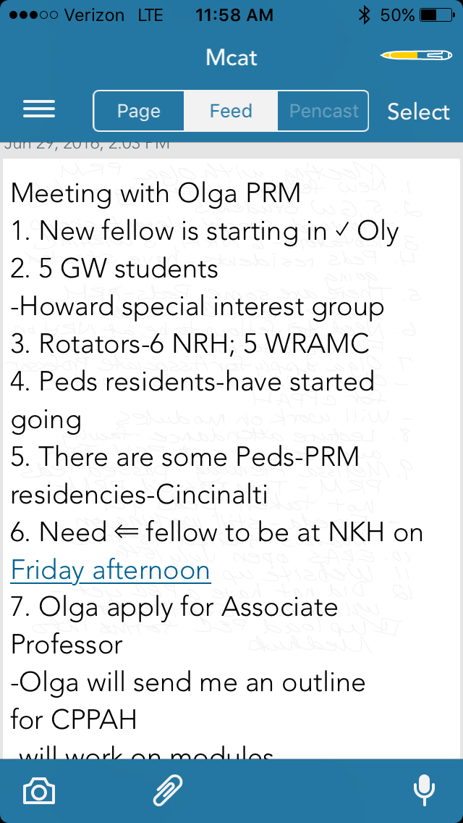

Slide 28
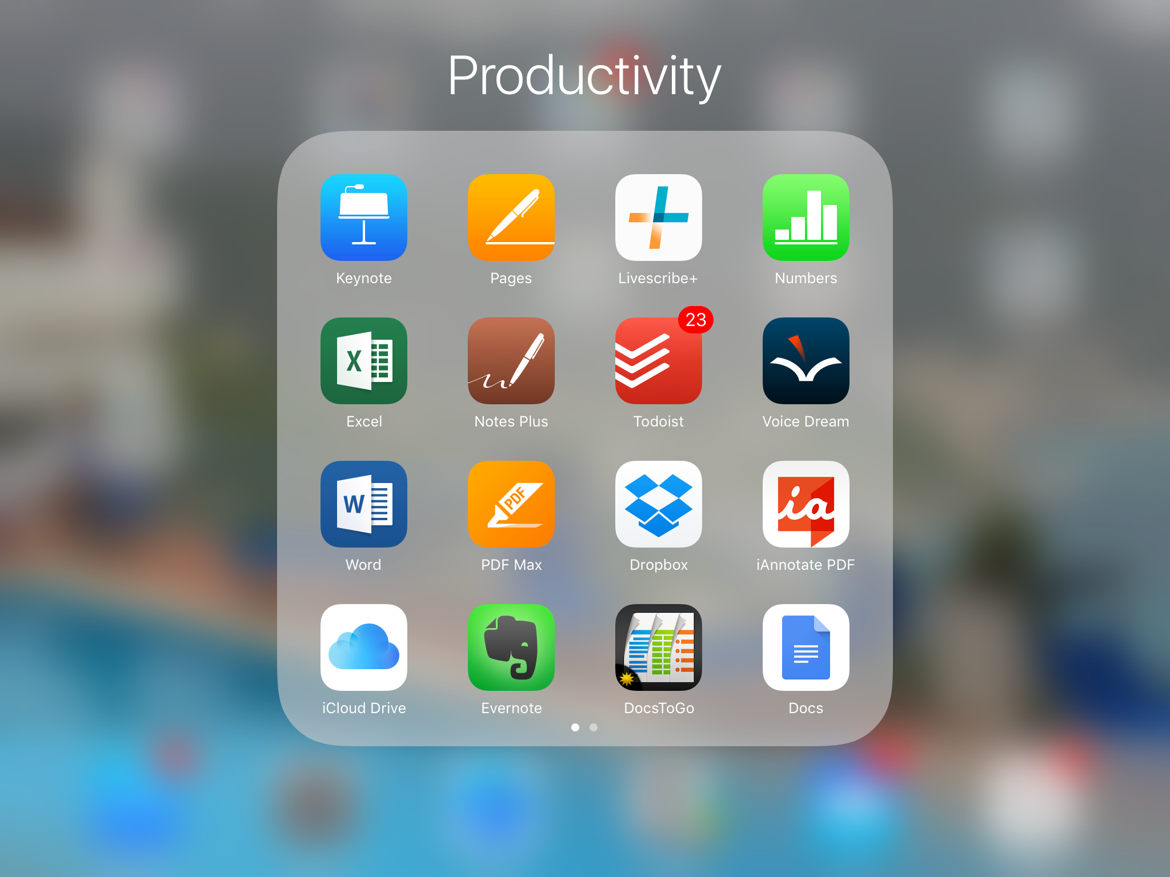


Slide 29
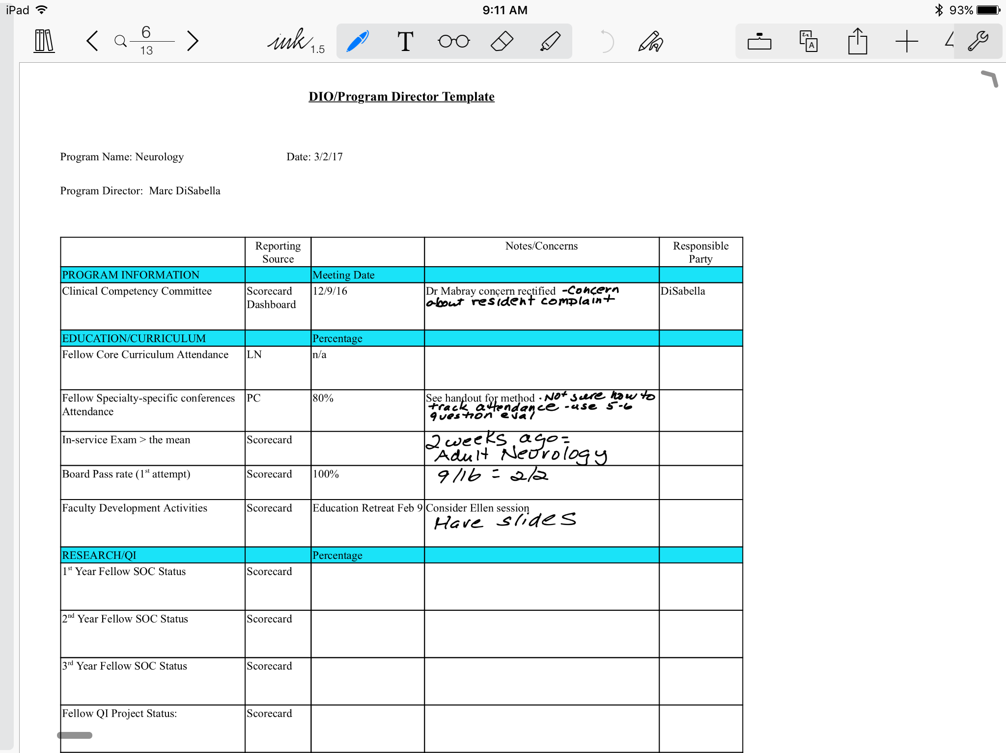

Slide 30


Slide 31
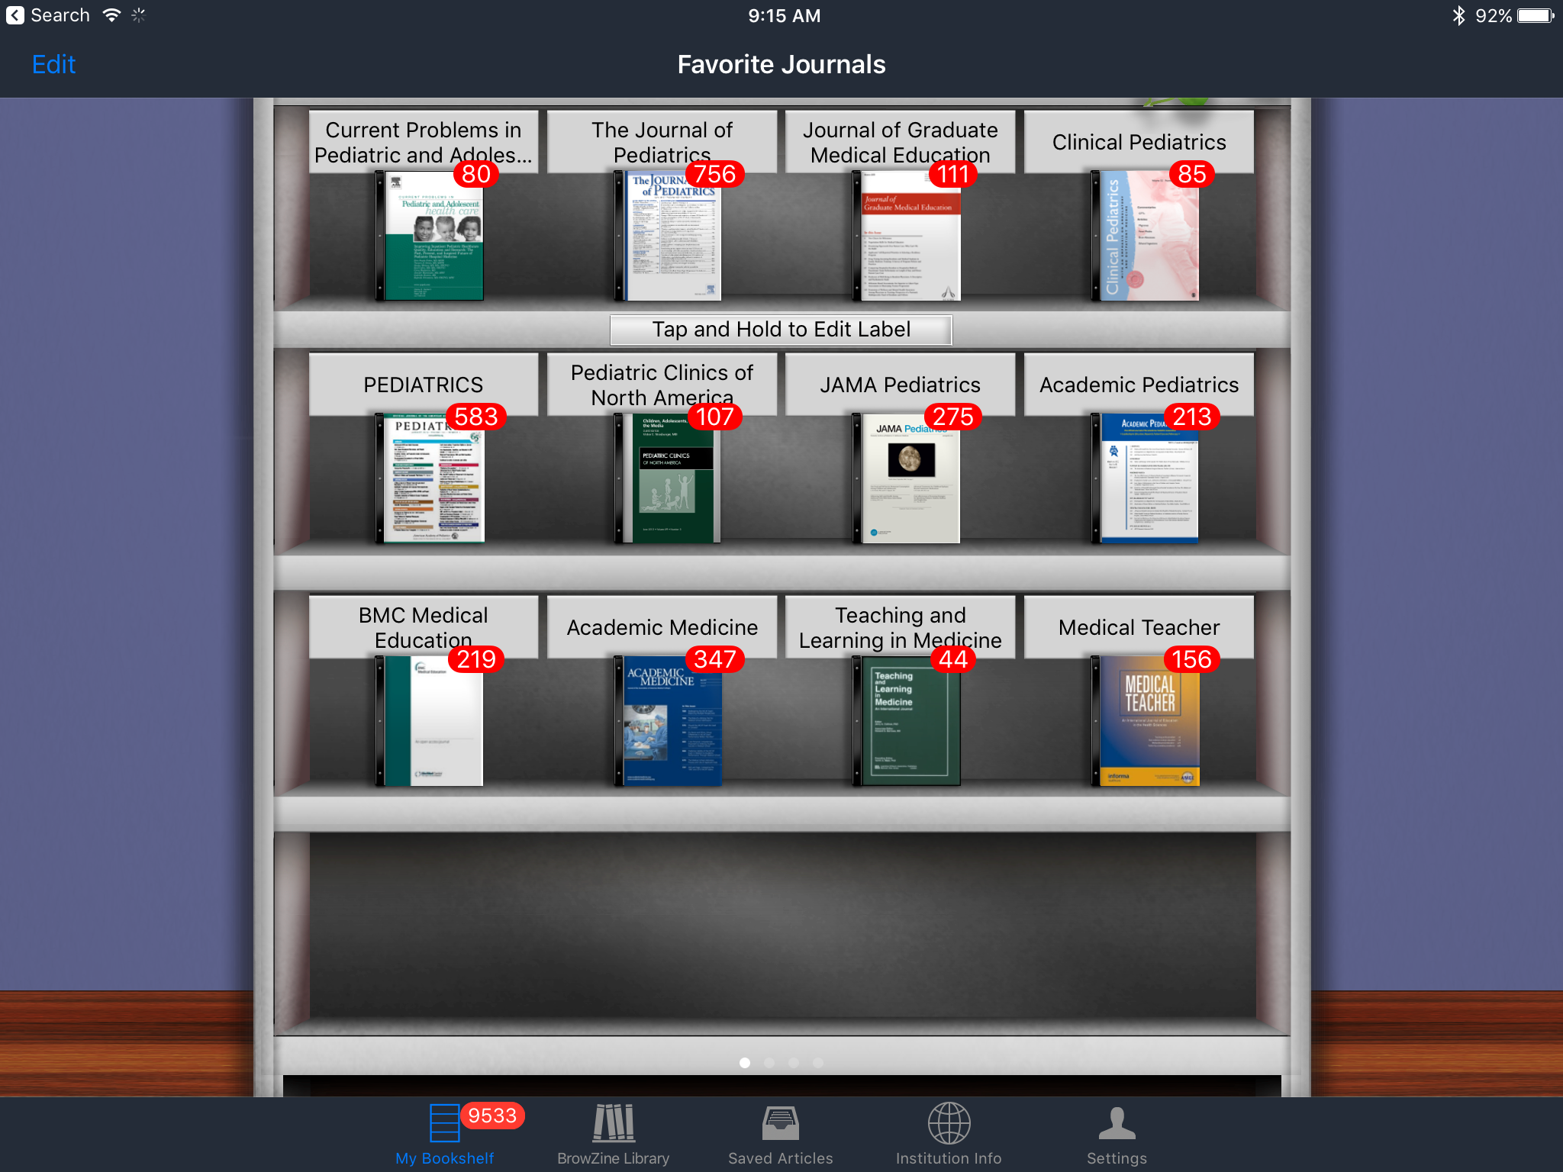

Slide 32
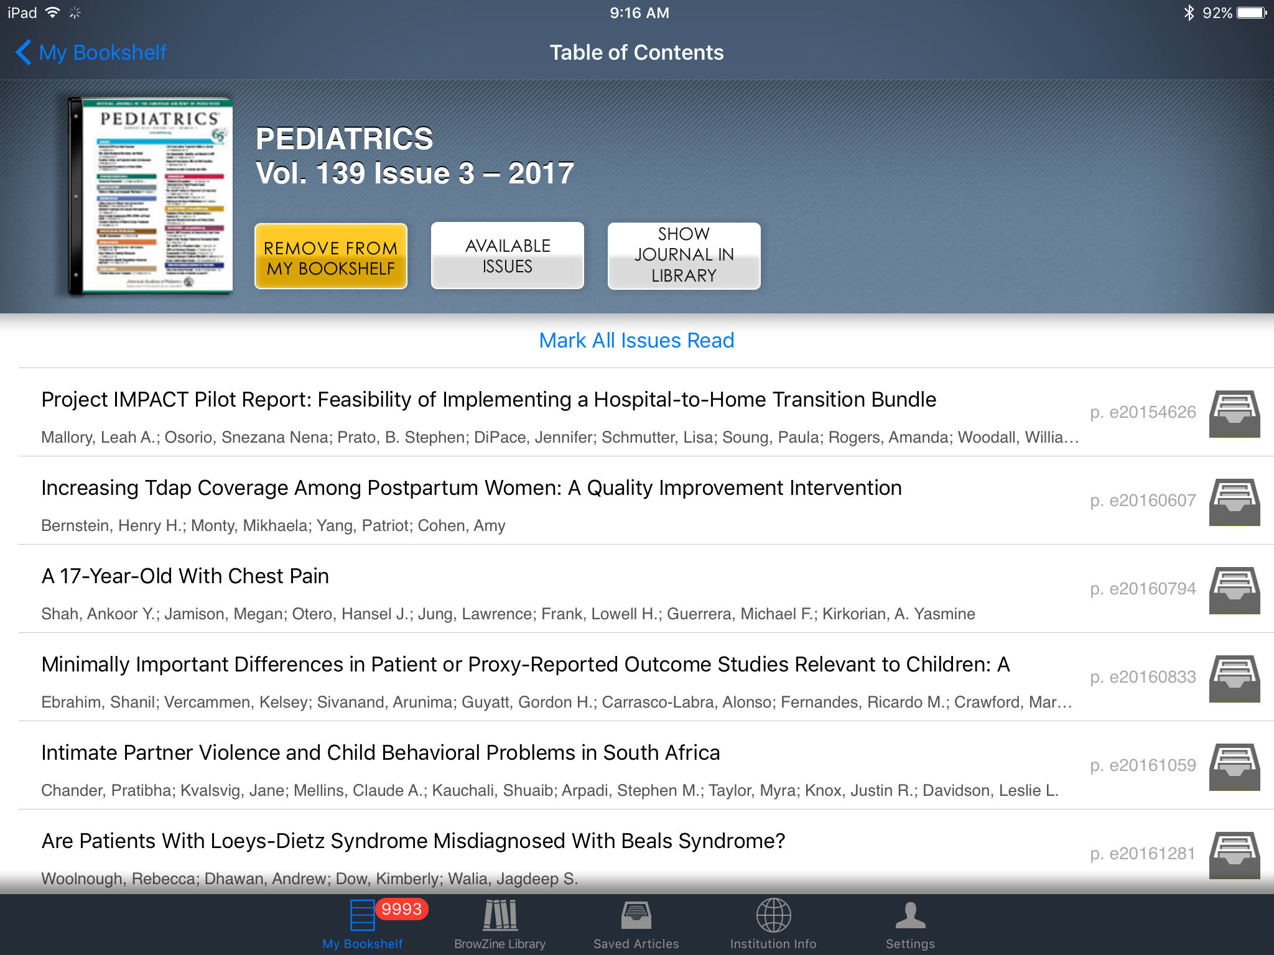

Slide 34
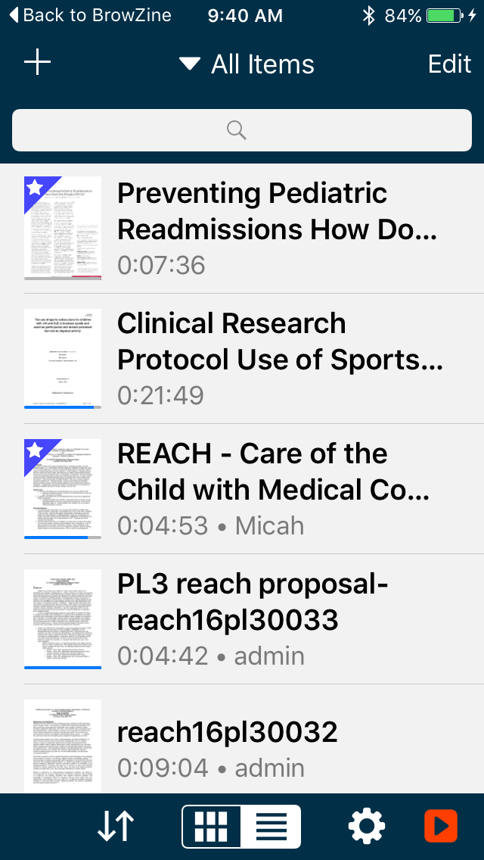

Slide 35
