Slide 1



Next Generation Sequencing… more than just a sequel
“Sanger”
“Next Gen”
“Deep Space 9”

Slide 2
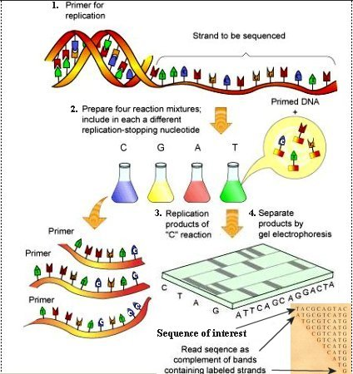
Sanger→ Gel

Slide 3
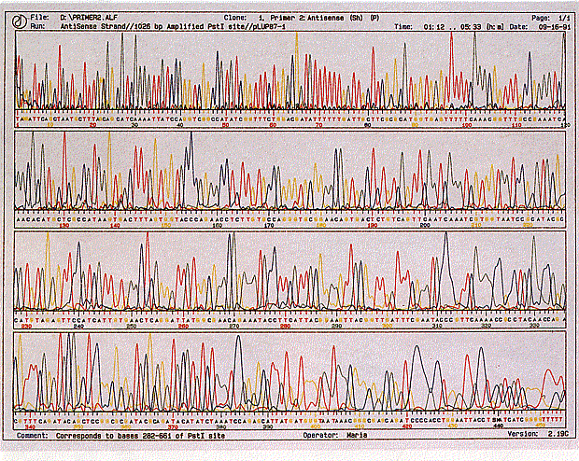
Sanger→ Capillary

Slide 4
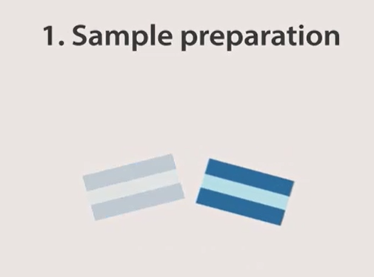
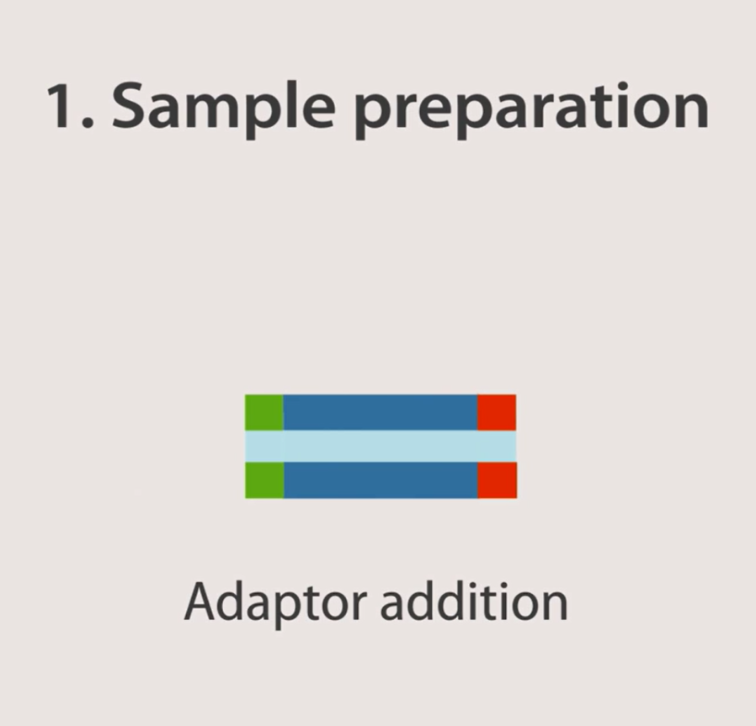

Slide 5
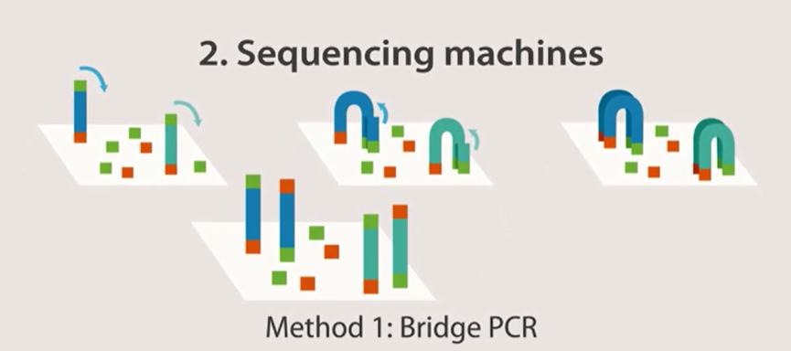

Slide 6
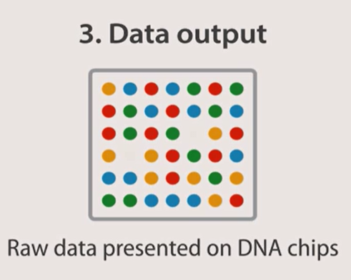

Slide 7
DNA Sequencing Methods in NGS
Pyrosequecning
Sequencing by synthesis
Sequencing by ligation
Ion semiconductor sequencing

Slide 8
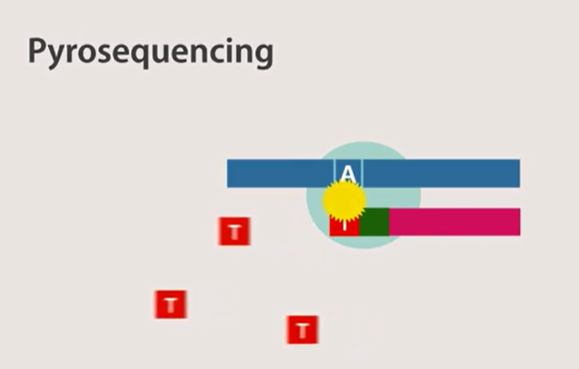
Pyrophosphate + Chemical→ Light

Slide 9
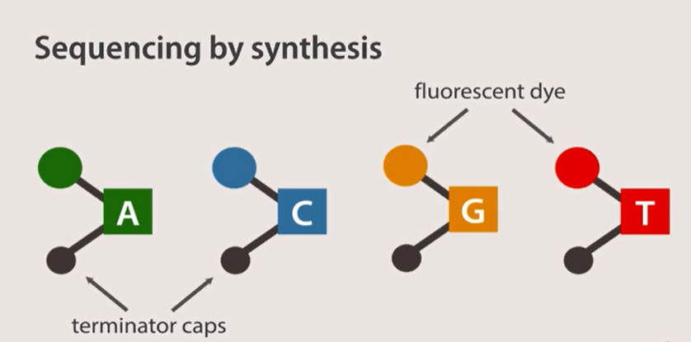

Slide 10
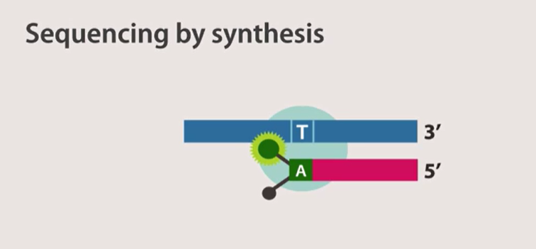

Slide 11
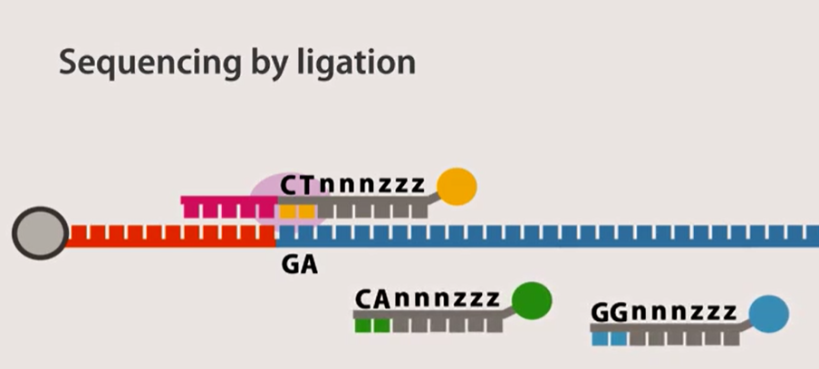

Slide 12
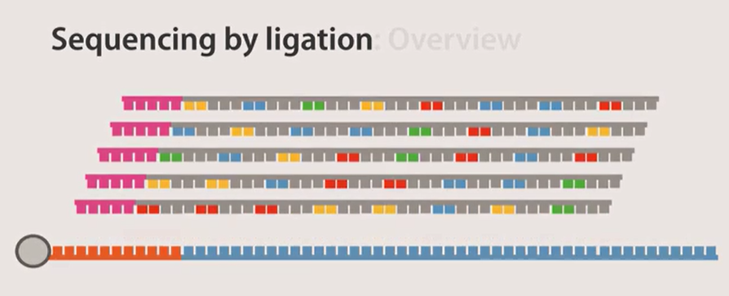

Slide 13


Slide 14
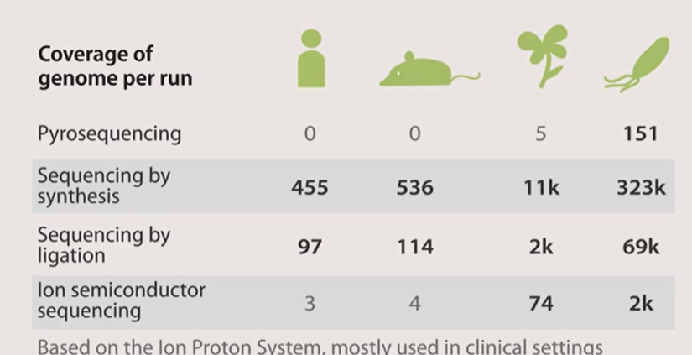

Slide 15
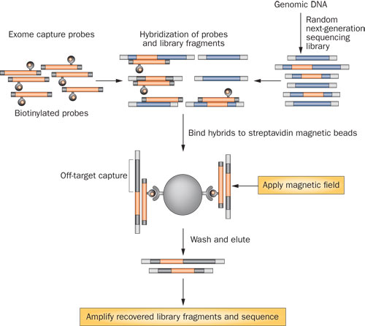
WES vs. WGS

Slide 16
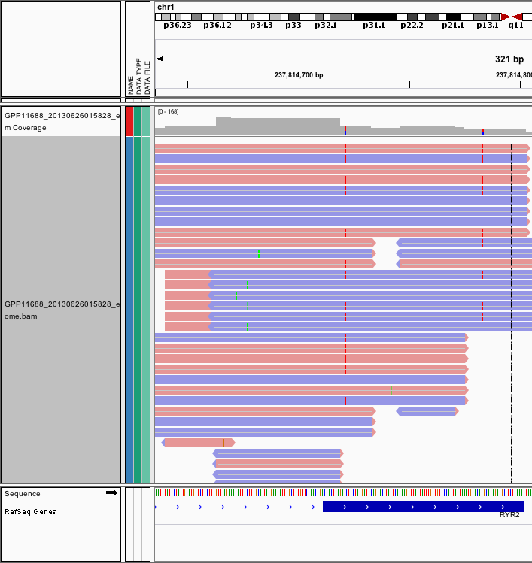

Slide 17
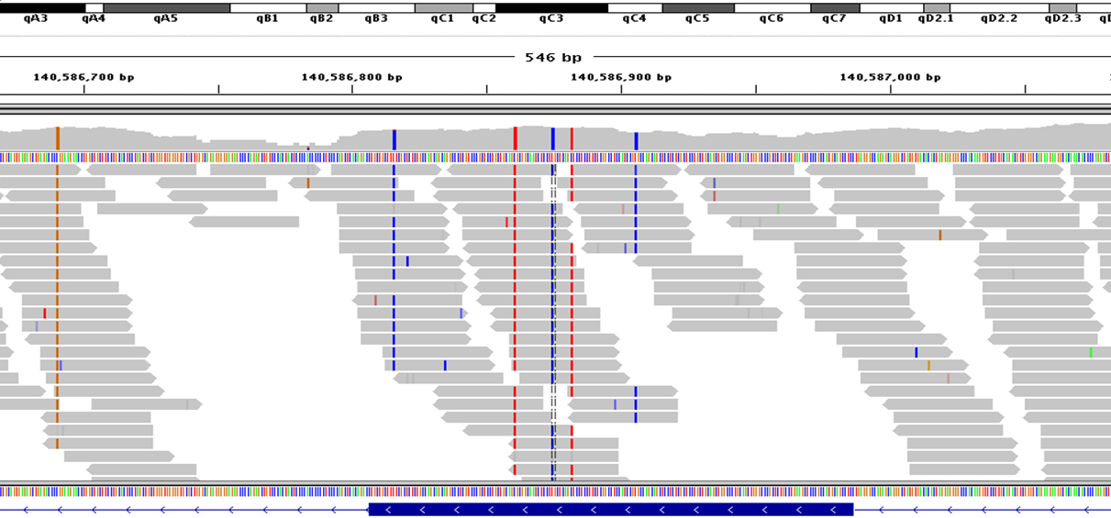

Slide 18
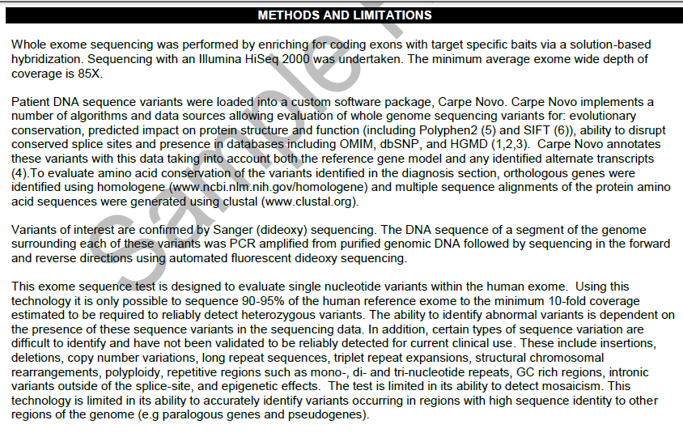

Slide 19
Clinical vs. Research Exomes

Slide 20
So…you can afford exomes… now what do you do with it?

Slide 21
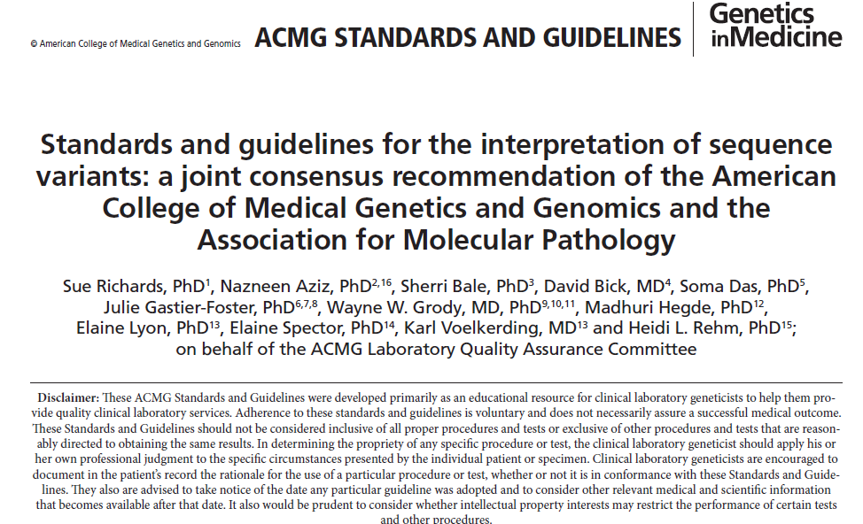
Does the Change Matter?

Slide 22
The Range of Options
Pathogenic
  Likely Pathogenic
    Uncertain Significance
      Likely Benign
        Benign
Want to give it a try? Find a mentor and use the guide on LearnRD to at least get you started

Slide 23
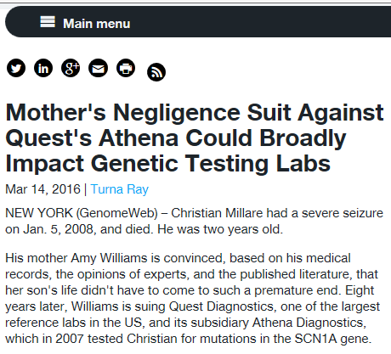

Slide 24
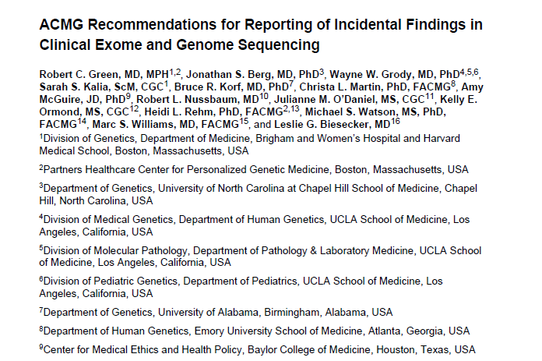
Incidental Findings

Slide 25
Why Use it At All?
Families willing to accept risk for benefit
Unless we use it, it won’t improve
Becoming “standard of care” for some situations
Research exomes identify new diseases and new gene associations→ new treatments

Slide 26
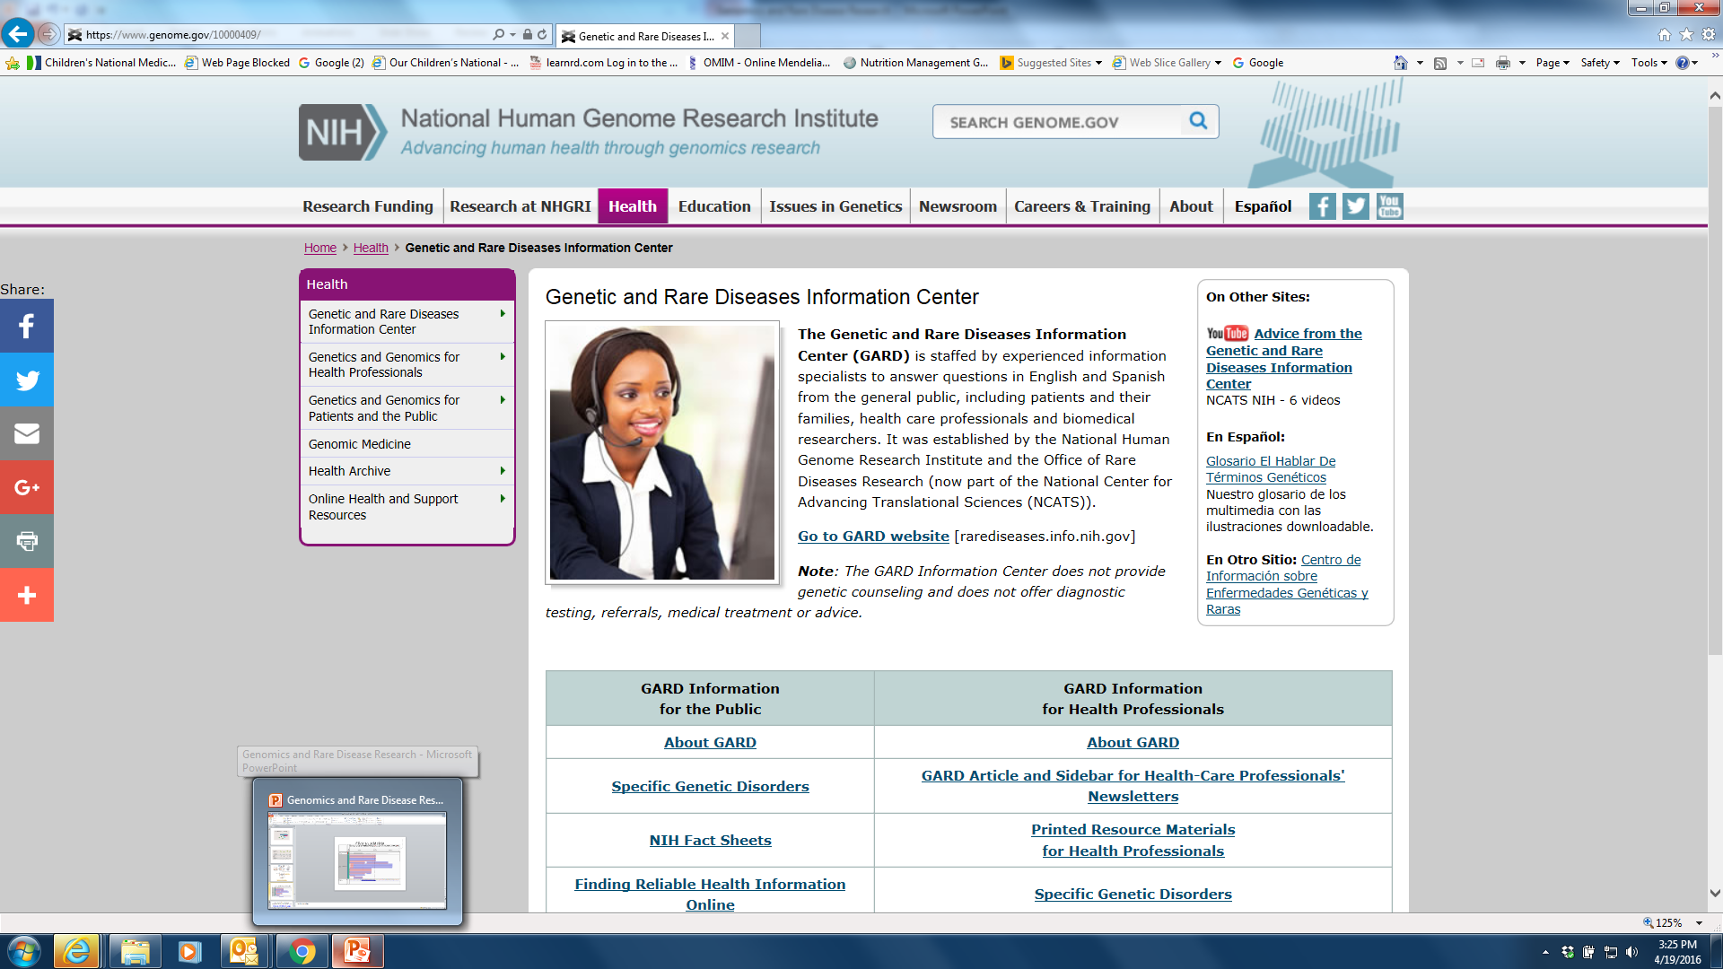

Slide 27
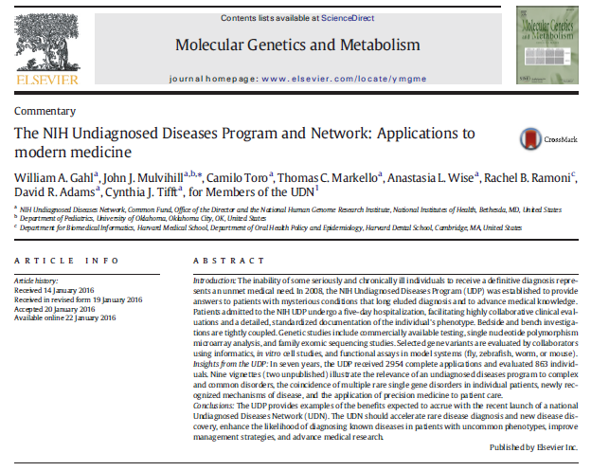

Slide 28
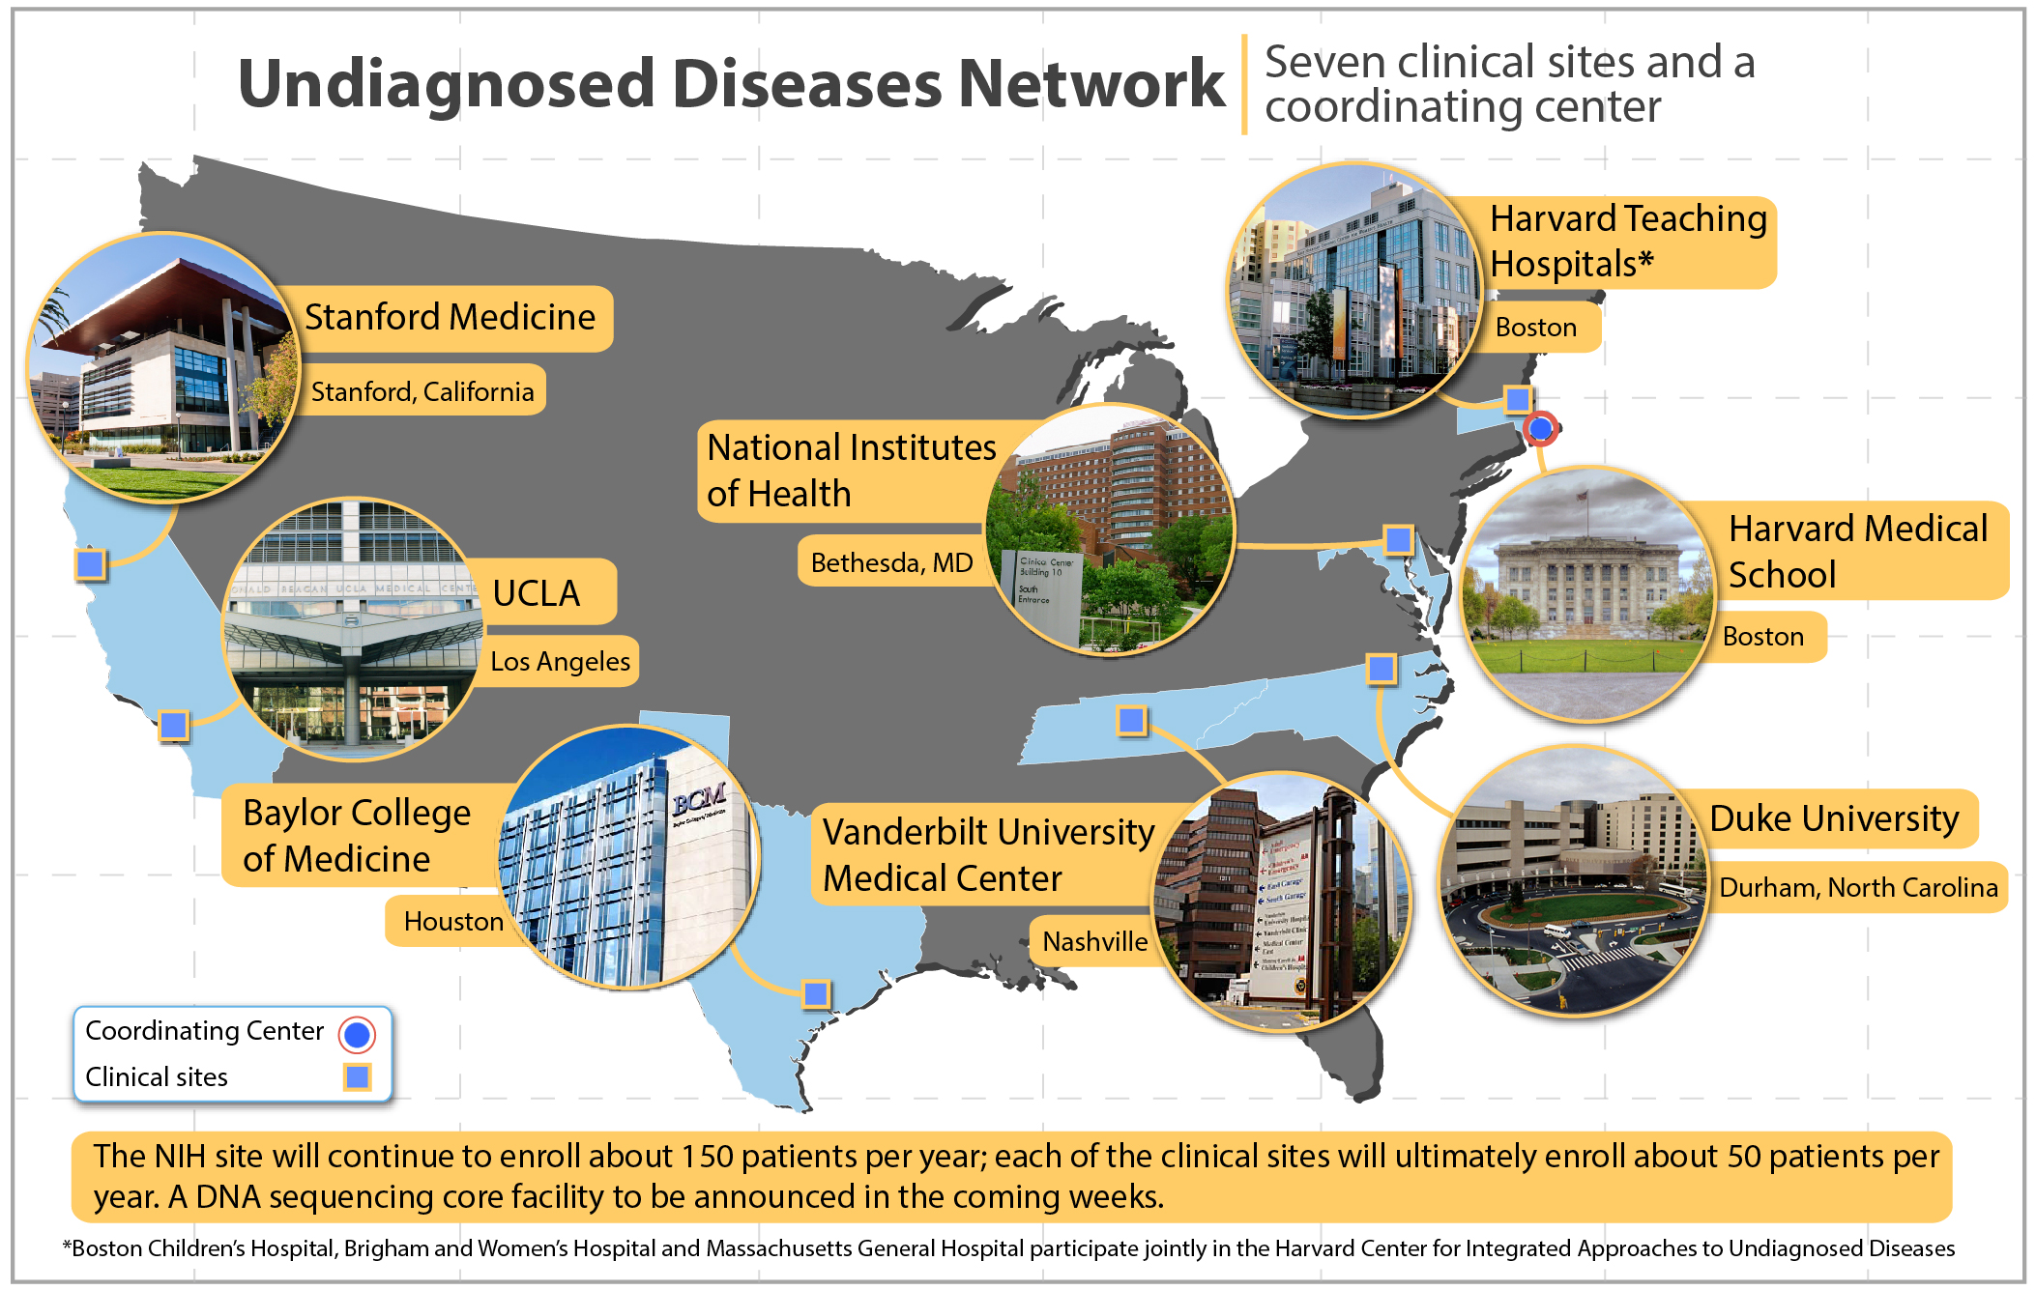

Slide 29
Annimations from Companies
(we do not support or endorse, but like free educational videos!!
http://www.bing.com/videos/search?q=illumina+video&&view=detail&mid=C48CB89CC901687C8705C48CB89CC901687C8705&FORM=VRDGAR
http://www.bing.com/videos/search?q=illumina+video&&view=detail&mid=6B29333E6D4EF34426416B29333E6D4EF3442641&rvsmid=C48CB89CC901687C8705C48CB89CC901687C8705&fsscr=0&FORM=VDFSRV

