Slide 2
Rare Disease Scholar’s Program:
Equipping the Next Generation of Rare Disease Clinical Researchers to Be Successful
Debra S. Regier, MD PhD (PI)
Children’s National Rare Disease Institute
Division of Genetics & Metabolism
Associate Professor of Pediatrics
Marshall Summar, MD (co-PI)
Mary Ottolini, MD (co-PI)
Notes:
Good morning.
Thank you for having me.
My name is Neha Shah, I am a pediatric hospitalist and educator here at Children’s National.
I have been part of the Children’s family for a long time, in fact, I went to college and medical school at GW and then continued on to complete my pediatric training and hospitalist fellowship here. I am excited to tell you more about my experience as an educator here at Children’s and the innovative project that I conducted with the support of the Children’s Academy of Pediatric Educators.
So as you can see from the title, my aim was to develop a curriculum focused on care of children with medical complexity for trainees across the nation

Slide 3
Rare Disease Scholars
Attract and retain new investigators in the field of rare disease.
This goal will be accomplished through identifying specific needs of rare disease clinical researchers:
  More collaboration (network development, multi-sites, multi-disciplinary, patient advocacy groups)
  Research success (publication numbers, grant obtaining and retention)
  Exposure to patient and family groups (cohort, funding, support, reputation)
  Working with small populations (recruitment, small “n” statistics)

Slide 4
Rare Disease Scholar’s Program
LearnRD Portal & Web-Ex
Rare to Common: aka creative funding
NCATS Institute Funding
NIH grant writing: aka fun with Paula!
PCORI funding
Creating a Biosketch: more with less!
Optimizing YOUR CV
Genomics 101
Statistics 101
Statistics for small cohorts
Creating a Biorepository
Creating an Undiagnosed Disease Program
Working with industry
Working with the FDA
Leading Teams
Collaboration: the best of times and the worst of times
Monthly RDCRN Education committee Scholars Presentations
Work Group sessions to review progress
Two members asked to speak at Spring Committee meeting (DC)
Team Building
Project Planning
Patients/ Families
DC-specific
  NIH
  ^{21st} Century Cures Act
Poster Presentation
Participation in national rare disease meeting
Networking

Slide 5
Scholar’s Outcome Measures
Year 1
Years 2-5+
Team Building
Project Planning
Patients/ Families
DC-specific
Rare to Common: aka creative funding
NCATS Institute Funding
NIH grant writing: aka fun with Paula!
PCORI funding
Creating a Biosketch: more with less!
Optimizing YOUR CV
Genomics 101
Statistics 101
Statistics for small cohorts
Creating a Biorepository
Creating an Undiagnosed Disease Program
Working with industry
Working with the FDA
Leading Teams
Collaboration: the best of times and the worst of times
Monthly RDCRN Education committee Scholars Presentations
Two members asked to speak at Spring Committee meeting (DC)
Poster Presentation
Participation in national rare disease meeting
Networking
Maintain access to site for funding time period
CRIA-12
Quiz
Satisfaction
Self-report
CV
CRIA-12
Quiz
Satisfaction
Self-report
CV
CRIA-12
CV
ORCID (publications)

Slide 6
Less Scut Work….More support and resources!
-Email
-Portal for quizzes/evalatuions
-Webex
-EVERYTHING recorded
-Opportunities to present to RDCRN committee (in person or electronically)

Slide 7
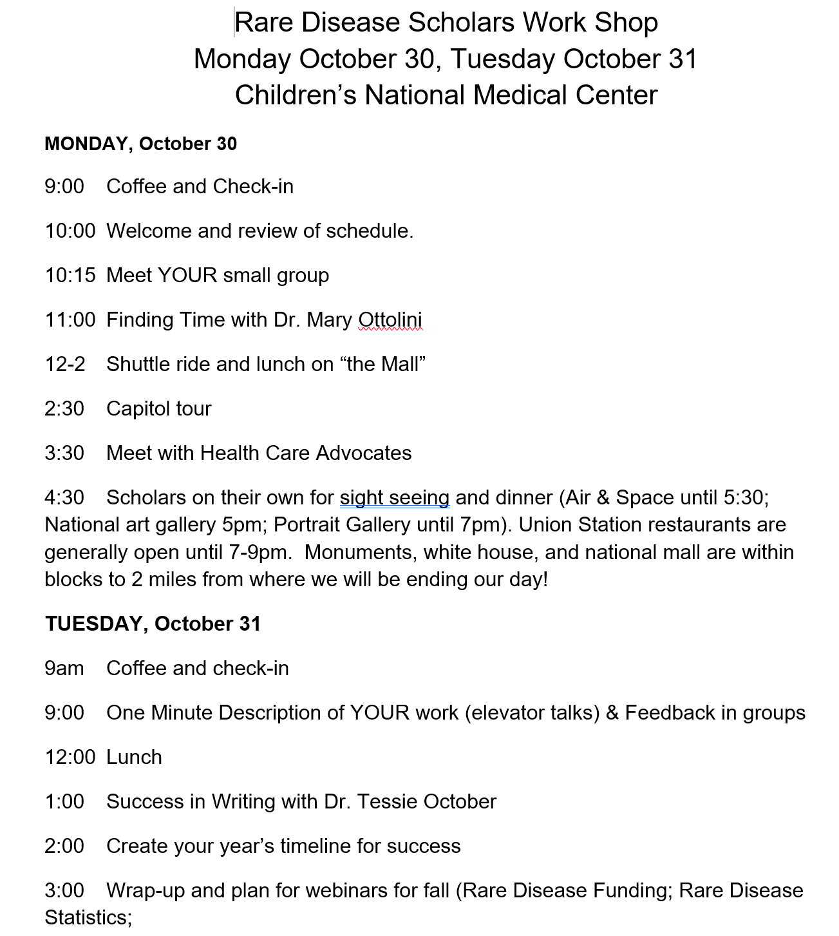

Slide 8
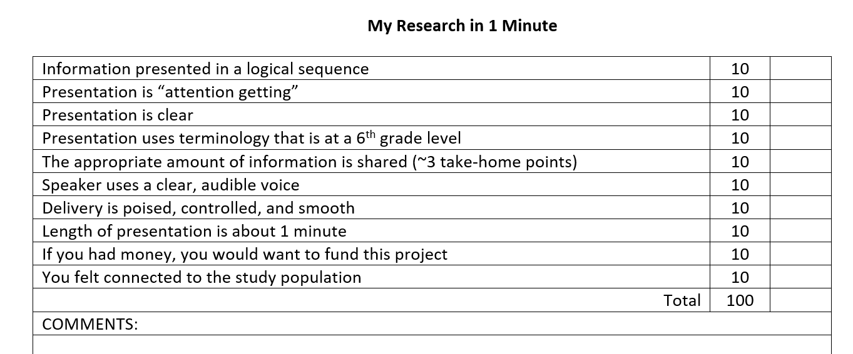

Slide 9
LearRD.com

