Slide 1
Writing a Successful Career Development (K) Award
Paula Gregory, PhD
LSUHSC School of Medicine

Slide 2
K= Career Development
K awards provide support for senior postdoctoral fellows or faculty-level candidates.
K awards are designed to promote the career development of specific groups of individuals based on their past training and career stage.

Slide 3
Advantages to Participating in K Award Program
Higher number of research publications
Participation did not delay start of independent career
Collectively, researchers had a significantly higher RO1 success rate
For those followed over time, had more subsequent NIH research support and more NIH research project renewals

Slide 4
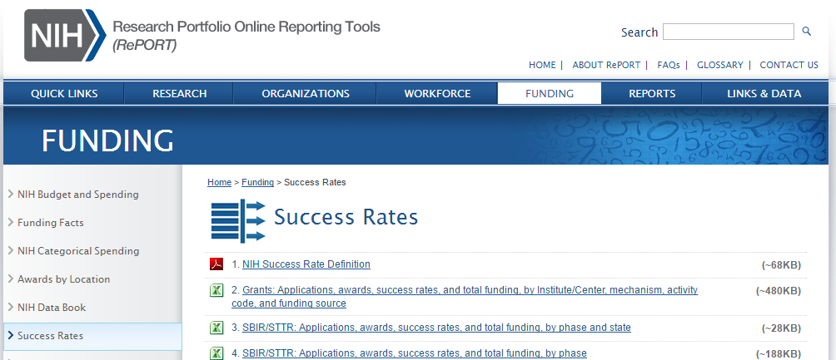
http:// report.nih.gov/success_rates/index.aspx

Slide 5
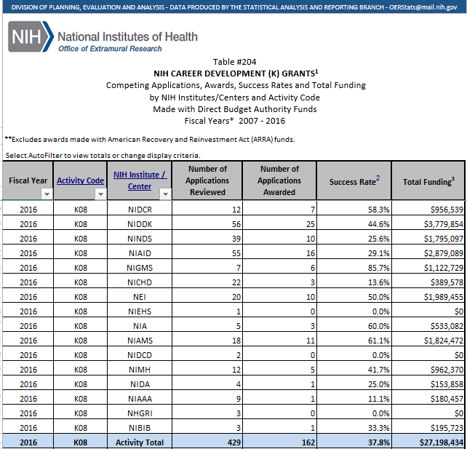

Slide 6
Types of K Awards
There are 14 different types of K awards
Mentored (KO1, KO8,KO7, K12, K23,K25 K99)
Support clinicians and basic scientists

Slide 7
NIH Career Development Awards
Lead to independent research career
Provide additional training and intense mentoring; strong mentor key to success
Provide 3-5 years of partial salary support and limited research funding

Slide 8

https://researchtraining.nih.gov

Slide 9

KO8: Mentored Clinical Scientist Research Career Development Award
Purpose: prepare qualified individuals for independent research careers in health related research/translational research
Some postgraduate training essential
Clinical doctoral degree

Slide 10

K23: Mentored Patient-Oriented
Research Career Development Award
Purpose: support the career development of investigators committed to patient-oriented research
Completion of all clinical training, including subspecialty training
Clinical or nursing doctoral degree

Slide 11
Eligibility Criteria for K Awards
Candidate:
  Doctoral degree, clinical or research
  No more than 4-5 years postdoctoral training(check PA announcement)
  US citizen, non-citizen national or permanent resident (exceptK99/R00)
  Not eligible if previous PI on R or K grants
Mentor:
  Strong track record in peer-reviewed funding
  Strong mentoring track record

Slide 12
Other Career Development Awards
American Diabetes Association
American Cancer Society
American Heart Association
American Gastroenterology Association
  Salary support for 3-5 years
  All require junior faculty; no more than 7 years from fellowship training
  Some support for the research

Slide 13
Our Best Advice
Contact Your Program Officer at NIH
Contact Your Program Officer at NIH
Contact Your Program Officer at NIH

Slide 14
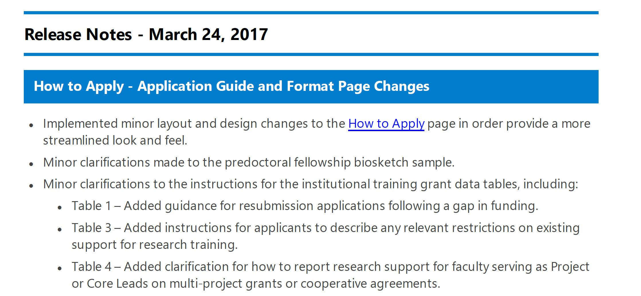
Tip #1: Use the Most Recent Instructions
https://grants.nih.gov/grants/how-to-apply-application-guide.html#inst

Slide 15
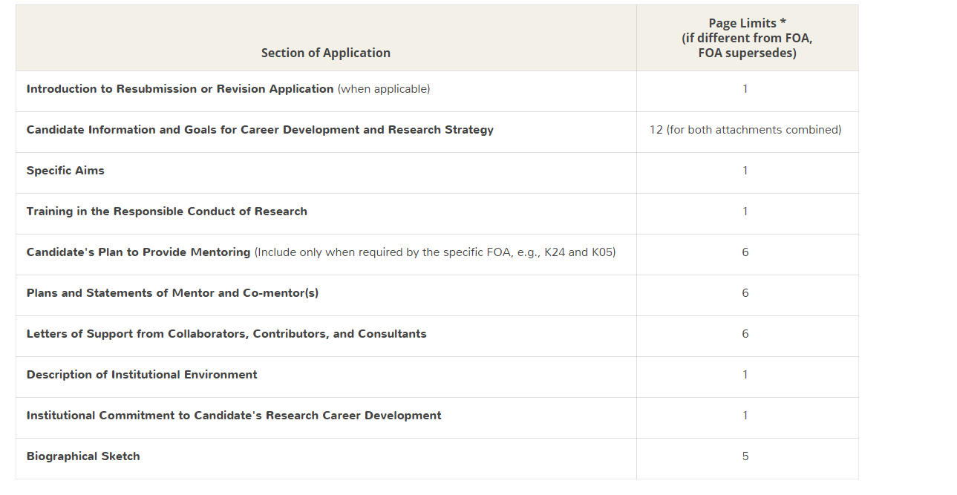
Anatomy of a K Award
For due dates on or
after May 25, 2016

Slide 16
Anatomy of a K Award
Main sections:
  The Candidate information (2-3 pages)
  Research Plan
  These sections combined cannot exceed 12 pages
    Training in the responsible conduct of research
    Description of Institutional Environment
    Institutional Commitment to Candidate
    Statements by Mentors, Co-Mentors, and Collaborators
Notes:
Jessica please check page limits- Page limits checked- 4/11/16, JA.

Slide 17
The Candidate : Applicant's Background and Goals for Fellowship Training
All in 1 attachment as of May 2016
1- Candidate’s background
2- Career goals and objectives
3- Career development activities during award period

Slide 18
Candidate’s Background
Describe your training which enables you to engage in this research-include examples of prior research experience (basic or clinical).
Describe evidence of productivity- abstracts, papers, awards.
Describe any formal research training-degree programs (MS, MMSc,MPH, PhD) and/or courses.

Slide 19
Career Goals and Objectives
What are your short term (over the course of the K) goals?
Why do you need this award?
What additional training do you need?
What are your long term career goals ?
Remember: The goal of K is help you to transition to independent investigator, you need to reflect this goal in this section.

Slide 20
Career Development Activities During Award Period
What will you accomplish in your research over the course of the award?
What additional training will you receive?
What new skills will you master? How?
How will you assess your progress?
Provide specific examples:
  courses you will take-names/dates
  how you will be evaluated by your mentoring team e.g. q 6 month meetings
  timeline for milestones e.g. completion of coursework, submission of manuscripts, subsequent grant submission

Slide 21
Training in the Responsible Conduct of Research (RCR)- for clinical research grants
Must include plan to obtain instruction in RCR
Document prior instruction in RCR (including date)
Plans must address 5 components: format, subject matter, faculty participation, duration of instruction, and frequency of instruction.
May include individualized instruction/independent scholarly activities that will enhance the applicant’s understanding of ethical issues related to specific research activities
Applications lacking a plan will be considered incomplete and may be delayed in the review process or may not be reviewed.
Example: I plan to take the course “Responsible Conduct of Research” (course #____) at ____. This covers common ethical dilemmas that arise in clinical research, how research on human subjects is regulated by the federal government, and what constitutes research misconduct. I have previously been certified in the conduct of responsible research by completing the Collaborative Initiative Training Initiative www.citiprogram.org on November 2, 2015….
This section is limited to 1 page.
Notes:
Checked link, JA, 4/5/16.

Slide 22
Training in the Responsible Conduct of Research (RCR)- for clinical research grants
Must include plan to obtain instruction in RCR
Document prior instruction in RCR (including date)
Plans must address 5 components: format, subject matter, faculty participation, duration of instruction, and frequency of instruction.
May include individualized instruction/independent scholarly activities that will enhance the applicant’s understanding of ethical issues related to specific research activities
Applications lacking a plan will be considered incomplete and may be delayed in the review process or may not be reviewed.
Example: I plan to take the course “Responsible Conduct of Research” (course #____) at ____. This covers common ethical dilemmas that arise in clinical research, how research on human subjects is regulated by the federal government, and what constitutes research misconduct. I have previously been certified in the conduct of responsible research by completing the Collaborative Initiative Training Initiative www.citiprogram.org on November 2, 2015….
This section is limited to 1 page.

Slide 23
Institutional Commitment to Candidate’s Research Career Development (Cont’d)
  Letter from your department chair or division chief indicating:
    your position for the duration of the award (cannot be contingent on receipt of award)
    protection of your research time
    your access to resources, facilities

Slide 24
Statement by Mentor
Your primary mentor:
  senior investigator with publication record
  track-record of/current NIH funding
  prior evidence of mentoring experience and success
  a researcher in the field you are proposing to work
  able to support your project financially and with time
  needs to provide a mentoring plan including frequency of meetings with you

Slide 25
Statements by Mentors, Co-Mentors, and Collaborators (Cont’d)
Co-mentor(s)
  Include co-mentors who will complement the primary mentor’s strengths by offering different expertise
  Establish a mentoring team (advisory committee) (3-4 members)
      Indicate frequency at which it will meet with you
  Each person on your team should have a clear role reflected in your career dev. plan and in your research plan
  Signed statements must be provided by each member of the proposed mentoring team.

Slide 26
Research Plan Sections
  Research Plan
    Specific Aims
    Research Strategy
        Significance
        Innovation
        Approach

Slide 27
Research Plan to include
Sound research project consistent with level of research development and objectives of career development plan. Demonstration of quality of research thus far, and ability of candidate to carry out the research.
Description of relationship between mentor’s research and candidate’s proposed research plan.
If >1 mentor proposed, respective areas of expertise and responsibility should be described.
Focus of K23 is POR, but complementary laboratory research related to POR may be proposed as opportunity for career development in translational research.

Slide 28
Research Plan Advice
Creative but feasible and achievable
Related to your mentor’s work but takes it in another direction
Utilizes the expertise of your mentor(s)
Provides you with new skills
Will provide direction for your independent funding

Slide 29
Research Plan Approach
In Significance, must include:
Describe scientific premise for proposed project, including consideration of strengths and weaknesses of published research/preliminary data crucial to your application.

Slide 30
Research Plan Approach
Approach must include:
Describe experimental design/methods proposed and how they will achieve robust/unbiased results.
  E.g. how relevant biological variables, such as sex, are factored into research designs and analyses for studies in vertebrate animals and humans.

Slide 31
Other Sections
  Cover letter
    include list of referees
    no longer requires study section request-New optional form for institute request
  Biosketch (yours & your mentoring team)
  Budget
  Enrollment table
  Human Subjects
  Animals

Slide 32
NIH salary contribution
The purpose of this Notice is to announce that starting with FY2016 awards and effective immediately, NHLBI will increase its salary contribution up to a maximum of $100,000 for all applicable K-series award activities that NHLBI currently supports
Check with your institute

Slide 33
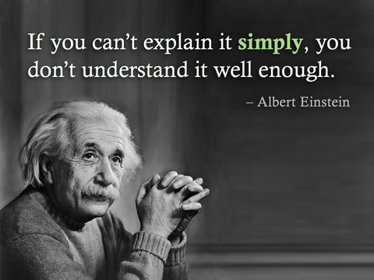

Slide 34

What is unique about the K awards?
  The candidate and career plan are about a third of what is scored
  The mentor(s) are also scored

Slide 35
Common mistakes
Lack of strategy
Lack of time to prepare application
Candidate Section inadequately presents your expertise
Career Goals not concisely/precisely stated
Career Plan lacks detail (timeline)
Mentor letters inadequate

Slide 36

Timeline
Identify appropriate mechanism and make decision to apply 6 months prior to submission deadline
Print and highlight the K Award instructions
Print Guidelines for Reviewers and read the scoring criteria for Career Development sections
Talk to your university grants office to be sure what their deadlines/requirements are

Slide 37


Slide 38
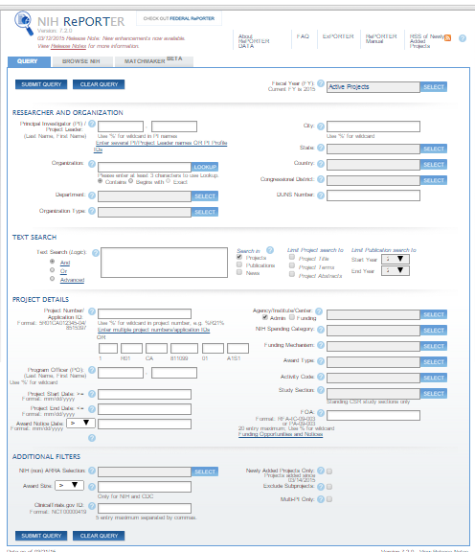
RePORTer allows you to search all NIH funded grants (current & past)

Slide 39
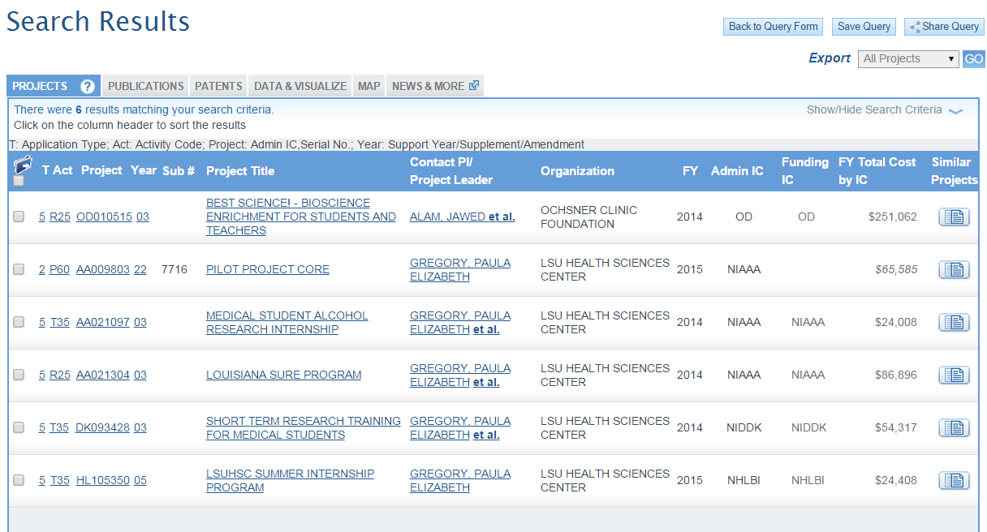

Slide 40

The Career Development Plan
Candidate Background
Career Goals and Objectives
Career Development/training Plan
Mentor letters
Biosketch (new format)

Slide 41
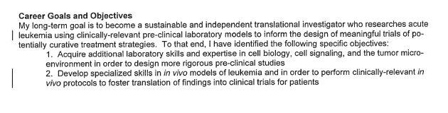
Career Goals and Objectives
The goal of the “K” is help you to transition to independent investigator, you need to reflect this goal in this section.

Slide 42
Candidate Information
YOU and your mentor are the most important pieces of the application
Sell yourself!
Don’t just reiterate your Biosketch, use this section to highlight your unique qualifications
Explain why you need this award to get to the next level

Slide 43
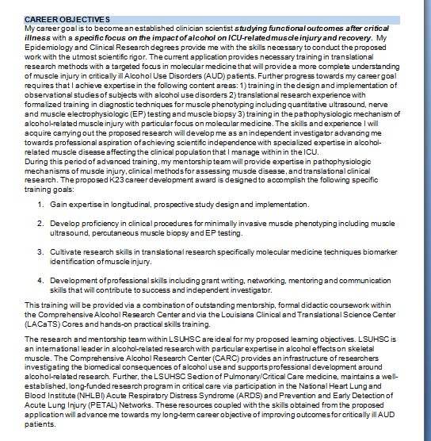

Slide 44
Career Development Activities
Education and Activities
Be specific!!
Course/course numbers/description
Conferences/seminars
Timing and frequency of meetings with mentors

Slide 45
Review Criteria for the Candidate
Does the candidate have the potential to develop as an independent and productive researcher?
Are the candidate's prior training and research experience appropriate for this award?
Is the candidate’s academic, clinical (if relevant), and research record of high quality?
Is there evidence of the candidate’s commitment to meeting the program objectives to become an independent investigator in research?
Do the letters of reference address the above review criteria, and do they provide evidence that the candidate has a high potential for becoming an independent investigator?

Slide 46
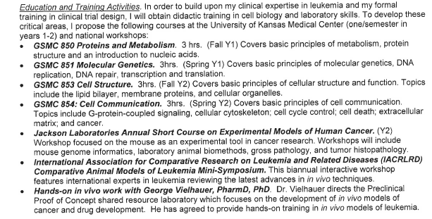
Career Development Activities
Education and Activities

Slide 47
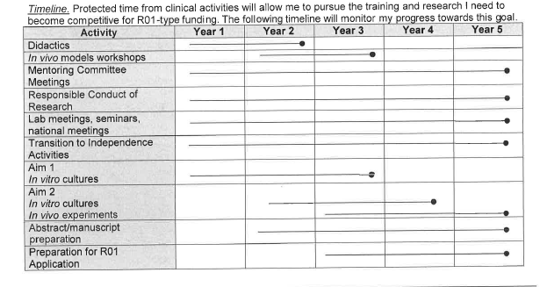
Timeline of Career Development Activities During Award Period
Weakness noted: no specific details of the intended publications

Slide 48
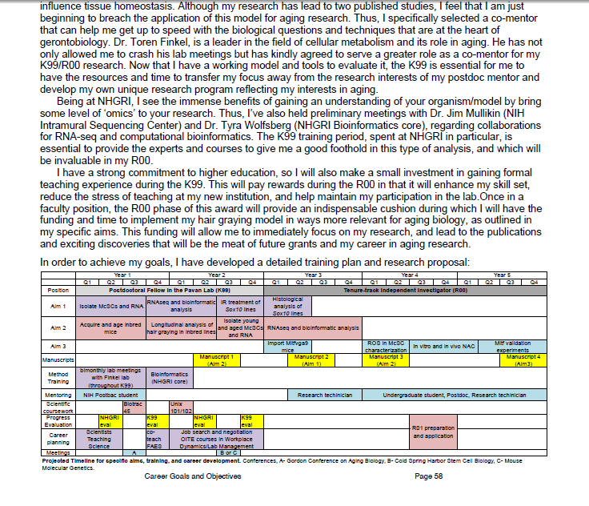
A timeline that pulls together the training and research

Slide 49
Review Criteria for Career Goals
What is the likelihood that the plan will contribute substantially to the scientific development of the candidate and lead to scientific independence?
Are the candidate’s prior training and research experience appropriate for this award?
Are the content, scope, phasing, and duration of the career development plan appropriate when considered in the context of prior training/research experience and the stated training and research objectives for achieving research independence?
Are there adequate plans for monitoring and evaluating the candidate’s research and career development progress?

Slide 50

Mentors – a key component of the Career Development

Slide 51
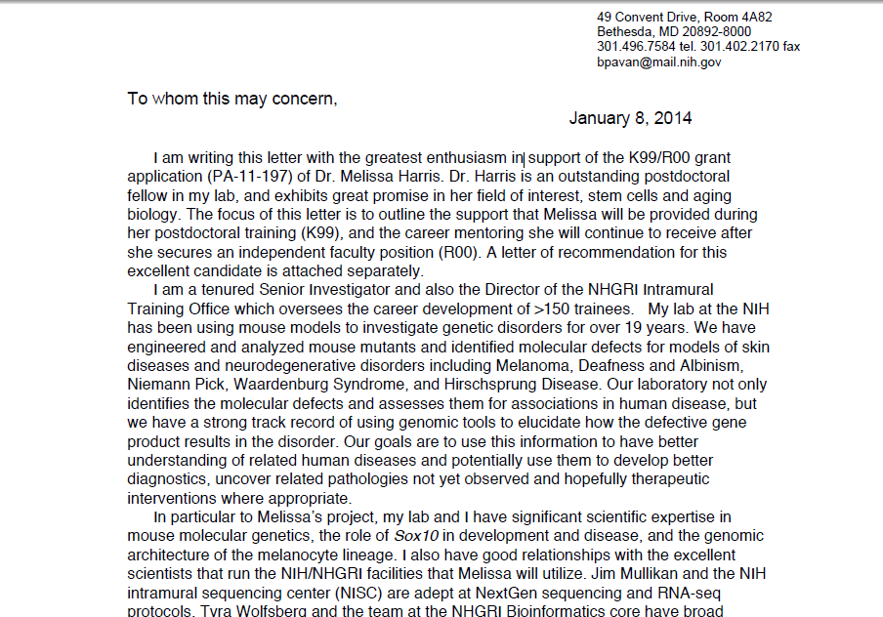
Mentor’s letter should tie in with their Personal Statement and with the Career Development Plan and with the research

Slide 52
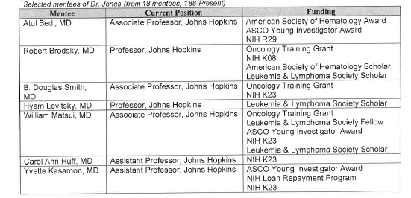
Career Development Activities
Mentors and Mentoring Committee

Slide 53
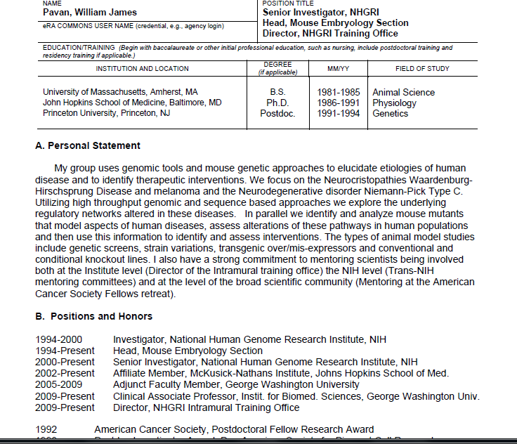
The mentor’s Personal Statement should mention their qualifications as a MENTOR

Slide 54
Review Criteria for Mentors
Are the qualifications of the mentor(s) in the area of the proposed research appropriate?
Do(es) the mentor(s) adequately address the candidate’s potential and his/her strengths and areas needing improvement?
Is there adequate description of the quality and extent of the mentor’s proposed role in providing guidance and advice to the candidate?
Is the mentor’s description of the elements of the research career development activities, including formal course work adequate?
Is there evidence of the mentor’s, consultant’s and/or collaborator’s previous experience in fostering the development of independent investigators?
Is there evidence of the mentor’s current research productivity and peer-reviewed support?
Is active/pending support for the proposed research project appropriate and adequate?
Are there adequate plans for monitoring and evaluating the career development awardee’s progress toward independence?

Slide 55

Edit, edit, edit!

