Slide 1

Teaching Others About Your
Excellence As An Educator:
Developing Your Teaching Portfolio
And Preparing for Promotion
With attribution to Naomi L. C. Luban, MD

Slide 2
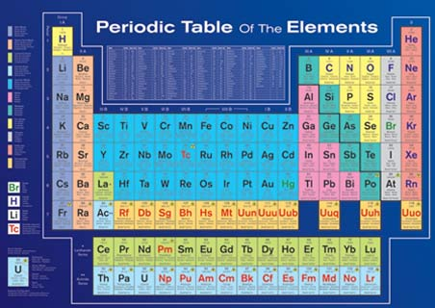
Objectives
Understand the purposes of an educational / teaching portfolio
Develop a “Tool Box” to capture the scholarly nature of education
Recognize the elements needed to build a portfolio

Slide 3
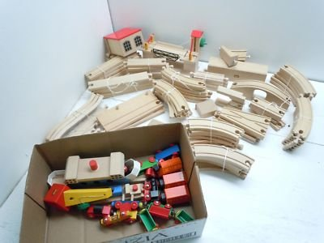
Put Any Two Words Together To
Define Your Academic Position
Clinical Educator
Clinical Scientist
Clinician Scholar
Medical Educator
Clinical Investigator
Physician Scientist
Research Scientist
Despite title, most faculty have one rank and are on one track
Every academician teaches and needs to
document his/her teaching

Slide 4
Bayer Model of Scholarship
Scholarship of DISCOVERY
  Internal / externally funded research
  Author peer reviewed publications
  Author book chapters / book editorship
Scholarship of INTEGRATION: Create a new way of seeing or doing things
  Meta-analyses
  Designing / delivering professional development workshops
  Team science contributions

Slide 5
Bayer Model of Scholarship
Scholarship of APPLICATION: Using existing knowledge to solve real world problem
  Development of a service or center to study a disease
  Participation in clinical trials QI / QA
Scholarship of TEACHING

Slide 6
Developmental of a Teaching Portfolio
Definition: a systematic collection of materials documenting your excellence as an educator
Purpose:
A broad perspective on educational activities
Track activities, achievements and showcase areas of expertise
Serve as a communication tool with mentor / advisor / division chief
Provide organization to materials and activities
Begin at first hire and update
annually when do Goals and Objectives

Slide 7

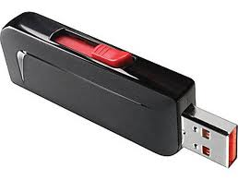
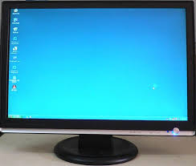

The Only Way To Do This: SAVE EVERYTHING

Slide 8
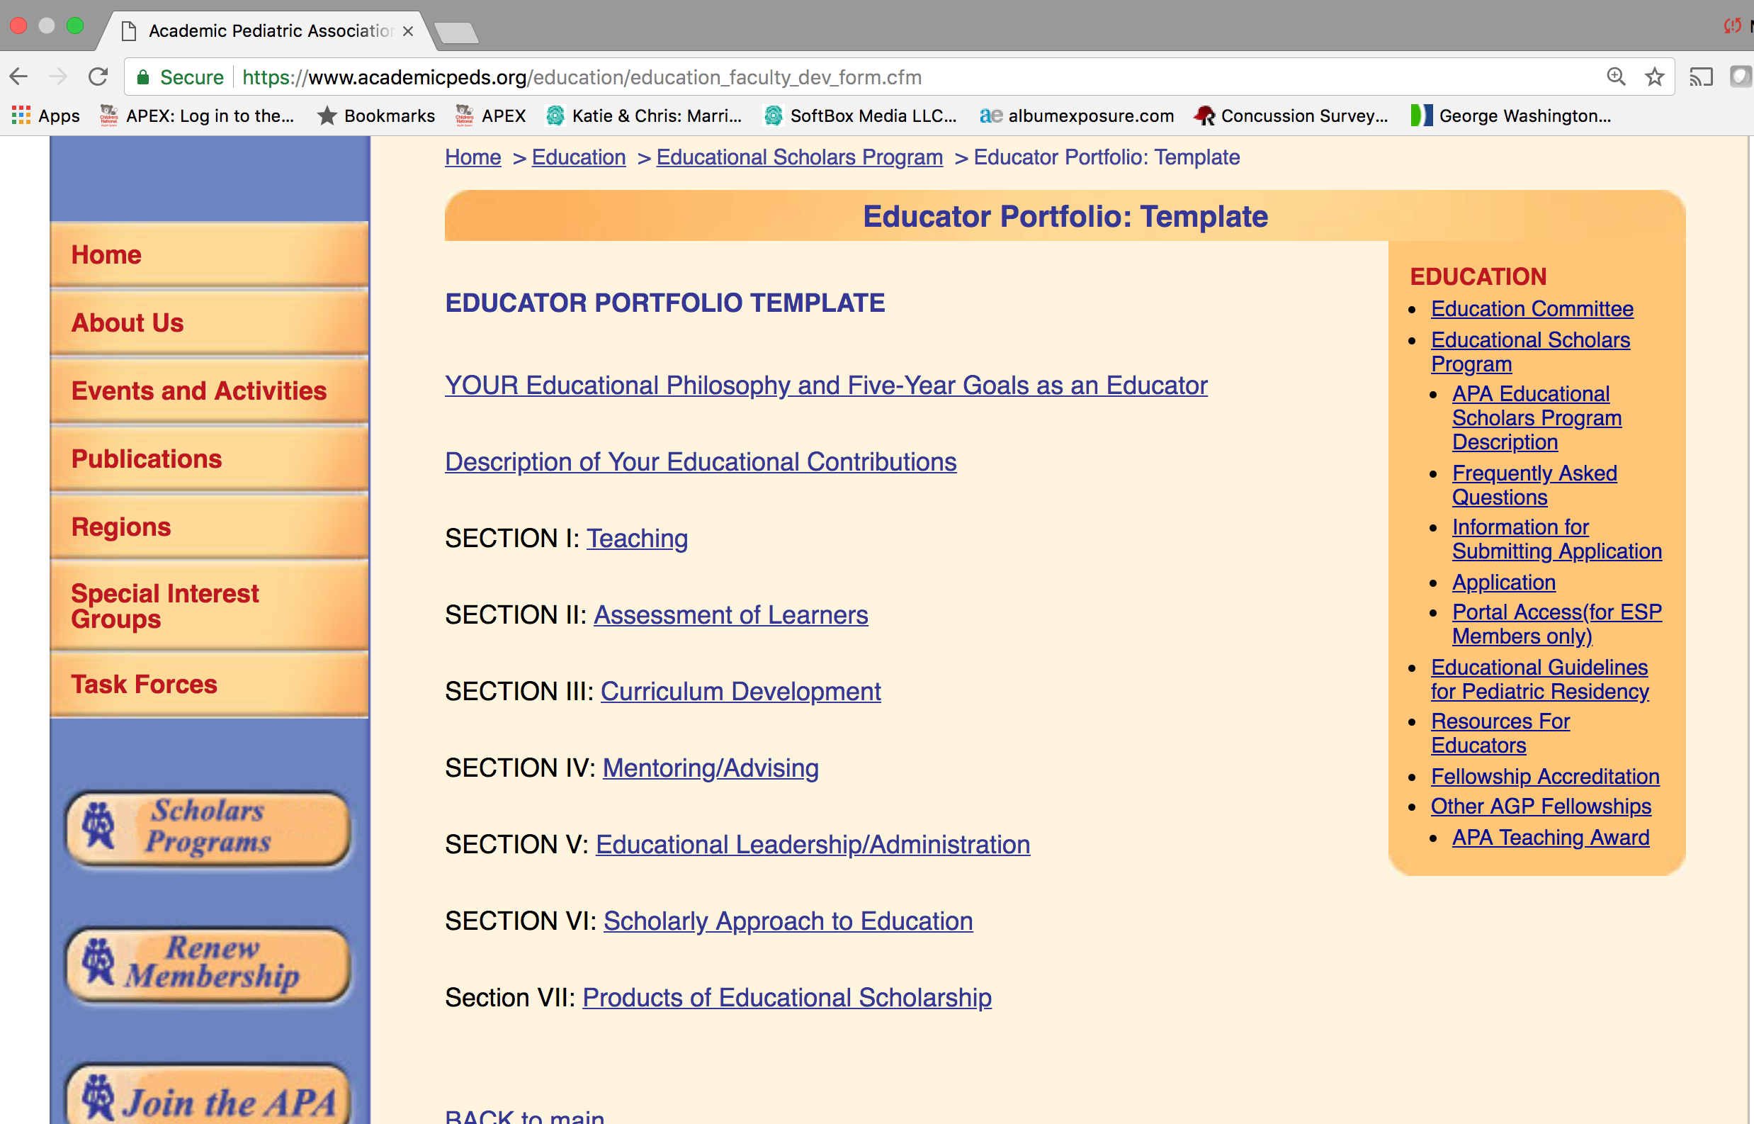

Slide 9
What a Teaching Portfolio Should Be
Structured
Representative
Selective
Finalized to show accomplishments
Supported by relevant data to show EVIDENCE of teaching ability and endeavor

Slide 10
Teaching Impact
Curricular contribution
Peer letters of support that document your impact in future education, e.g., your teaching of EKG basics resulted in advanced knowledge in adult cardiology
Textbooks / teaching materials
  Problem based learning
  Simulation cases
National exam writing
Mentorship in education

Slide 11
Teaching Effectiveness
Med hub / from division / department if primary appointment outside of CNMC
Peer review
  Especially important for outside presentations
Letters from learners
Teaching awards

Slide 12
Differences Between a CV and Portfolio
Your CV describes WHAT you DO
Your Teaching Portfolio is your
“Evidence of Excellence”
as a Teacher

Slide 13
CV
+
TP
Academic Demographics Training What you do as educator: Leadership Teaching Advising Evidence: Peer Reviewed Papers Grants Invited Presentations Educational Repositories Journal Reviews / abstracts and grant reviews Committee work
Evidence of Excellence Linked to Education Roles/Activities Teaching Evaluations Curriculum evaluation Administration/Leadership Education Committee including Resident, Fellow selection committee Accomplishments Residency, Fellowship, Recruitment Match results Fellowship Oversight Match results Exam results Post-fellowship positions Self-Reflection

Slide 14
Components of the Portfolio
Curriculum and Course Development
    - Learner Objectives
    - Methods and Development Sources
    - Materials and Resources
    - Evaluations
Teaching Evaluations from
    - Peers
    - Fellow and Resident / Doctoral and Postdoctoral
    - Medical, College and High School Students
Teaching Awards
Anything which shows development and improvement in your teaching

Slide 15
Components of the Portfolio
Learner Performance Assessment
- New evaluations tools
- Reliability / Validity / Use
- Local vs. more widespread use
Advising
- Students, Residents, Jr. Colleagues
- Formal vs. Informal
- Work Product and Evidence of Achievement
- Where are they now?
Use Google and other e-sources
Educational Administration
- Department / Hospital / SOM Committees

Slide 16
Components of the Portfolio
Teaching Scholarship – may mimic CV
  - Publications, Abstracts, Posters
  - Presentations & Workshops
  - National / State Committees
Continuing Education
  - Workshops/Seminars with Educational Focus
  - Certifications (Master Teacher)
  - Extra Degrees (MEd, MBA, MsCTR)
Teaching Awards and Honors
  - Golden Apple
  - Other

Slide 17
Teaching Philosophy or Educational Statement
When I teach I …
My role as the teacher is to…
The role of learner is to…
I have been successful if…
The top three characteristics of a good teacher are…
Excellent teachers recognize that students are…
My primary goal in teaching can be summarized as…

Slide 18
Achievements of Students / Mentees
Measures of performance
      - Scores on standardized tests
      - Exceptional certification / honors / awards
Publications and presentations (more “classic” mentorship model)
Positions secured (career mentoring)
Career choices (career mentoring)

Slide 19
Example of Mentorship / Advising Grid

Slide 20
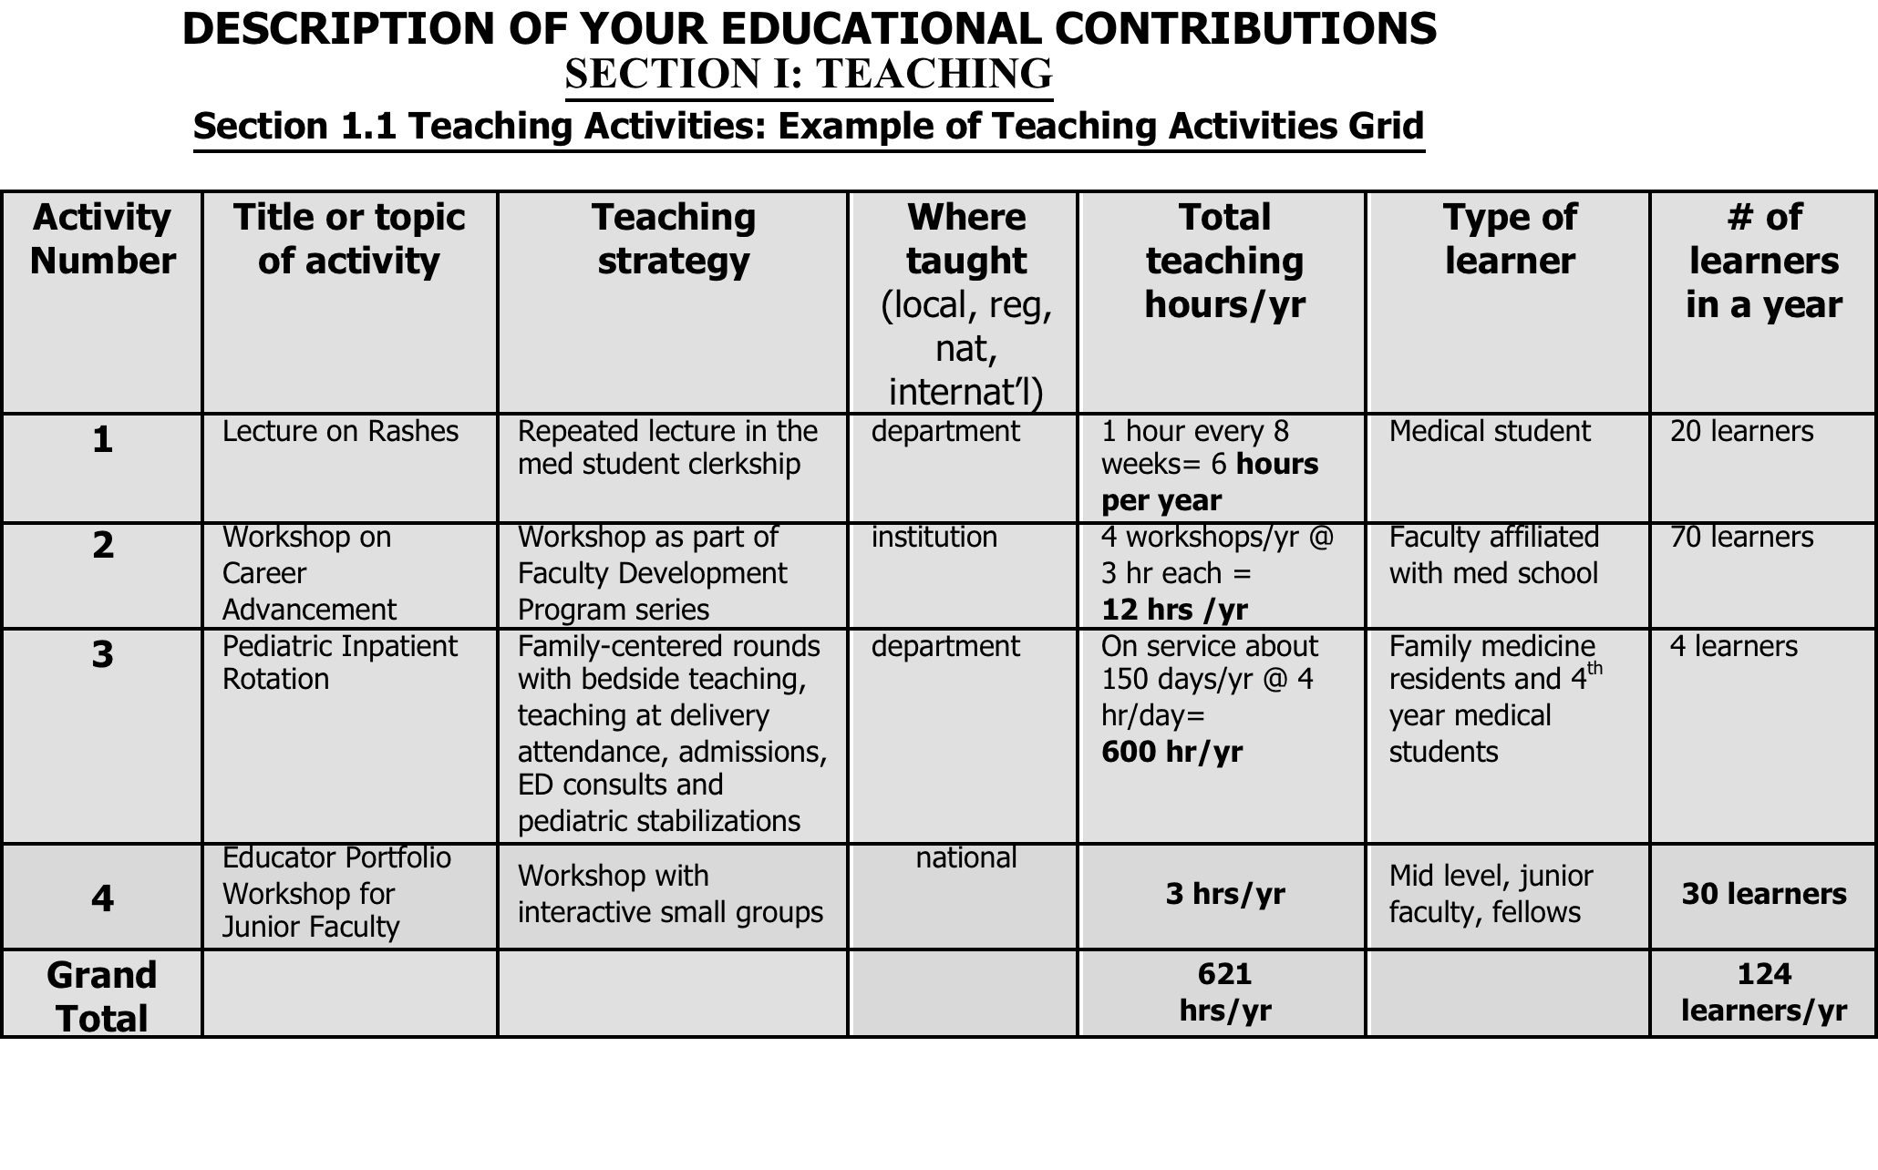
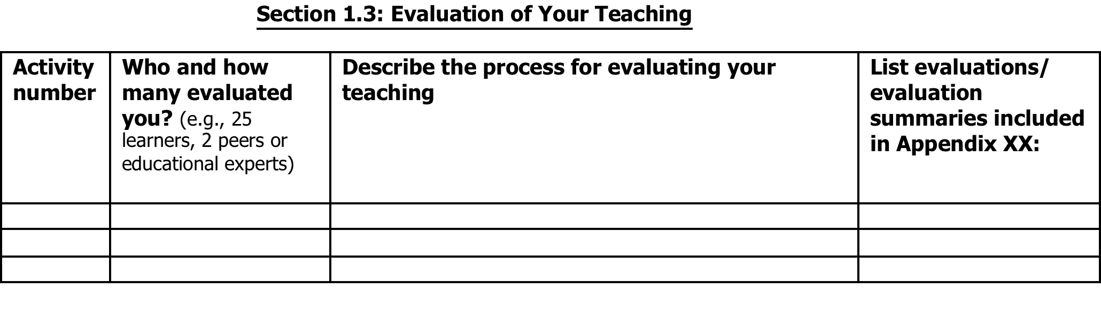
Teaching Portfolio

Slide 21
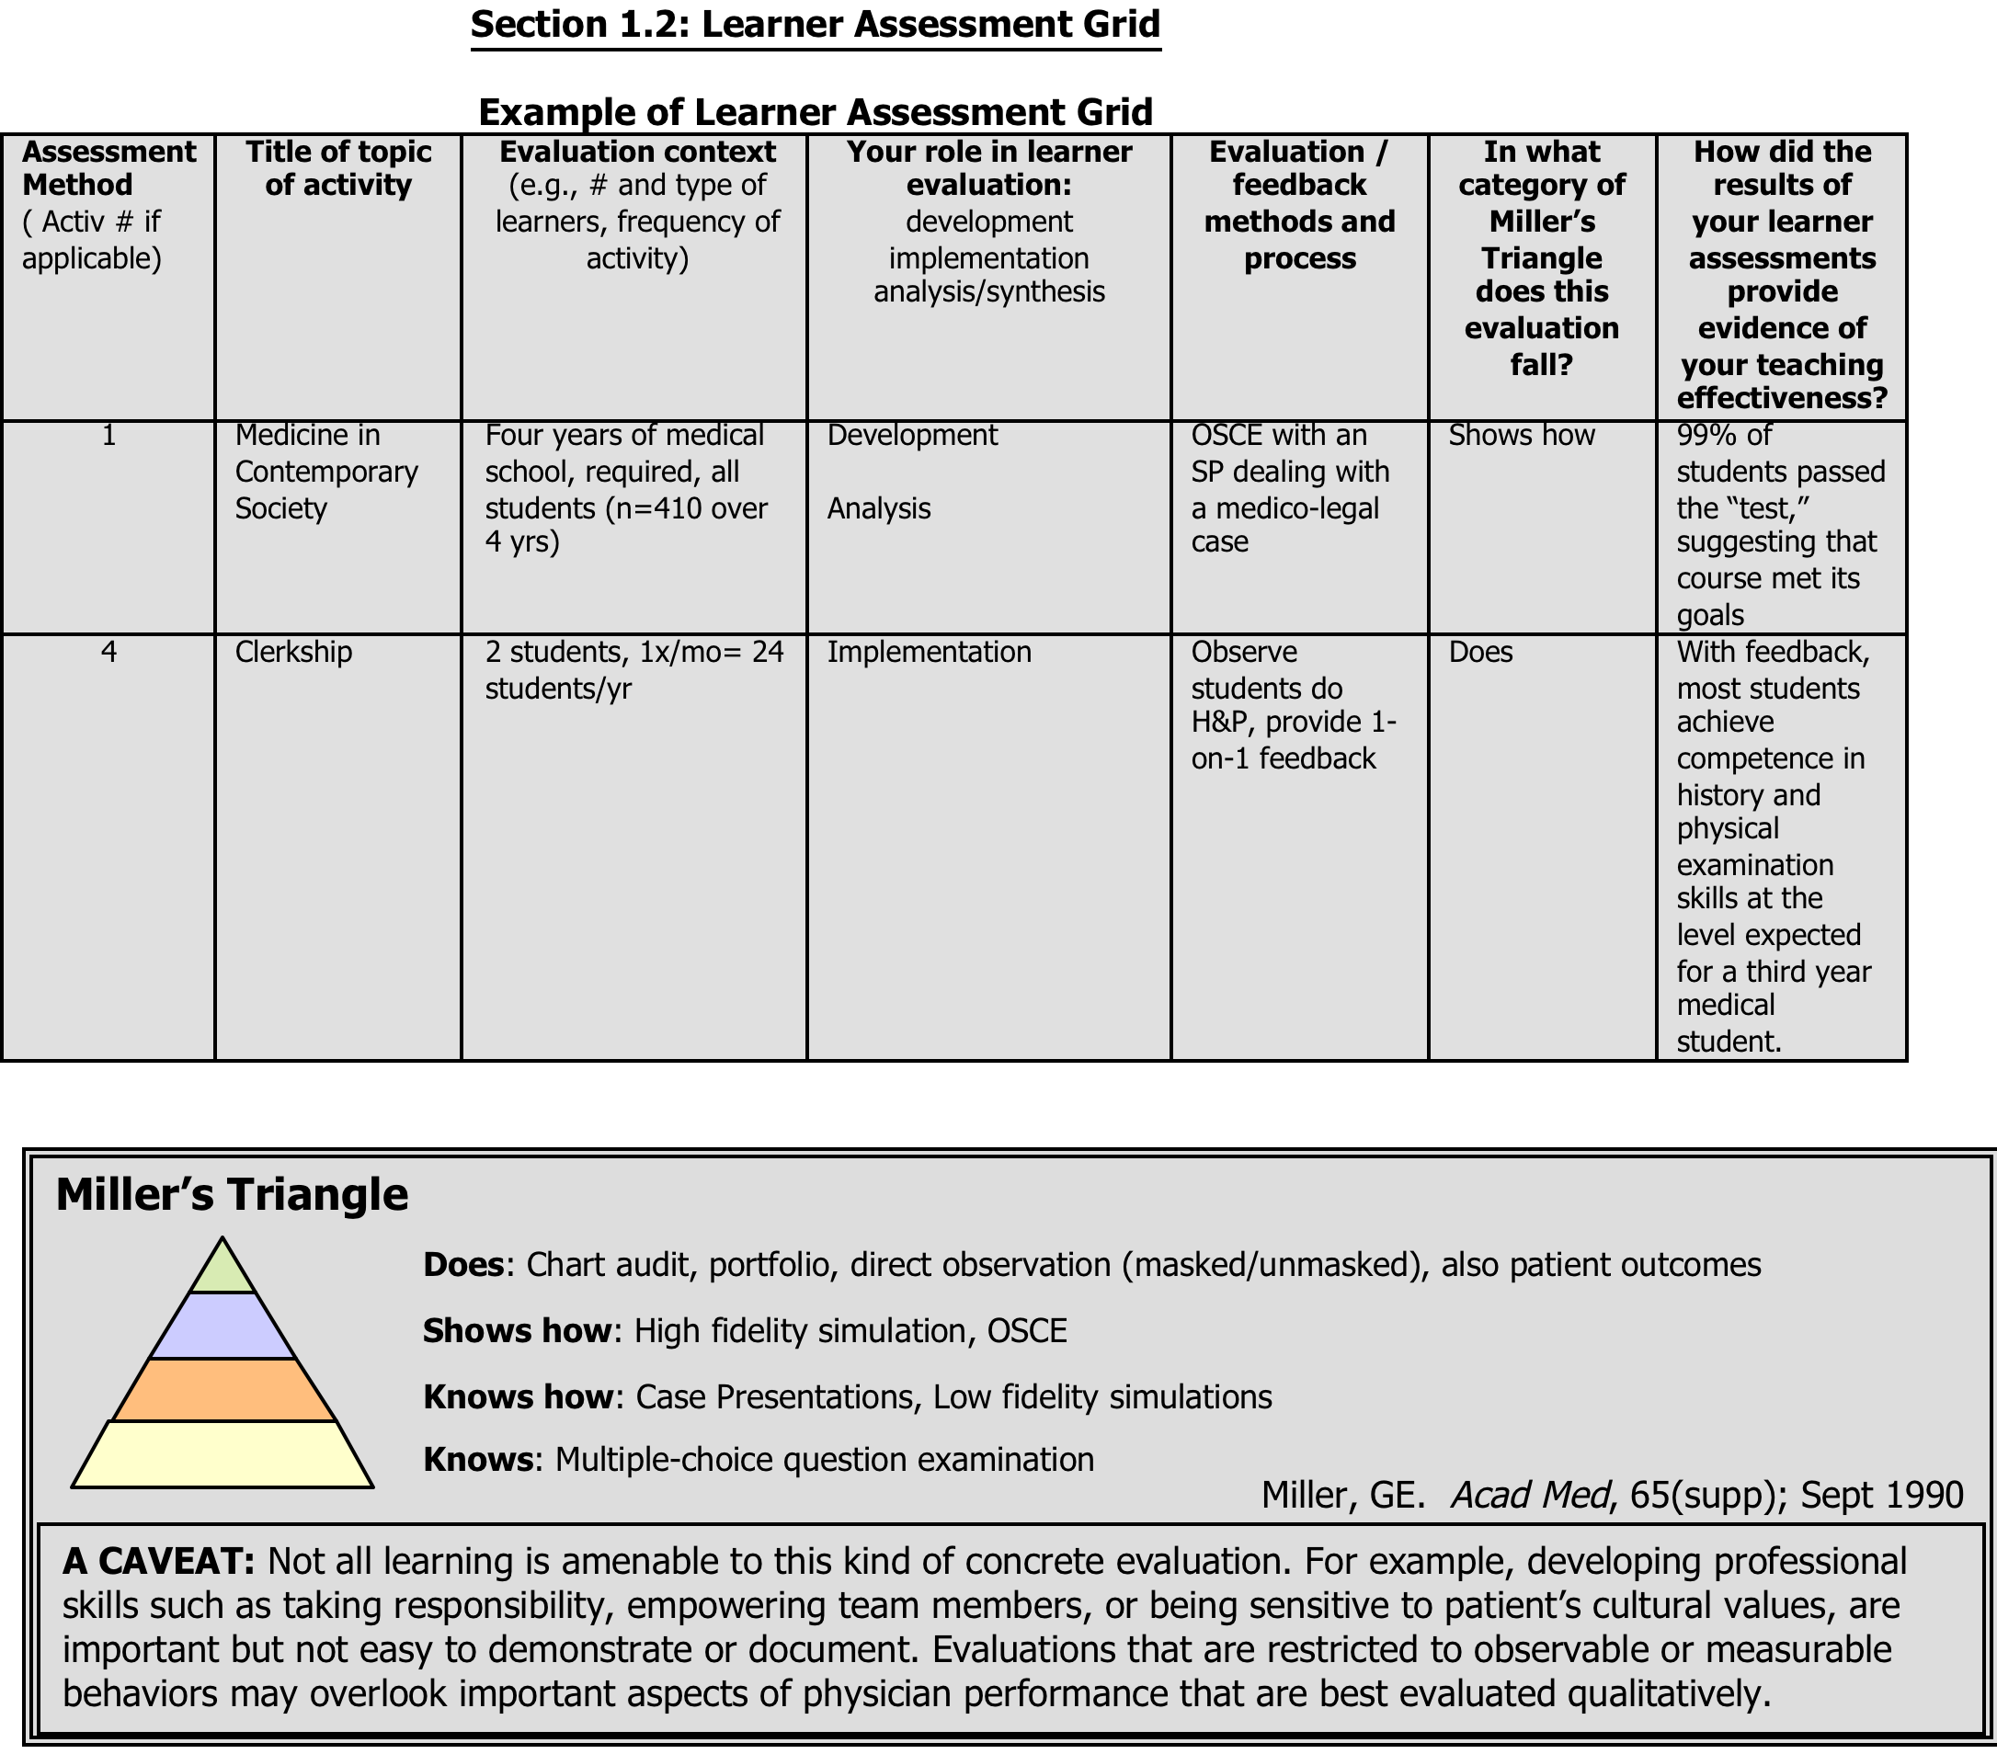
Educator’s Portfolio

Slide 22
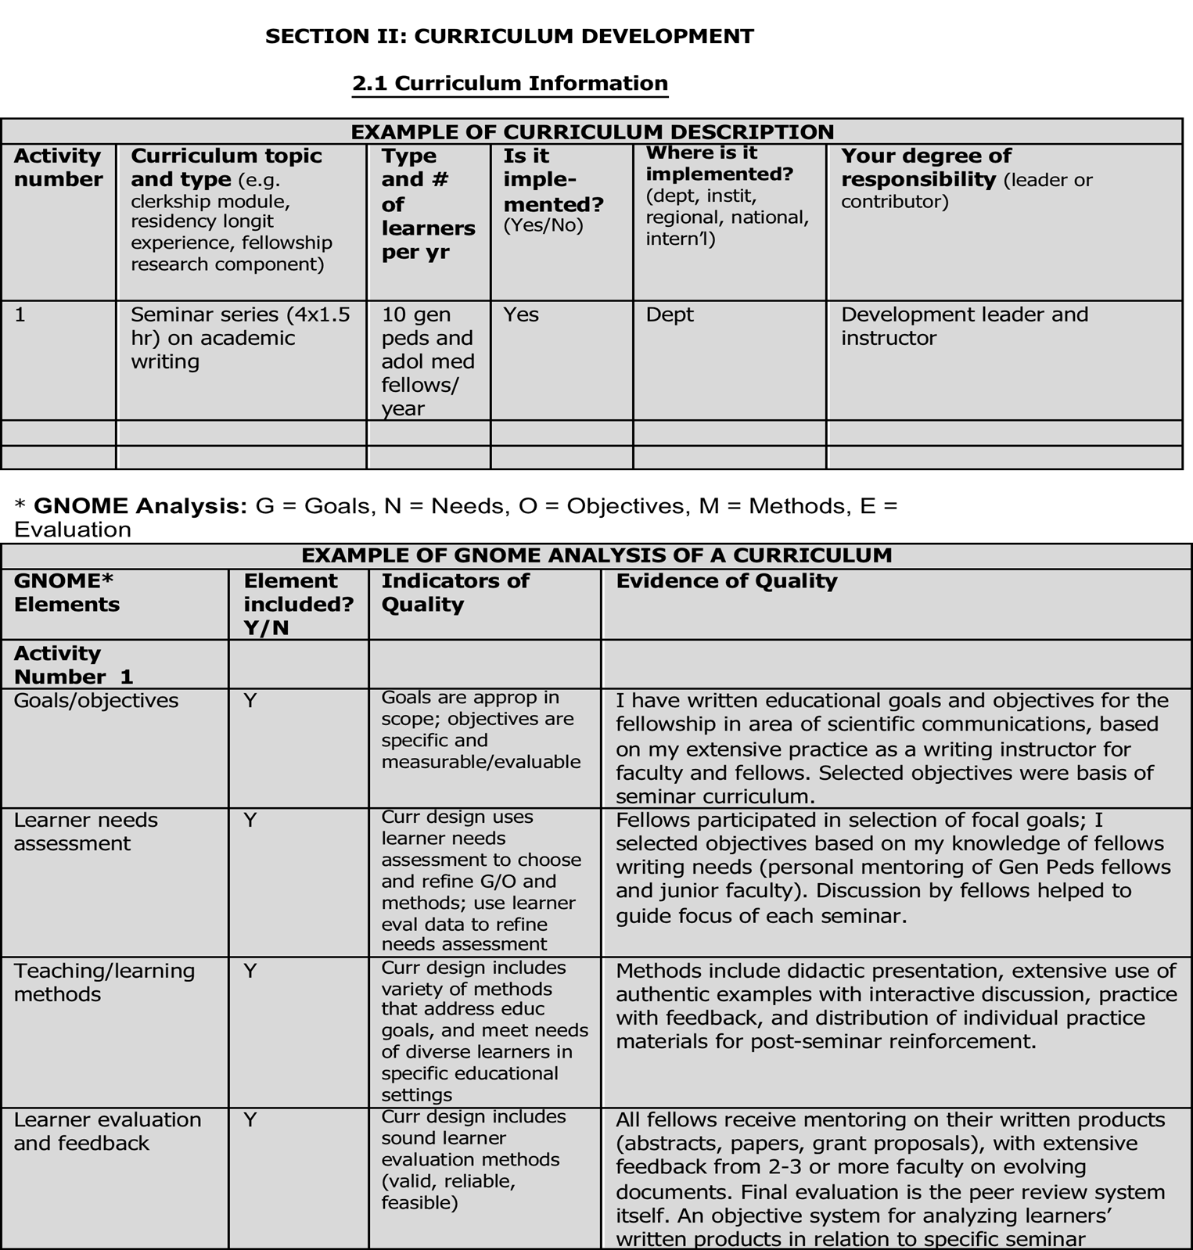

Teaching Portfolio

Slide 23
Example of Curriculum Development
Course | Learner Objectives | Development Sources | Methods | Materials & Resources | Evaluations
Airway Management for Emergency Medicine and Critical Care Medicine Fellows | 1) Contrast differences btw. adult & pediatric airways 2) Assess anatomical structures for airway mgmt. 3) Differentiate btw. advantages & disadvantages of different airway mgmt. techniques 4) Compare common pharm. agents for airway mgmt. 5) Appraise risks for complications of airway mgmt. 6) Demonstrate facility with airway mgmt. skills | 1) Pediatric Advanced Life Support (PALS) Provider Manual. AHA 2) Advanced Cardiac Life Support (ACLS) provider Manual. AHA 3) Stoelting & Miller. Basics of Anesthesiology 4) Motoyama & Davis. Anesthesia for Infants and Children | 10-day course: pretest & OSCE, didactics, selected readings, daily practice & assessment. Anatomical Assessment: 5 Major Criteria Basic Skills: Mask Ventilation Triple Maneuver LMA insertion Laryngoscopy Intubation | 1) Orientation Pack with objectives 2) Daily OR assignments 3) Faculty Review card & evaluations Selected readings: From- Stoelting & Miller. Basics of Anesth. 2000. Motoyama & Davis. Anesthesia for Infants & Children. 2005. | a) 15-question Multiple Choice Question Quiz b) 6-Station OSCE c) 5-Point (Likert) Scale Confidence d) Daily evaluation cards

Slide 24
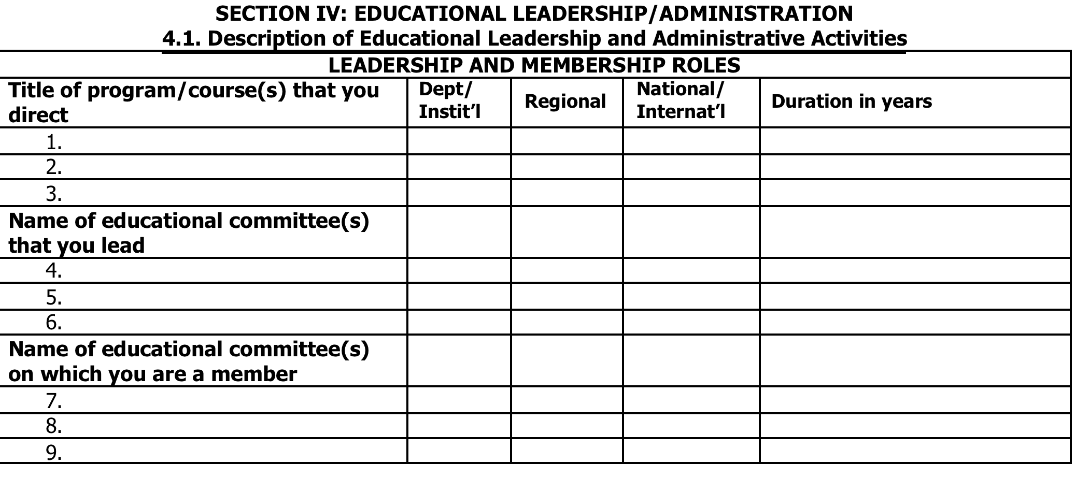
Teaching Portfolio

Slide 25
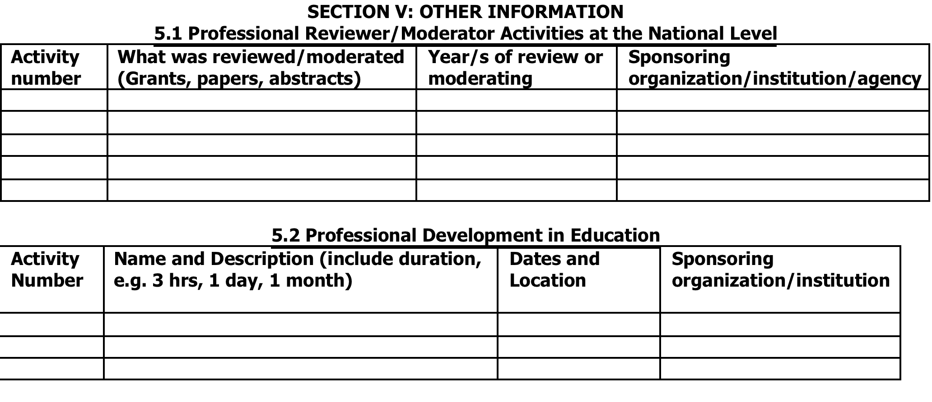
Teaching Portfolio

Slide 26
Using Glassick’s Criteria When Planning an Educational Project
Fincher RM, Simpson DE, Stewart PM, et al: Scholarship in teaching: An imperative for the 21st century. Academic Medicine 2000;75:887-94

Slide 27
Glassick’s Six Criteria for Evaluation of Education Scholarship
Clear goals: stated purpose, realistic objectives, important questions
Adequate preparation: understanding of literature, appropriate skills, needed resources (e g, expert collaborators)
Appropriate methods: methods match goals, effective use and flexible application of methods

Slide 28
Miller’s Triangle: Quality of Learner Assessments
Does
Shows how
Knows how
Knows
Chart audit, portfolio, direct observ, pt outcomes
High fidelity simulations, OSCEs
Case presentations,
low fidelity simulations
Multiple Choice Exams
[Miller, GE. Acad Med, 65(supp); Sept 1990]

Slide 29


What is the Educational Outcome
“Gold Standard?”
Patient Care
Simulation
Direct Observation
360 Feedback
Trainee Performance
Trainee Knowledge
Trainee Perception
Standardized
Tests
Surveys

Slide 30
Glassick’s Six Criteria for Evaluation of Education Scholarship
Significant results: goals are achieved, results are important, field is advanced
Effective presentation: presentation well organized, forums appropriate, message clear
Reflective critique: work critically evaluated, supported with good evidence, evaluation used to improve future studies

